Slide 1


Chapter 11
Computer Organization and Architecture: Themes and Variations, 1st Edition Clements
Computer Organization and Architecture

Slide 2
Secondary Storage
Secondary storage covers technologies used to store data with access times far longer than those of cache and DRAM.
Secondary storage systems generally have capacities far greater than main stores; for example, 2 TB hard drive compared with 8 GB DRAM
Secondary storage uses magnetic and optical storage technologies, although solid state flash technologies are beginning to replace some magnetic based devices.

Slide 3
Computer Organization and Architecture: Themes and Variations, 1st Edition Clements
IBM shipped the first disk drive in 1956 as part of the 305 RAMAC system.
Its platter was 24 inches in diameter; it had a capacity of 5 MB, was larger than a washing machine and cost thousands of dollars.
By 1983 the first PC disk drive was introduced by Seagate which also stored 5 MB but cost a mere $1,500 and just managed to fit inside a PC.
Today, hard disk drives have capacities of 4,000,000 MB and some cost less than $50.

Slide 4
Computer Organization and Architecture: Themes and Variations, 1st Edition Clements
The disk drive uses a technology we have understood since the 1940s.
The magnetic disk is a direct descendent of the phonograph invented by Thomas Edison in 1877.
Edison originally stored sound along a track on a cylinder covered by tin foil (later wax).
The Edison phonograph stored sound by physically deforming the side of the groove to store sound vibrations, whereas the magnetic disk stores data by magnetizing the surface of a track.
The CD/DVD/Blu-ray stores data by changing the optical properties of the surface of a track.

Slide 5
Computer Organization and Architecture: Themes and Variations, 1st Edition Clements
A disk drive uses a flat rotating platter is covered with a very thin layer of a material that can be locally magnetized in one of two directions, north-south or south-north.
This platter rotates under a write head that magnetizes the surface to create a circular track of 1s and 0s.
When the data is retrieved, a read head that’s normally co-located with the write head detects the magnetization of the surface and uses it to reconstruct the recorded data.
In practice, the construction and operation of real disk drives is immensely complex, because the size of the magnetized regions is very small and the disk rotates at a high speed.

Slide 6
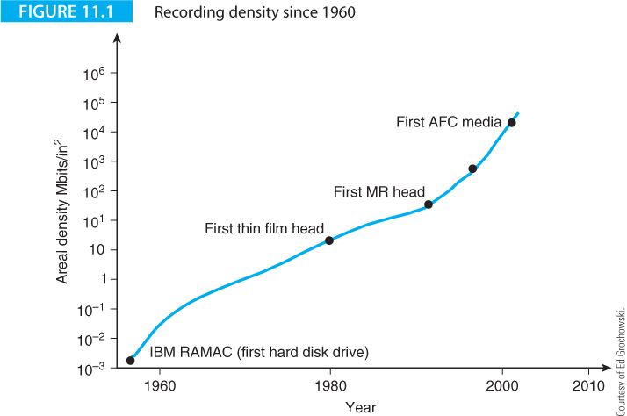
Computer Organization and Architecture: Themes and Variations, 1st Edition Clements
Figure 11.1 plots areal density against the year for disk drives and illustrates the increase in recording density in the 45 years from 1956.
Areal density specifies the density of bits and is often measured in bits per square inch. Areal density increased from approximately 2 x 10⁻³ Mbits/in² to 4 x 10⁴ Mbits/in², an increase of the order of 10⁷ in 15 years.
By 2010 Toshiba was shipping disks with an areal density of 540 Gbits/in² (i.e., 54 x 10⁴ Mbits/in²) and only one year later announced a 2.5 inch hard drive for use in laptops with a density of 744 Gbits/in².

Slide 7
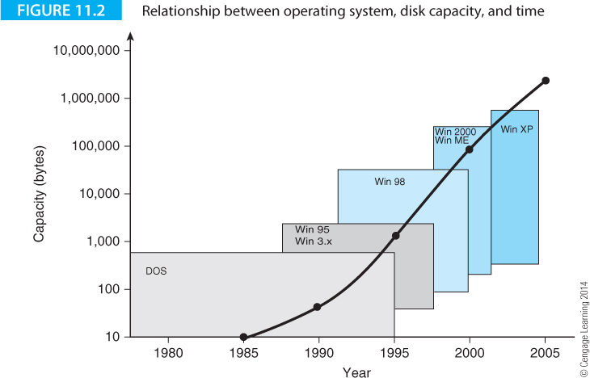
Computer Organization and Architecture: Themes and Variations, 1st Edition Clements
Disk capacity has gone hand in hand with the development of Microsoft’s operating systems.
Figure 11.2 demonstrates how both disk capacities and operating systems have grown.

Slide 8
Computer Organization and Architecture: Themes and Variations, 1st Edition Clements
Magnetism and Data Storage
Magnetic storage technology is rather quaint; it belongs to the early days of computer technology and relies on electromechanical mechanisms with moving parts.
Magnetic recording techniques have been used for a long time; for example, the wire sound recorder recorded speech on a reel of steel wire before being replaced by the tape recorder after WW2.
However, magnetic storage technology stubbornly refuses to go away in spite of its inherent limitations.
The magnetic properties of matter are probably the most obvious means of storing data because magnetism is an excellent binary recording medium: magnetic particles can be magnetized North-South or South-North.
When certain substances are magnetized, they remain magnetized until they are magnetized in the opposite sense, which makes magnetic storage mechanisms inherently non-volatile.

Slide 9
Computer Organization and Architecture: Themes and Variations, 1st Edition Clements
The origin of magnetism lies in the atomic structure of matter; in particular, the behavior of electrons in atoms.
An electron has two motions, its orbit round the nucleus and its spin. The principal cause of magnetization is the spin of electrons. Electrons have two quantized spin values that are called spin up and spin down.
In a ferromagnetic material the spins of individual atoms couple; that is, there is an interaction between neighboring atoms. When an external magnetic field is applied, ferromagnetic atoms tend to align with the field.
When the external magnetic field is removed, a ferromagnetic material can retain some of the magnetization in the direction of the applied field.
The quantum interactions between electrons in a ferromagnetic material have a range that extends beyond the individual atoms.
This interaction causes the magnetic moments of atoms within a region called a domain to align in parallel. Domains vary in size from 30 nm to 150 mm.

Slide 10
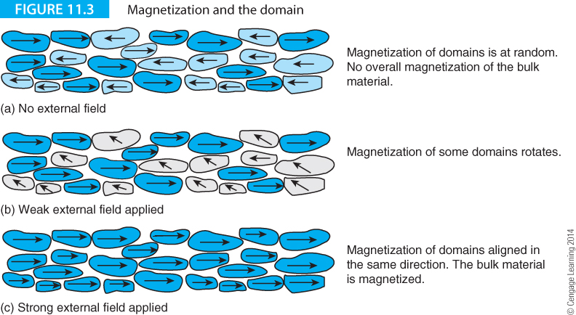
Computer Organization and Architecture: Themes and Variations, 1st Edition Clements
In a bulk ferromagnetic material, the individual domains are aligned at random as Figure 11.3(a) illustrates and there’s no overall magnetization. Figure 11.3(b) demonstrates the effect of applying an external field.
Domains that are magnetized in the same direction as the external field remain magnetized in that direction. Domains that are magnetized in other directions rotate the direction of their magnetization in the direction of the external field.

Slide 11
Computer Organization and Architecture: Themes and Variations, 1st Edition Clements
The internal field is the sum of the external field and the field due to the domains and more and more domains become oriented in the direction of the external field.
Suddenly, the number of domains rotating in the direction of the external field increases as the internal field builds up like an avalanche.
Soon, all domains are magnetized in the same direction Figure 11.3(c) and bulk material is said to be magnetized. If the external field is removed, the material remains in the magnetized state because the fields from the domains are sufficient to keep the domains from realigning themselves.

Slide 12
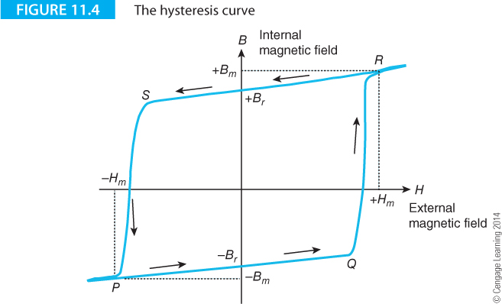
Computer Organization and Architecture: Themes and Variations, 1st Edition Clements
Plotting the internal field against the external field for a ferromagnetic material, the hysteresis curve of Figure 11.4.
The horizontal axis, H, represents the external field. In the absence of an external field, the internal field is either +B_{m} or –B_{m}; that is, the material is magnetized in one of two states.

Slide 13
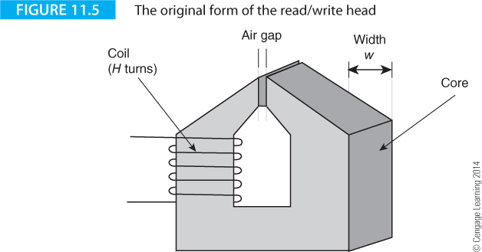
Computer Organization and Architecture: Themes and Variations, 1st Edition Clements
The Read/write Head
Figure 11.5 describes the structure of a read/write head used for writing and reading data on magnetic recording media.
Very early recording heads consisted of toroids of magnetically soft metallic ferromagnets with a few turns of wire around them.

Slide 14
Computer Organization and Architecture: Themes and Variations, 1st Edition Clements
High-frequency magnetic fields induce eddy currents in the write heads that reduce the head’s efficiency. Second-generation heads used non-conducting ceramic ferromagnetic materials called ferrites.
Constructing read/write heads is difficult because of the complex interacting requirements of the recording system. The air gap must be narrow. If the gap is large, the area of magnetization is also large and the number of bits that can be stored is reduced.
It’s also necessary to build the heads with a ferromagnetic material that has a very high saturation. A strong field is required to magnetize the particles on the recording medium.
The head material must also have a low remnant magnetization (i.e., the residual field after the write current has been turned off). If the remnant magnetization is too high, previously magnetized bits can be disturbed by the remnant field.

Slide 15
Computer Organization and Architecture: Themes and Variations, 1st Edition Clements
If the same head is used for reading as well as writing, it must have a high value of permeability (a material’s permeability is a measure of its ability to conduct magnetic flux, the higher the permeability the easier it is to magnetize a material).
Read heads should also have a low saturation magnetostriction.
Magnetostriction describes a phenomenon whereby a change in magnetic field changes the material’s physical dimensions, and vice versa.
If a read head suffers any form of physical shock, magnetostriction generates a spurious field and hence a spurious current in the coil.
On top of all these magnetic properties, the head must be physically robust and resistant to both wear and corrosion.

Slide 16
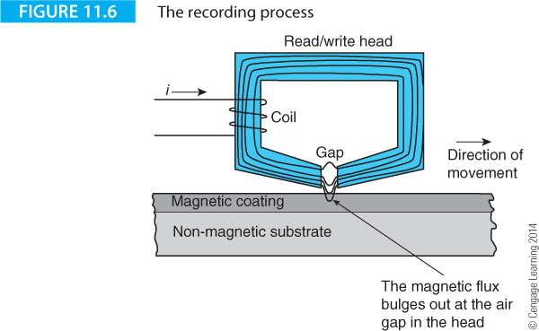
Computer Organization and Architecture: Themes and Variations, 1st Edition Clements
Figure 11.6 describes the recording process. A coil of wire is wound round a ring of metal. When a current is passed through the coil, a magnetic field is created in the coil and this, in turn, induces a field in the ring.
The ring contains a tiny air gap and the field has to flow across the gap. In practice, it leaks out into the surrounding world. If the gap is close to a ferromagnetic material, this external field can magnetize it.

Slide 17
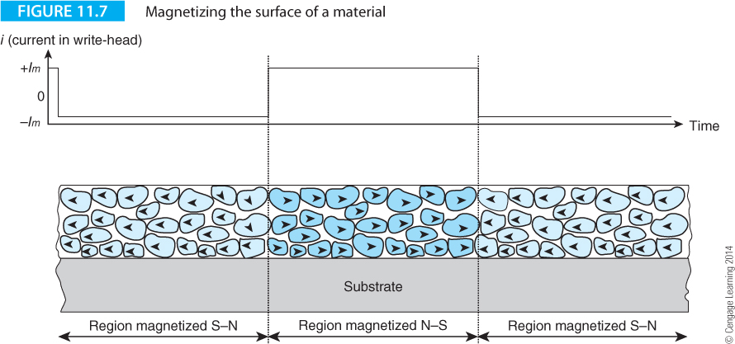
Computer Organization and Architecture: Themes and Variations, 1st Edition Clements
Figure 11.7 illustrates the effect of switching the current in the write-head coil and the corresponding magnetization of the surface passing under the write-head.

Slide 18
Computer Organization and Architecture: Themes and Variations, 1st Edition Clements
Limits to Magnetic Recording Density
There are physical limitations on the ultimate areal density of magnetic recording mechanisms; that is, there is a finite limit to the maximum number of bits that can be stored in a square inch.
As the anticipated theoretical limit is reached, physicists and engineers seem to find ways of extending this theoretical maximum (echoes of Moore’s law).
In the 1990s scientists believed that the superparamagnetic effect imposed a limit on magnetic recording density. The minimum amount of magnetic material that can be used to store information is the magnetic grain from which bulk magnetic materials such as the surface of a disk are constructed.
When grains reach sizes of the order of 10 nm or so, thermal effects can cause these grains to spontaneously demagnetize at room temperature.
This corresponds to a maximum areal density of about 6 Gb/cm² or 0.93 Gb/in²

Slide 19
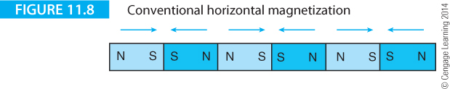
Computer Organization and Architecture: Themes and Variations, 1st Edition Clements
Limits to Magnetic Recording Density
Figure 11.8 illustrates surface recording with horizontal magnetization.
This figure represents the worst case with the smallest possible regions of magnetization, magnetized alternately NS and SN.
An alternative to horizontal magnetization is the vertical or perpendicular magnetization of Figure

Slide 20
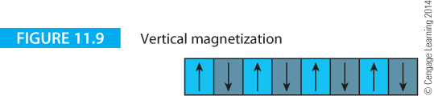
Computer Organization and Architecture: Themes and Variations, 1st Edition Clements
An alternative to horizontal magnetization is the vertical or perpendicular magnetization of Figure 11.9 in which the magnetic domains are magnetized at right angles to the surface of the recording medium.
Perpendicular recording reduces the demagnetizing influences of adjacent bits because they are oriented so they do not oppose each other; they form part of a closed magnetic field.
A different write head structure is required for writing. A so-called monopole head is required to write magnetic transitions vertically within the media.

Slide 21
Computer Organization and Architecture: Themes and Variations, 1st Edition Clements
The proximity of the tiny magnetic particles to each other tends to demagnetize adjacent particles.
Figure 11.10 illustrates a means of reducing the size of vertical particles without demagnetization developed by Fujitsu.
This technology can provide an eight-fold increase in areal density over conventional techniques and permit densities in the region of 50 Gb/cm². By about 2000 esoteric magnetic media with areal densities approaching 700 Gb/cm² (100 Gb/in²) were being proposed.
By 2011 disks with area densities of over 700 Gb/in² were being sold.

Slide 22
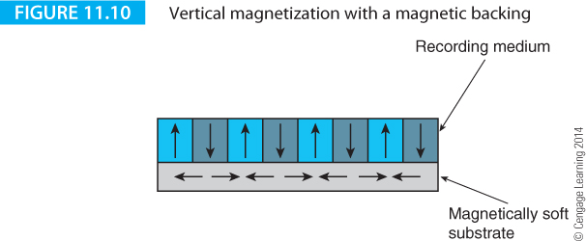
Computer Organization and Architecture: Themes and Variations, 1st Edition Clements
One approach to delaying the inevitable effects of superparamagnetism is to modify the media’s magnetic properties by increasing the energy barrier required to reverse the state of a grain.
The arrangement in Figure 11.10 uses a layer of magnetically soft material beneath the magnetic recording surface.

Slide 23
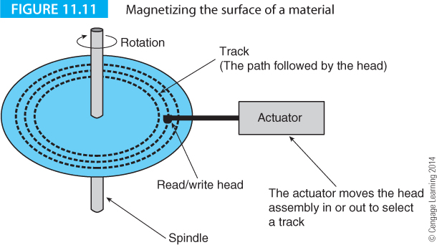
Computer Organization and Architecture: Themes and Variations, 1st Edition Clements
Principles of Data Recording on Disk
The next step is to look at how data is stored on a disk and how the recording and playback process works. Figure 11.11 shows how data is arranged on the surface of a disk.
The read/write head steps in towards the center or out towards the periphery. As the disk rotates, the head describes a circle, called a track.
A track is too large a unit of data to be practical, so the track is divided into individual sectors. A sector is the smallest unit of data that can be read from or written to the disk.

Slide 24
Computer Organization and Architecture: Themes and Variations, 1st Edition Clements
The structure of data on a disk has important implications for the performance of disk drives.
Consider the granularity of data; small sectors are inefficient because a large file would take up many sectors, each of which has an overhead.
Large sectors are inefficient if you wish to store small units of data; for example, if sectors were 8 KB and you were using a lot of 3 KB files, each sector would waste 5 KB. Typical disk drive sectors are 512 bytes.

Slide 25
Computer Organization and Architecture: Themes and Variations, 1st Edition Clements
Platter Size
The standard hard disk in a PC is called a 3.5 inch drive.
You would expect the platter to be less than 3.5 inches.
It isn’t.
The diameter of a platter is 3.75 inches.
And, yes, a 3.5 inch drive isn’t really 3.5 inches wide; it’s four inches wide.
The term 3.5 inches refers to its form factor and not its physical width.

Slide 26
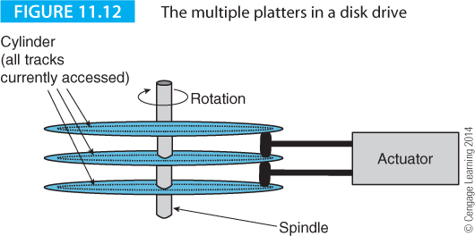
Computer Organization and Architecture: Themes and Variations, 1st Edition Clements
To reduce the physical size of a disk drive and increase its data capacity, disk manufacturers co-locate several platters on the same spindle and the read/write heads that read each surface are connected to the same actuator so that all heads step in or out together.
Early disk drives didn’t use the top- and bottom-most surfaces to store data and the arrangement of Figure 11.12 has four surfaces.
However, modern disk drives use all surfaces .

Slide 27
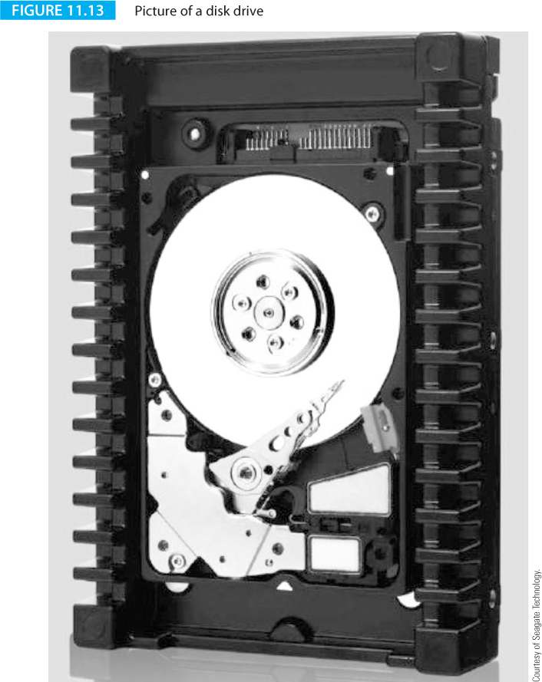
Computer Organization and Architecture: Themes and Variations, 1st Edition Clements

Slide 28
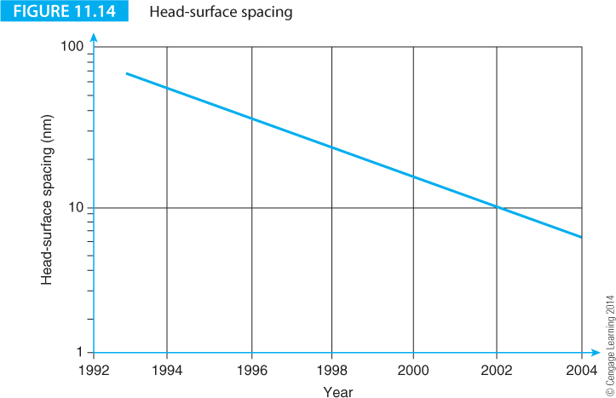
Computer Organization and Architecture: Themes and Variations, 1st Edition Clements
Figure 11.14 illustrates the way in which the surface-head gap has been reduced between 1993 and 2004.
The improvement is somewhat under an order of magnitude with contemporary heads tracking a disk surface at a height of about 10 nm (i.e., 10⁻⁸ m), an unimaginably small gap.

Slide 29
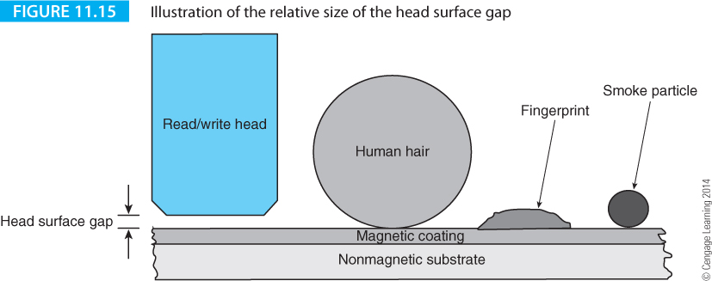
Computer Organization and Architecture: Themes and Variations, 1st Edition Clements
Should the head fail to follow the surface of a disk and hit the surface at about 50 mph, it damages the magnetic coating and destroys data. Such an event is called a head crash, and is the origin of the term now used to indicate any sudden and catastrophic computer system failure.
Figure 11.15 gives ad illustration of just how small the read/write head to surface gap is. On the same scale we have the gap together with a human hair, a smoke particle, and a fingerprint.

Slide 30
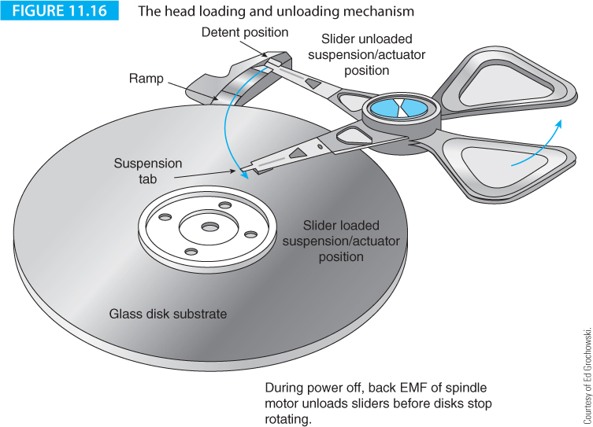
Computer Organization and Architecture: Themes and Variations, 1st Edition Clements

Slide 31
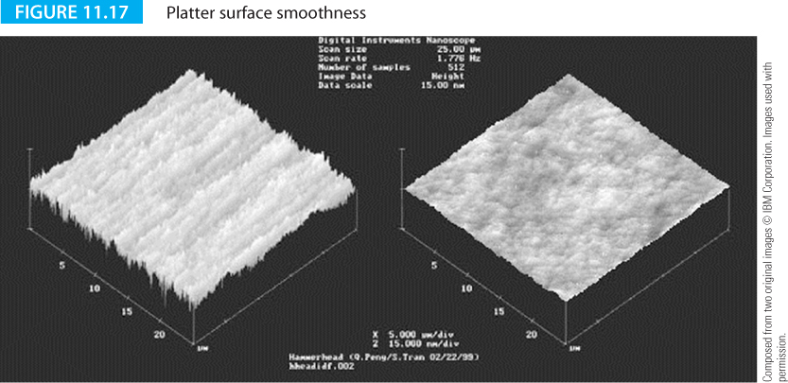
Computer Organization and Architecture: Themes and Variations, 1st Edition Clements
Some platters are made of glass because it is more thermally stable, smoother, and harder than aluminum. Figure 11.17 is a photomicrograph from IBM showing the relative surface smoothness of both aluminum and glass surfaces.
Glass is more rigid than aluminum for the same weight of material. Improved rigidity reduces noise and vibration at high speeds. The rigidity of glass allows platters to be made thinner and lighter which reduces the load on spindle motors.

Slide 32
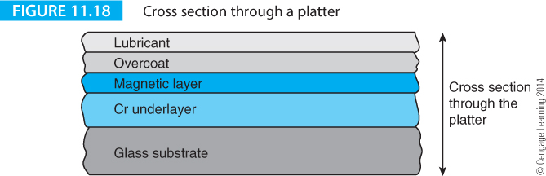
Computer Organization and Architecture: Themes and Variations, 1st Edition Clements
Modern platters contain five or more layers (Figure 11.18).
The uppermost layer is a lubricating layer that enhances the durability of the head-disk interface.
Below the lubricating layer lies a thin protective carbon-based overcoat. The lubricating layer is about 1 nm thick and the overcoat 15 nm thick.
The recording surface consists of two layers; the recording layer (often a compound of cobalt and chromium) and a chromium underlayer.
A glass substrate provides the surface that holds these other five layers.

Slide 33
Computer Organization and Architecture: Themes and Variations, 1st Edition Clements
The GMR Head – a Giant Step in Read Head Technology
The conventional read head has an important limitation, inductance. In order to detect the changing magnetic flux, the coil round the head requires a lot of turns to pick up sufficient signal.
Increasing the number of turns raises the coil’s inductance. Inductance is a property of circuits that resists the rate at which a current changes.
Increasing the inductance of a read head reduces the rate at which it can read changes in the magnetic flux at the disk’s surface
Fortunately, another magnetic property of matter was discovered that made it possible to do away with the inductive read head.
Moreover, removing the read head means that head can be optimized for writing.

Slide 34
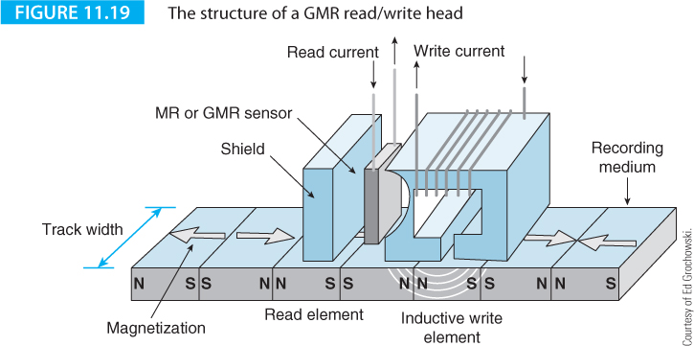
Computer Organization and Architecture: Themes and Variations, 1st Edition Clements
A magnetic field causes a tiny change in the electrical resistance of certain materials, a property called the magnetoresistive effect, MR.
Detecting changes in magnetic flux from a disk using the MR effect has advantages over inductive read-heads because the inductance of an MR head is lower and it’s possible to read data more rapidly.

Slide 35
Computer Organization and Architecture: Themes and Variations, 1st Edition Clements
The GMR Head – a Giant Step in Read Head Technology
In the late 1980s, researchers discovered that some materials exhibited massive changes of up to 50% in their resistivity in the presence of a magnetic field. This property was called the giant magnetoresistive (GMR) effect and is found in materials consisting of alternating very thin layers of metallic elements.

Slide 36
Computer Organization and Architecture: Themes and Variations, 1st Edition Clements
In a read/write head assembly the read element consists of a GMR sensor between two magnetic shields. These magnetic shields reduce unwanted magnetic fields from the disk so that the head detects only the magnetic field from the recorded data bit under the head. In a merged head a second magnetic shield also functions as one pole of the inductive write head. The advantage of separate read and write elements is that both elements can be individually optimized.

Slide 37
Computer Organization and Architecture: Themes and Variations, 1st Edition Clements
Pixie Dust
At the beginning of 2001 IBM announced a breakthrough in disk technology that could increase areal densities by a factor of four. IBM used a sandwich with three layers to store data.
The top layer is a ferromagnetic material that stores the data. The lower layer is an antiferromagnetic layer.
Antiferromagnetism occurs when atoms align themselves antiparallel to a magnetic field, the opposite of ferromagnetism. However, antiferromagnetics is a very weak effect.
Between these two layers sits pixie dust, a three atom thick layer of the element ruthenium.
Ruthenium is a rare metal belonging to the same group as platinum and only about twelve tons are produced annually.

Slide 38
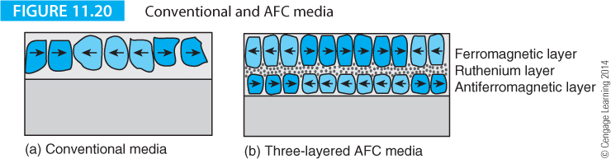
Computer Organization and Architecture: Themes and Variations, 1st Edition Clements
This sandwich is called an antiferromagnetically-coupled (AFC) media and is capable of areal densities of up to about 100 Gb per inch². IBM claims that AFC media avoids the high-density data decay.
The ultra-thin ruthenium layer forces the adjacent layers to orient themselves magnetically in opposite directions.
The opposing magnetic orientations make the entire multilayer structure appear much thinner than it actually is. Thus, small, high-density bits can be written easily on AFC media, but they will retain their magnetization due to the media's overall thickness.

Slide 39
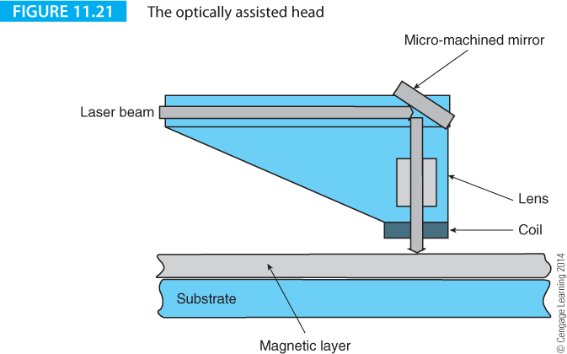
Computer Organization and Architecture: Themes and Variations, 1st Edition Clements
Figure 11.21 illustrates the principal of the optically assisted write head. A tiny laser beam performs the surface heating.
An optical fiber delivers the laser beam to the disk’s surface via an optical fiber and a lens assembly.
Pulsing the laser beam allows you to selectively heat the surface. A current is passed through the coil above the surface of the disk to magnetize the heated spot in one sense or another.

Slide 40
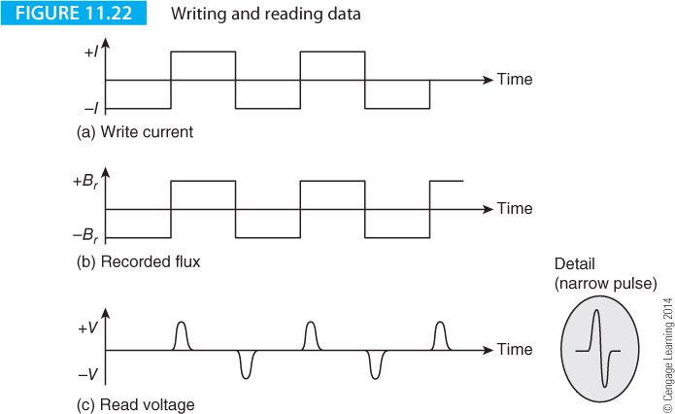
Computer Organization and Architecture: Themes and Variations, 1st Edition Clements
When a read head passes over a magnetized surface, the changing magnetic flux induces a current in the coil and a voltage across the coil’s terminals. The voltage is proportional to the rate of change of the magnetic flux; that is, you can detect only a change in flux density.
Figure 11.22 illustrates the write current in the write and the resulting magnetization of the recording surface. Below this is a trace of the voltage induced in the coil when the recorded surface passes under the head.

Slide 41
Computer Organization and Architecture: Themes and Variations, 1st Edition Clements
You can’t store a long string of ones and zeros on the surface reliably because only changes in flux lever create a signal in the head.
If you record 00000 or 11111 both sequences would produce the same output, nothing.
Suppose, for example, you stored the string 000111111111110000, the read head would detect only two flux transitions, the initial 0 to 1 and the final 1 to 0.
A GMR head can detect absolute magnetization because even a constant field creates detectable low or high resistance in the magnetoresistive element. However, there is no delineation between the ones and zeros in a long string.

Slide 42
Computer Organization and Architecture: Themes and Variations, 1st Edition Clements
Digital data recording mechanisms (both magnetic and optical) encode data prior to recording in order to avoid situations in which the recorded information is difficult to read back.
In particular, they avoid longs runs or constant magnetization; that is, they ensure that the recoded flux changes state regularly.
This restriction is required to extract a data clock from the disk.
Most recorded codes are known as self-clocking because the bit pattern recorded on the magnetic surface contains sufficient information to allow hardware to recreate or regenerate a clock wave that can be used to sample the incoming data.

Slide 43
Computer Organization and Architecture: Themes and Variations, 1st Edition Clements
The design of codes for recording data is a fine art because of the many conflicting requirements.
You want to increase the efficiency of the code by reducing the number of flux reversals required to record each bit (the best you can do is one transition per bit).
You want to make the recorded symbols for 1 and 0 as unlike each other as possible in order to make it easy to tell the difference between 1s and 0s in the presence of noise and other extraneous signals.
You want to ensure that there is no significant gap between flux transitions to make the code self-clocking; you want to avoid patterns that contain low-frequency components because the analog circuits that process data from the read head do not handle low frequencies well.

Slide 44
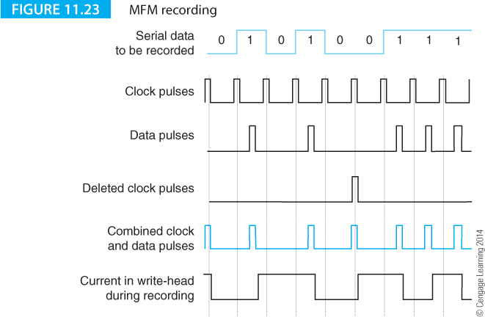
Computer Organization and Architecture: Themes and Variations, 1st Edition Clements
Any recording code is a compromise. Figure 11.23 illustrates an encoding method once used by floppy disk drives called modified frequency modulation, MFM.
Floppy disk drives operate on the same principles as the hard disk except that the head is in contact with the recording surface and the speed of rotation is very much slower.

Slide 45
Computer Organization and Architecture: Themes and Variations, 1st Edition Clements
Figure 11.23 shows the sequence of bits to be recorded; that is, 010100111. A clock pulse marks the boundary between each of these bits.
The first step in the encoding process (line labeled Data pulses) is to generate a pulse whenever the data bit to be stored is a 1.
If these pulses were used to store data directly, a problem would occur whenever the input stream contained two or more consecutive 0s, because there would be no recorded data.

Slide 46
Computer Organization and Architecture: Themes and Variations, 1st Edition Clements
MFM solves the problem of a lack of signal when there is a stream of 0s by recording a 1 at the cell boundary between two consecutive 0s.
This rule ensures that a string of 0s still creates flux transitions, and yet the inserted pulse is not interpreted as a 1 because it falls between cell boundaries rather than in the middle of a cell.
The bottom line of Figure 11.23 is the current in the write head that changes direction on each pulse.

Slide 47
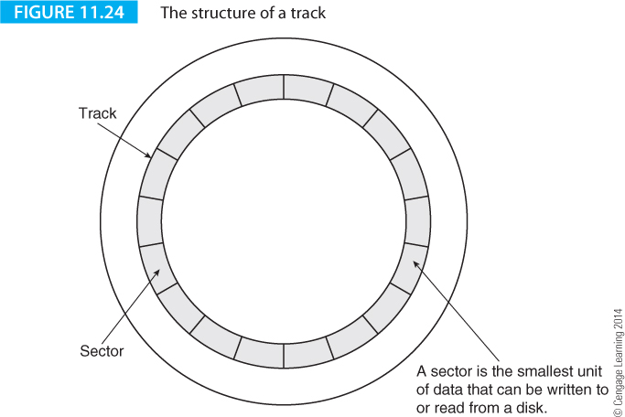
Computer Organization and Architecture: Themes and Variations, 1st Edition Clements
Figure 11.24 illustrates the structure of a track. A sector should be as large as possible for the purposes of storage efficiently.
Since each sector contains housekeeping information, small sectors are inefficient because they waste disk space. A sector should be as small as possible because of storage efficiency. Since a sector is the smallest unit of data that can be written, the unit of granularity of a file is the sector.

Slide 48
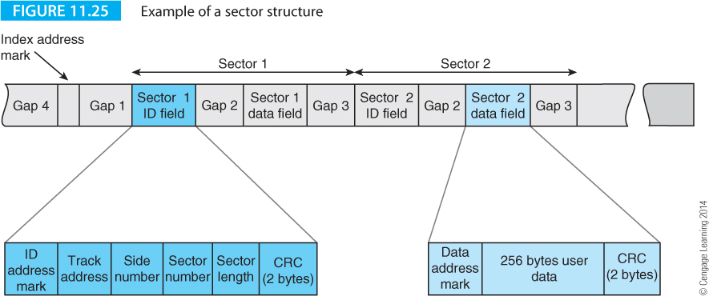
Computer Organization and Architecture: Themes and Variations, 1st Edition Clements
Figure 11.25 shows the structure of a track that is written to the disk when the disk is first formatted (this is a floppy disk sector structure which is easy to understand).
Until this structure is laid down, the disk cannot be used to record data.
The overhead needed to store data has no equivalent in semiconductor memories.

Slide 49
Computer Organization and Architecture: Themes and Variations, 1st Edition Clements
Zoning
The circumference of a track is π·d, where d is the diameter of the track. It there are n sectors per track, the length of a sector is π·d/n. The approximate size of a bit is given by π·d/(m·n), where m is the number of bits per sector.
Because the value of d varies radically between the inner and outer tracks, the width of a bit varies correspondingly. If the size of a bit is sufficiently large to be detected on the innermost track, it is too large on the outermost track and the storage efficiency is compromised.
Disks deal with the problem of different track lengths by zoning, whereby adjacent tracks are grouped into zones and each zone has a different number of sectors. Some of today’s disks divide the surface into 30 or more zones.
Zoning affects the rate at which data is read from the disk. With fewer sectors along the innermost track, the data transfer rate may be 60% less than when reading a sector at the outermost edge.

Slide 50
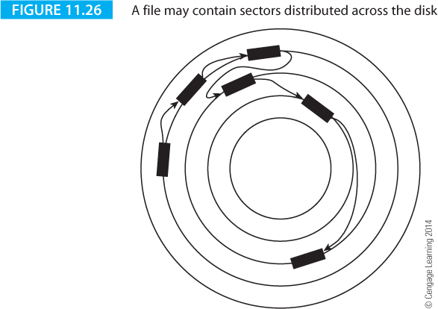
Computer Organization and Architecture: Themes and Variations, 1st Edition Clements
Figure 11.26 demonstrates how a file is read. A file is composed of a sequence of sectors. The sectors themselves may be arranged as a linked list or a directory may define the sequence of sectors belonging to a file.
When files are first created they are allocated sequential sectors. After a period of file creation and deletion, the free sectors on a disk become highly scattered and the resulting files heavily fragmented.
Operating systems can either automatically or manually defragment files by periodically reorganizing their structure to minimize the seek time.

Slide 51
Computer Organization and Architecture: Themes and Variations, 1st Edition Clements
The access time of a disk is composed of two major components: the time taken to access a given track (the seek time) and the time to access a given sector once its track has been reached (the latency).
The latency is easy to calculate. Assuming that the head has stepped to a given track, the minimum latency is zero (the sector is just arriving under the head).
The worst-case latency is the period of one revolution (the head has just missed the sector and has to wait for it to go round).
On average, the latency is 1/2t_{rev}, where t_{rev} is the time for a single revolution of the platter. If a disk rotates at 7,200 rpm, its latency is given by:
½ x 1/( 7,200 ÷ 60) = 0.00417s = 4.17 ms.

Slide 52
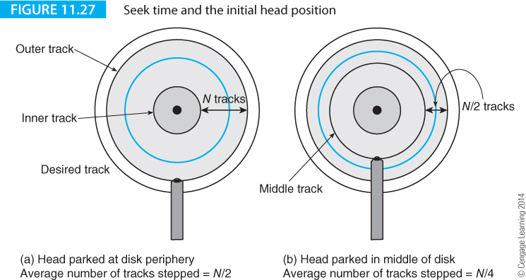
Computer Organization and Architecture: Themes and Variations, 1st Edition Clements
What is the average seek time? Suppose the disk has N sectors and it takes t_{step} seconds to step from track-to-track.
If the head is parked at the edge of the disk after each seek, the average number of tracks to step over when seeking a given track would be N/2, and the average seek time is given by ½ x N x t_{step}.
Figure 11.27(a) illustrates this situation.

Slide 53
Computer Organization and Architecture: Themes and Variations, 1st Edition Clements
However, suppose that the head were automatically moved to the center of the tracks (track number N/2) after each access - Figure 11.27(b).
When a new seek operation is issued, the head can move either left or right. In this case the average number of tracks to step is N/4, and the average seek time becomes ¼ x N x t_{step}.

Slide 54
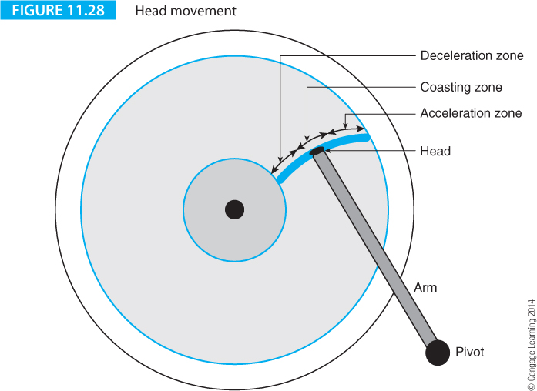
Computer Organization and Architecture: Themes and Variations, 1st Edition Clements
Figure 11.28 demonstrates the movement of an arm with a rotary actuator where it spends part of its time accelerating up to speed, part of its time moving at approximately common speed across the disk’s surface, and part of its time decelerating as it approaches its target destination.

Slide 55
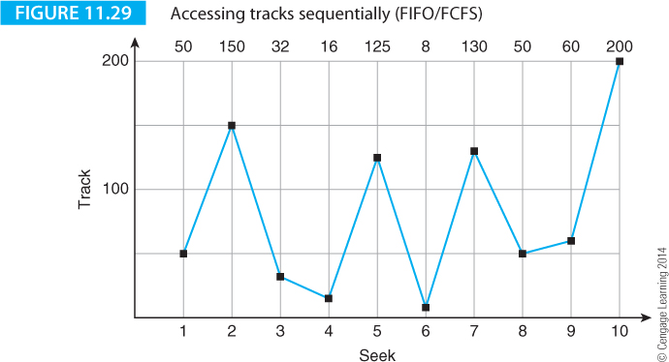
Computer Organization and Architecture: Themes and Variations, 1st Edition Clements
Accessing Sectors
Suppose an operating system makes a series of requests to a disk drive for sectors on tracks 50, 150, 32, 16, 125, 8, 130, 50, 60, 200. Figure 11.29 provides a head movement graph of the time plotted against the position of the head if the requested tracks are accessed in the order in which they were received; that is first-come, first-served (FCFS).

Slide 56
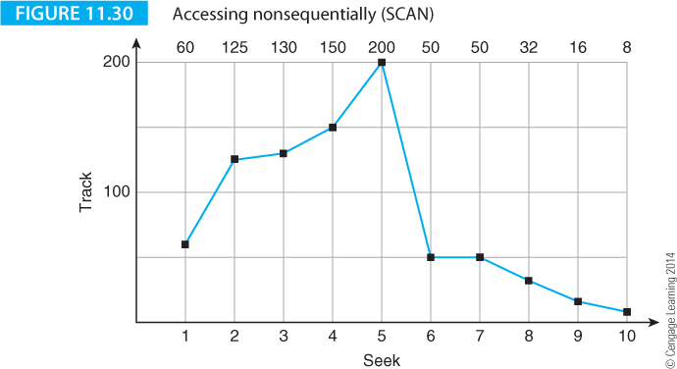
Computer Organization and Architecture: Themes and Variations, 1st Edition Clements
Operating systems often provide support for disk drives. For example, Figure 11.30 illustrates the same situation as in
Figure 11.29 except that the tracks are buffered and the surface of the disk is first swept in one direction and then back in the other direction.

Slide 57
Computer Organization and Architecture: Themes and Variations, 1st Edition Clements
Algorithms for scanning
FIFO First-in-first out (also called first come first served, FCFS). This algorithms processes requests in the order in which they are received. It is fair to all processes. Sequence = 10, 19, 3, 14 ,12, 9. Average seek length = 8.2.
SSTF Shortest seek time first. The next seek is the one that is closest to the current head position. This algorithm selects the next request as the one requiring the least movement of the head. Because newer requests may be serviced before older requests, it is not fair. Sequence = 10, 12, 14, 19, 9, 3. Average seek time = 5.0.
SCAN The approach implements the so-called elevator algorithm by taking the closest request in the direction of travel. It satisfies all outstanding requests in the current direction of head motion before reversing direction. Sequence = 10, 14, 19, 12, 9, 3. Average seek time = 5.0.

Slide 58
Computer Organization and Architecture: Themes and Variations, 1st Edition Clements
LOOK This is a modest variation on SCAN where the software looks ahead and changes direction when there are no requests beyond the current sector.
C_SCAN The circular scan algorithm moves the head in one direction, sweeping across the disk. However, the head then moves back to the other edge of the disk and starts again. It is a unidirectional version of SCAN. Sequence = 10, 14, 19, 3, 9, 12. Average seek time = 6.8.
FSCAN This algorithm is intended to deal with arm stickiness. Two request queues are required. Initially, at the start of a scan all requests are in one queue and the other queues is empty. Once a scan is in progress, all new requests are put in the other queue. This mechanism defers all new requests until the existing ones have been serviced. It is, of course, a fair access mechanism.

Slide 59
Computer Organization and Architecture: Themes and Variations, 1st Edition Clements
SMART Technology
Hard disks are complex electromechanical devices operating at the frontiers of technology.
Electromechanical systems with moving parts are far more unreliable than their semiconductor counterparts.
The major disk manufacturers developed a technology called SMART that monitors the performance of hard disk drives and can predict the probability of failure and therefore provide the user with an advance warning of possible failure.
The acronym SMART stands for self-monitoring, analysis and reporting technology

Slide 60
Computer Organization and Architecture: Themes and Variations, 1st Edition Clements
Some of a disk drive’s parameters that can be used to indicate possible failure are
head flying height
data throughput
spinup time
re-allocated sector count
seek error rate
seek time performance
spin try recount
drive recalibration recount

Slide 61
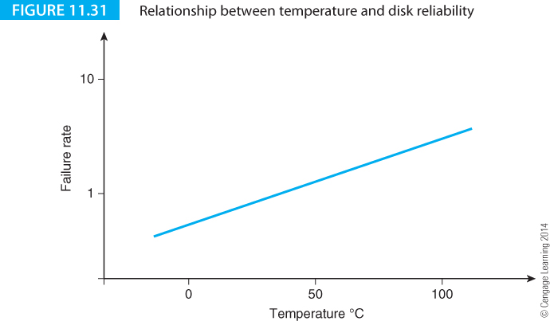
Computer Organization and Architecture: Themes and Variations, 1st Edition Clements
Effect of Temperature on Disk Reliability
The reliability of both the electronics and the mechanics such as the spindle motor and actuator bearings degrades as temperature rises. Operating a disk drive at extreme temperatures for long periods dramatically reduces its life expectancy.
Figure 11.31 shows the relationship between the temperature and reliability of a hard disk drive.

Slide 62
Computer Organization and Architecture: Themes and Variations, 1st Edition Clements
Shake, Rattle and Roll
Mechanical systems are sensitive to disturbances such as vibration. It is not easy to keep heads centered over tracks spaced at a pitch of 50 nm (2,000 times narrower than a human hair at 100 microns) on rotating disks. Disk drives use feedback to center the head over a track; that is, an error signal due to mispositioning of the head is used to move the to reduce the error.
When a drive suffers from external vibration, the head moves off position and generates a bigger error signal which moves the head back. Unfortunately, this is a post hoc solution; the correction happens after the disturbance.
An Hitachi white paper (Rotational Vibration Safeguard) describes a new technique used to minimize the effects of vibration.
Two vibration sensors are located on the disk drive’s board to detect movement. The signals from these sensors move the head actuator back into position before the head has wondered off track. In actual tests where a disk was shaken to reduce performance to about 30%, the application of the rotation vibration safeguard mechanism increased performance to 90%.

Slide 63
Computer Organization and Architecture: Themes and Variations, 1st Edition Clements
Secure Memory and RAID Systems
in 1987, Patterson, Gibson, and Katz at UC Berkeley published, A Case for redundant array of inexpensive disks, RAID, proposing a means of exploiting the inexpensive disk systems found in PCs.
The expression array of inexpensive disks implies a regular structure built around commodity, off-the-shelf disk drives, and redundant implies a degree of fault tolerance; that is, the failure of a single drive should not bring down the entire system.
The RAID concept rapidly moved out of the laboratory and by the mid-90s, RAID systems were being advertised in personal computer magazines.
Today, most PCs have motherboards with RAID support.
Patterson et al proposed several ways of organizing clusters of drives at Level 0 RAID, Level 1 RAID, etc. The various RAID levels provide different functionalities; some emphasize speed and some reliability

Slide 64
Computer Organization and Architecture: Themes and Variations, 1st Edition Clements
Disk drives are inherently serial storage devices. In a RAID system multiple disk drives are operated in parallel and the bits of a single file are divided between the individual drives.
RAID arrays can be used to improve the performance of disk systems or to improve their reliability.
By replicating data across several disks, the failure of a single disk can be made invisible to the system.
RAID systems are important in applications where data security is vital (e.g., banking).
The reliability of n disk drives is about 1/n that of a single because there are n of them to fail.
If data is distributed between the disks of an array, the failure of one disk doesn’t cause the system to crash. This statement is not true of Level 0 RAID, which is a special case.

Slide 65
Computer Organization and Architecture: Themes and Variations, 1st Edition Clements
To understand RAID, we need to remember two concepts.
First, the data recorded on disks is stored in sectors.
Second, each sector has a frame check sequence that can detect one or more errors in a sector.
This ability to detect errors means that a RAID array can rapidly respond to the failure of an individual drive unit.
The key concept in RAID technology is striping. Disk space is divided into units called stripes that may be as small as a single sector or as large as several megabytes.
These stripes are spread out or interleaved across several disks in parallel.
The way in which data is allocated to the stripes, and the stripes allocated to the individual drives determines the level of the RAID system.

Slide 66
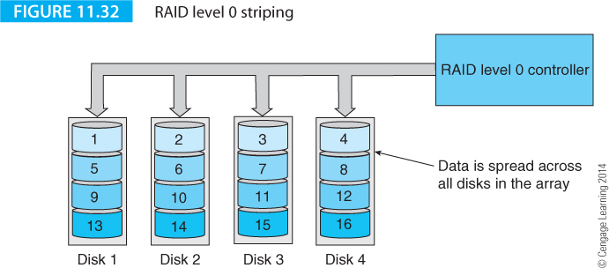
Computer Organization and Architecture: Themes and Variations, 1st Edition Clements
RAID level 0 is the only level not using redundancy to provide additional security. A Level 0 RAID with n drives divides data into n stripes that are applied in parallel to the n drives.
Figure 11.32 demonstrates Level 0 striping with four drives.
The size of each disk drive should be the same; otherwise the effective size of a RAID array defaults to the size of the smallest drive in the array.

Slide 67
Computer Organization and Architecture: Themes and Variations, 1st Edition Clements
The advantage of a RAID 0 array is its high throughput. For n drives, the capacity is n times that of a single drive and the speed is higher because read operations can take place in parallel.
The RAID controller may be implemented in either hardware or software. However, as we said earlier, it is common for RAID controllers to be built into PC motherboards leaving the user with little to do other than to plug in the disk drives and configure the BIOS.
The capacity of a RAID 0 array with n drives is simply n times the capacity of one drive; that is, no capacity is lost due to redundancy and the storage efficiency is 100%. However, there is no fault tolerance and the loss of any drive in the array renders all the data invalid. Read and write performance is excellent.
Because the loss of one disk brings down the entire system, a RAID 0 array makes sense only if the data is frequently backed up and provision is made for failure between backups. In that case, RAID 0 is both efficient in terms of its use of disk space and fast because of its inherent parallel read and write mechanism.

Slide 68
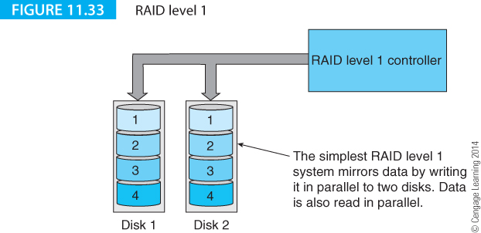
Computer Organization and Architecture: Themes and Variations, 1st Edition Clements
Figure 11.33 illustrates a level 1 RAID mirroring array replicates copies of stripes on multiple drives (here we are using only two drives in parallel).
Data security is increased because you can remove one of the drives without losing data.
Level 1 RAID system increase data security and improve access time. Suppose a given stripe is accessed.

Slide 69
Computer Organization and Architecture: Themes and Variations, 1st Edition Clements
The write time is the longer of the two parallel writes. Fortunately, most accesses are reads rather than writes.
Moreover, it is possible to cache writes and allow the disk to do the writing when it is free.
A level 1 RAID array is expensive because it duplicates data, but it can provide cost-effective security in an age where a large-capacity high-speed disk is of the order of $100

Slide 70
Computer Organization and Architecture: Themes and Variations, 1st Edition Clements
The efficiency of a two-disk RAID 1 system is 50% because data is simply duplicated.
Duplication provides excellent fault tolerance. If a drive fails, they system can continue working normally.
All you have to do is to remove the failed drive, install a new one, and then rebuild the lost data.

Slide 71
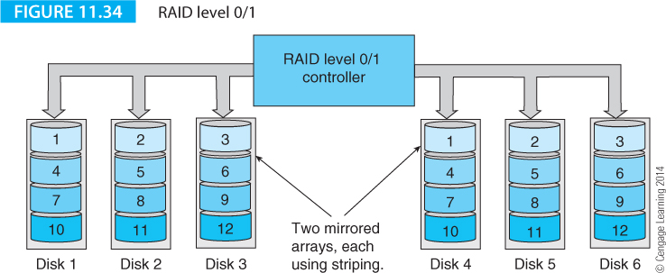
Computer Organization and Architecture: Themes and Variations, 1st Edition Clements
A hybrid system called RAID 0+1 or RAID 0/1 combines features of levels 0 and 1, by providing both fast data access and protection against drive failure.
Figure 11.34 illustrates a system with two sets of three drives. A stripe is written across drives 1, 2, and 3 to provide a level 0 RAID service. However, because drives 1, 2, and 3 are mirrored as 4, 5, and 6, the arrangement provides the security of a level 1 system.
This arrangement is the most costly form of RAID and upgrades require disks to be added in pairs.

Slide 72
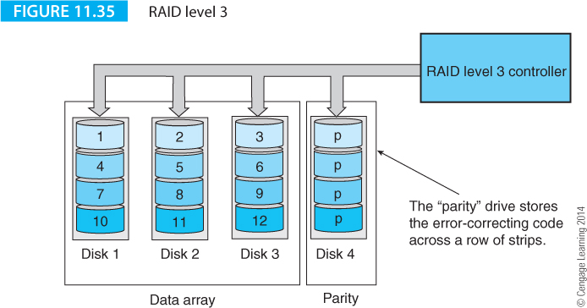
Computer Organization and Architecture: Themes and Variations, 1st Edition Clements
RAID Level 2 and Level 3
RAID levels 2 to 6 all distribute data in the form of stripes like level 0, but they do not fully replicate the data like level 1. In other words, levels 2 to 6 fall between the extremes of level 0 (no redundancy) and level 1 (redundancy by replication).
RAID levels 2 and 3 employ multiple synchronized disk drives; that is, the spindles are synchronized so that sector i passes under the read/write head of each of the disks in the array at the same time.

Slide 73
Computer Organization and Architecture: Themes and Variations, 1st Edition Clements
Level 2 and 3 arrays provide true parallel access in the sense that, typically, a byte is written to each of the disks in parallel.
The difference between levels 2 and 3 is that level 2 uses a Hamming code to provide error detection and correction, whereas level 3 provides only a simple parity-bit error detecting code.
The parity check data in a level 3 RAID is stored on one disk, whereas the Hamming code of a level 2 RAID may be spread over more than one drive. Figure 11.35 illustrates the concept of RAID level 3 which is also called bit-interleaved parity.

Slide 74
Computer Organization and Architecture: Themes and Variations, 1st Edition Clements
A single-bit parity code can’t normally be used to correct an error. But it can in a RAID level 3 array. Suppose a disk drive fails.
The stripes recorded on the failed disk are, therefore, missing. However, the stripes on the parity disk can be used to reconstruct the missing data.
Table 11.3 illustrates a level 3 array with four data disks and a parity disk. If disk 3 fails, we have the situation of Table 11.4.
Because we know the parity bit across each row, we can recalculate the missing data. For example, in line 1, the bits are 0,1,?,0,1. Since the parity bit is odd, there must be an odd number of 1’s in the data bits. Therefore, the missing bit must be 0.
bit 1 | bit 2 | bit 3 | bit 4 | P
0 | 1 | 0 | 0 | 1
1 | 1 | 0 | 0 | 0
0 | 1 | 1 | 1 | 1
1 | 0 | 1 | 0 | 0
bit 1 | bit 2 | bit 3 | bit 4 | P
0 | 1 | ? | 0 | 1
1 | 1 | ? | 0 | 0
0 | 1 | ? | 1 | 1
1 | 0 | ? | 0 | 0

Slide 75
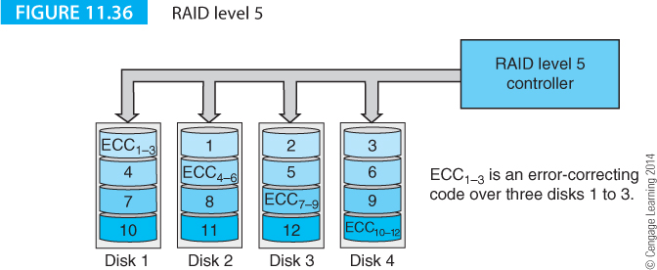
Computer Organization and Architecture: Themes and Variations, 1st Edition Clements
RAID Level 4 and Level 5
RAID levels 4 and 5 are similar to levels 2 and 3. However, in these cases the individual disks are not synchronized and operate independently of each other.
The stripes are much larger than levels 2 and 3. In level 4, block interleaved parity, the parity stripes are stored on a single disk, whereas in level 5 the parity stripes are interleaved and stored on all disks in the array.
You can update the parity information in RAID 5 systems more efficiently by changing the corresponding parity bits only when the data changes.

Slide 76
Computer Organization and Architecture: Themes and Variations, 1st Edition Clements
RAID level 5, Figure 11.36, is a popular configuration, providing striping as well as parity for error recovery.
The parity block is distributed among the drives of array, which gives a more balanced access load across the drives. A minimum of three drives is required for a level 5 RAID array.

Slide 77
Computer Organization and Architecture: Themes and Variations, 1st Edition Clements
Dealing with Failure in a RAID Array
When a hard drive in a RAID array fails, it has to be replaced. RAID controllers can be designed to be hot swappable. You pull out the failed drive and insert a replacement without powering down and rebooting. The new drive has to be configured for the array (rebuilding).
It’s easy to rebuild a drive in a RAID 1 system – you copy data from a working drive to the new mirror drive. Rebuilding data on a RAID 5 array takes a lot more time because you have to synthesize all the data by reading the appropriate stripes from the other disks and then performing an exclusive OR operation with the data.
RAID 0 The fastest and most efficient arrangement. No fault-tolerance is provided. Requires a minimum of two drives.
RAID 1 Data is mirrored (duplicated). This is the best choice for performance-critical, fault-tolerant environments. Requires a minimum of two drives.
RAID 2 This mode is not used with today’s drives that include embedded ECC mechanisms.
RAID 3 This mode can be used to speed up data transfer and provide fault-tolerance by including a drive with error correcting information that can be used to reconstruct lost data. Because this mode requires synchronized-spindle drives, it is rarely used today. Requires at least three disks.
RAID 4 Little used.
RAID 5 This mode combines efficient, fault-tolerant data storage with good performance characteristics. However, performance during drive failure is poor and rebuild time slow due to the time required to construct the parity information. Requires a minimum of three drives.
RAID 0+1 Striped sets in a mirrored set with four or more disks. Provides fault tolerance and improved performance.
RAID 1+0 Mirrored sets in a striped set. Like RAID 1+0 but with better performance.
RAID 5+1 A mirrored striped set. Requires at least three disks.

Slide 78
Computer Organization and Architecture: Themes and Variations, 1st Edition Clements
Solid-state Disk Drives
The days of the magnetic drive may be limited by the introduction of solid-state drives that mimic the hard drive electrically.
The solid-state hard drive uses semiconductor flash technology to store data and an electrical interface that makes it physically compatible with hard disk interfaces; that is, you just plug an SSD into a hard disk SATA socket.
The SSD has considerable advantages over the electromechanical disks, the most important of which are higher performance, lower power consumption, lower weight, and greater tolerance to shock.
In 2010 SSDs were finding their way into high-end executive laptops (in a 2 ½ inch form factor) and specialist high-end applications in 3 ½ form factors. The limitations of the SSD are twofold; their considerable cost premium over hard drives and their limited storage capacity.

Slide 79
Computer Organization and Architecture: Themes and Variations, 1st Edition Clements
Solid-state disks are constructed with the type of flash memory technology we discussed in the previous chapter; it’s only in recent years that the cost of flash memory has declined to the point at which large (over 128 GB) memories are economically feasible.
Because solid state disks have no moving parts, they are truly random access devices. There is no rotational latency and no seek time. Consequently, the fragmentation problem associated with hard disks simply goes away. It’s not necessary to periodically defragment an SSD when files are scrambled throughout the memory space.
As early as 2007, a white paper from IDC indicated the potential savings from an SSD-based notebook as:
IT labor savings for PC deployment 2.4%
Reliability savings for outsourced repair 1.4%
Reliability savings for repairs 7.5%
Reliability savings for user productivity due to hard drive loss 17.2%
Savings from power enhancements 16.9%
User productivity savings 54.5%

Slide 80
Computer Organization and Architecture: Themes and Variations, 1st Edition Clements
Magnetic Tape
Magnetic tape provides a means of archiving large quantities of data. In a world where the production of data is estimated to increase by 60% compounded annually, archival storage is vital.
In the 1960s and 1970s the preferred backing medium was magnetic tape because it was relatively cheap and could store large volumes of data.
Data is stored on tape as multiple parallel tracks (typically nine; i.e., eight data bits and a parity bit). Magnetic tape recording technology is virtually identical to disk technology except that there is a single track that is one bits wide along a long (typically 2400 feet) flexible magnetic tape.
A tape drive required large and powerful motors to spin reels of tape rapidly and to stop them equally rapidly.
Magnetic tape was available on 10.5 inch reels up to the 1980s and data was stored at, typically, 128 characters per inch.

Slide 81
Computer Organization and Architecture: Themes and Variations, 1st Edition Clements
All tape systems have a long latency because the tape has to be moved past a read/write head and the desired data may take several seconds or even minutes to locate. Consequently, tape is a purely archival medium.
Tape drives grew smaller and tape cartridges (similar to audio cassettes and VCR tapes) were developed. In order to store more data on the tape the information was stored along diagonal tracks on the tape by using rotating helical read/write heads, the same writing mechanism was used in domestic VCRs.
The QIC (Quarter-inch cartridge) set of standards introduced in 1972 provided a great leap forward over the reel-to-reel machines and supported 1.35 GB tapes with 30 tracks at 51K bits/inch linear density ad a 120 inch/s tape speed.

Slide 82
Computer Organization and Architecture: Themes and Variations, 1st Edition Clements
By 2010 the quarter inch cartridge was largely obsolete. Today, linear serpentine recording is widely used to store data on tape.
The term serpentine hints at the zigzag nature of the recording with some tracks recorded left to right and some right to left on the tape.
Consequently, when the tape reaches its end, it does not have to be rewound, but can simply change direction to continue reading or writing data.

Slide 83
Computer Organization and Architecture: Themes and Variations, 1st Edition Clements
It’s a popular myth that tape and cartridge recording technologies are obsolete. However, the death of tape is much exaggerated.
In January 2011, HP reported that the worldwide market for their LTO tape drives declined by about 30% between late 2008 and late 2009, but increased by 45% (of the 2008 figure) by the end of 2010.
This amounts to a renaissance in the use of magnetic tape. Moreover, tape has a much lower TCO (total cost of ownership) than disk drives. A large organization such as law enforcement or a medical institution has large quantities of data to store.
The total cost of ownership includes the equipment, media, floor space, maintenance, and energy consumption.
The TCO for data over a 12-year period in a large organization might be fifteen times greater for disk-based storage than for tape-based storage.

Slide 84
Computer Organization and Architecture: Themes and Variations, 1st Edition Clements
Towards the end of the 1990s the LTO (linear tape-open) standard was developed.
The word open indicates that the standard is not proprietary like the earlier standards that were owned by IBM or HP.
The first standard, LTO-1, introduced a 100 GB cartridge. By 2010 the LTO-6 standard had been launched and that provided a capacity of 1.5 TB, a data speed of 140 MB/s using 896 tracks at a linear density of 15,142 bits/mm.
The LTO standards have been scaled up to 12.8 TB/cartridge in version LTO-8 that has not yet been released. LTO-5 1.5 TB cartridges are not cheap.
In 2011 the cost of a cartridge was of the order of $50 which is compatible with hard-disk storage.

Slide 85
Computer Organization and Architecture: Themes and Variations, 1st Edition Clements
Manufacturing modern high-density tapes is not easy.
The distance between tracks is so small that tape dimensional stability becomes an issue.
Magnetic tape can change dimension under the influence of heat and humidity.
This means that tracks that were aligned with the parallel heads at the time the data was written may not be aligned when the tape is read at a later date.
This has led to the search for highly stable tape substrates; for example, some manufacturers use a polyamide that is a close relative of Kelvar.

Slide 86
Computer Organization and Architecture: Themes and Variations, 1st Edition Clements
Ultrium Technology
Ultrium technology is the generic name given to the set of Linear Tape-Open standards developed jointly by Quantum, HP and IBM to provide a common standard in a world where users were often forced to buy a proprietary recording technology that forced them to remain with one supplier.
The LTO standards have three important features:
They are regularly updated to keep pace with both demand and technological development
They use linear serpentine technology (in contrast with helical recording)
They offer the very high storage capabilities required in today’s world.

Slide 87
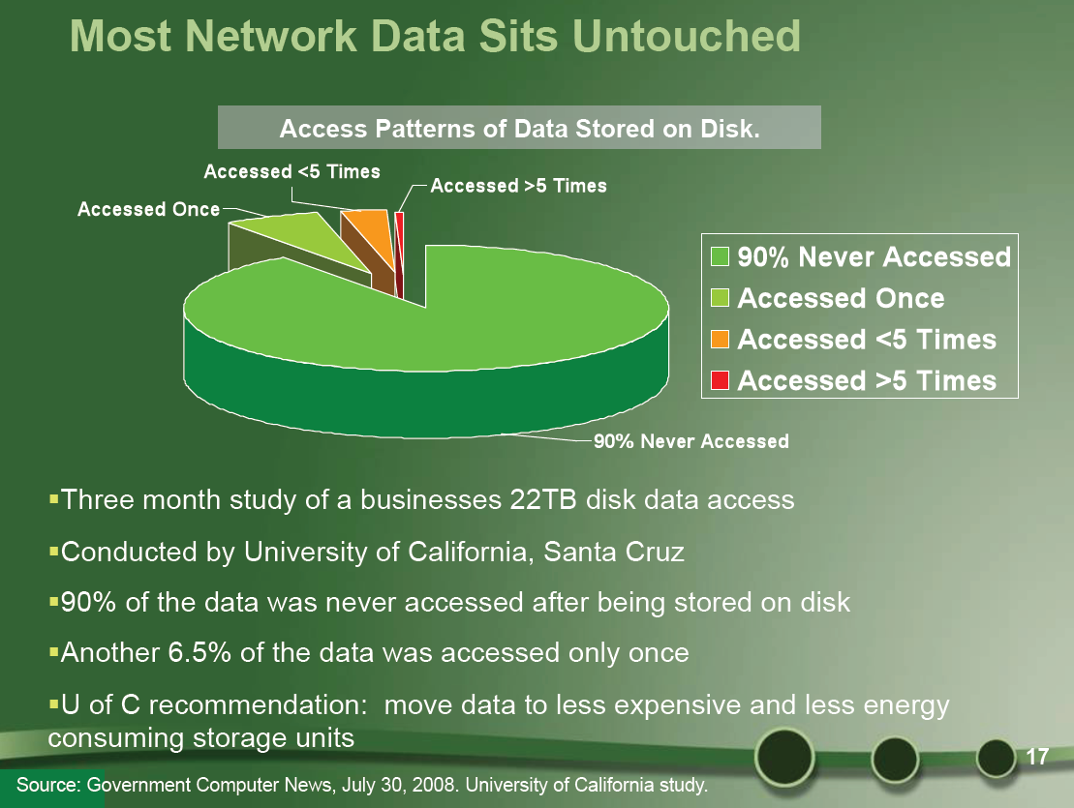
Computer Organization and Architecture: Themes and Variations, 1st Edition Clements
This slide makes the point that 90% of network data is never accessed. If data is stored on disks, it takes up expensive real estate and consuming power.

Slide 88
Computer Organization and Architecture: Themes and Variations, 1st Edition Clements
Optical Storage Technology
The optical digital storage medium was an invention waiting to happen and was inevitable.
It was just a matter of waiting to see which technology would predominate and which companies would get to the marketplace first.
Here we introduce the three optical recording mechanisms used by digital computers: the CD, DVD, and Blu-ray.
We will look at each of these in turn because they all employ the same underlying technology.
The difference between them is largely one of scale; as time has progressed it has become possible to scale down the size of the features on the disk that stores the data.

Slide 89
Computer Organization and Architecture: Themes and Variations, 1st Edition Clements
Philips developed their LaserDisc in the early 1970s and launched it in the 1980s. LaserDiscs shared some of the attributes of today’s compact discs CDs, but the LaserDisc used analog technology. The system was read-only and few films ever made it to disc.
During the 1970s Philips and Sony joined forces to develop optical storage; not least because Philips had considerable experience in optical technology and Sony had expertise in encoding and error correction mechanisms.
An important achievement of Philips and Sony was the standardization of the recording and playback mechanisms.
Two fundamental parameters are the size of the CD itself and the sampling frequency. The disc’s diameter is 12 cm and the sampling frequency was chosen as 44.1 kHz.
Although this seems a strange number, it’s the sampling rate required for high quality audio and the same frequency is used in television systems.

Slide 90
Computer Organization and Architecture: Themes and Variations, 1st Edition Clements
Optical Storage Technology
The first practical, low-cost, high-density optical storage mechanism was the CD introduced in 1981 as a means of storing high-quality sound.
The structure of a CD is similar to a magnetic disk because information is stored along a track.
A CD’s track is continuous and arranged as a continuous spiral. The spiral has about 20,000 turns which corresponds to a length of about 3 miles. The effective track density is 16,000 turns per inch and the theoretical maximum areal density is 1 Mb/mm² or 645 Mb per square inch.

Slide 91
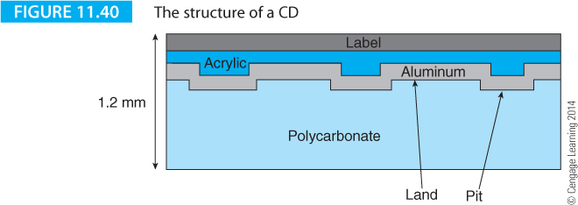
Computer Organization and Architecture: Themes and Variations, 1st Edition Clements
Digital information on a CD is imprinted on the surface of a 1.2 mm thick plastic disk in the form of a pattern that contains indentations, called pits, of varying length.
The pits are coated with a metallic mirror and a protective layer. The region of the surface that is not indented is called land. Data is stored from 25mm to 58mm from the center.
Data is read from the disk's surface by illuminating it with a tiny spot of light and then detecting how much light is reflected back from the surface. A change in reflected light intensity occurs every time the laser spot moves from the pit onto the land and vice versa.

Slide 92
Computer Organization and Architecture: Themes and Variations, 1st Edition Clements
Figure 11.40 illustrates the structure of the surface of a CD. A pit rises above the surface and it’s what us normal folk call a bump. The term pit refers to an indentation when looking down at the data-carrying layer from above the label side of the disk. The laser beam that reads the data sees a bump, rather than a pit.
Figure 11.40 shows four layers: the disk is 1.2 mm thick transparent polycarbonate plastic. The pits are coated with a thin layer of aluminum followed by a protective acrylic layer and then the label. This label side is much more sensitive to scratches and abrasion than the clear side.

Slide 93
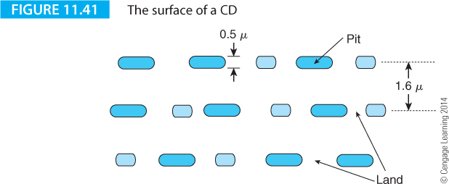
Computer Organization and Architecture: Themes and Variations, 1st Edition Clements
The areal density of a CD is a product of the number of bits stored along a track and the pitch of the tracks.
The size of the individual bits is determined by the size of the spot of light projected onto the disk's surface.
Figure 11.41 illustrates the structure and dimensions of the pits and land on a CD’s surface.
A bump is approximately 0.5 x 10⁻⁶ m and the track pitch is 1.6 x 10⁻⁶ m. The height of the bump (pit) is 1.25 x 10⁻⁷ m.

Slide 94
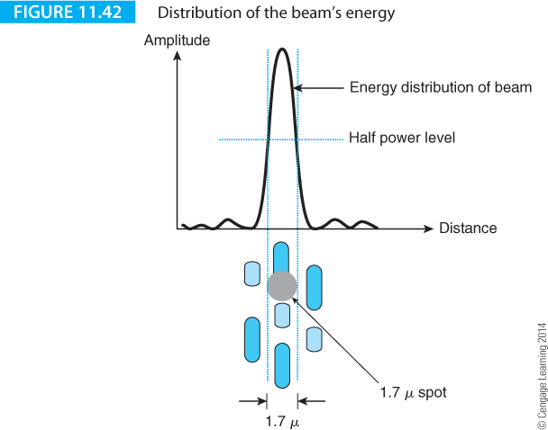
Computer Organization and Architecture: Themes and Variations, 1st Edition Clements
Characteristics of a laser beam

Slide 95
Computer Organization and Architecture: Themes and Variations, 1st Edition Clements
Abeam of light illuminates the pits and land along a track and the amount of reflected light is used to read the data.
In order to create and control the smallest possible spot of light, it is necessary that the light beam be both coherent and monochromatic.
A light source is monochromatic if the light waves all have the same frequency, unlike white light that contains frequencies distributed across the visible spectrum.

Slide 96
Computer Organization and Architecture: Themes and Variations, 1st Edition Clements
Figure 11.42 illustrates the energy distribution of a spot of laser light on the surface of a disk. A perfect spot would have hard edges between light and dark. Because of the wave-like properties of light, the edge of a spot is not sharp; it consists of a series of rings of light.
Figure 11.42 illustrates the relative dimensions of the spot, tracks, pits and land. When light hits a flat region on the surface, a large fraction of the light is reflected back. Suppose that the size of the spot is somewhat larger than an individual bump. When light hits a bump on the surface, some light is reflected back from the top of the bump and some from the surface around the bump.

Slide 97
Computer Organization and Architecture: Themes and Variations, 1st Edition Clements
In a CD, the height of the bump above the land is one quarter the wavelength of the laser light.
The light hitting the top of a bump travels x from its source to the surface and then to the observer. The light hitting the bottom of the bump travels a further λ/4 in each direction. The total difference traveled by the light reflected off the land is x + λ/2. Because the spot doesn’t cover a pit entirely and the path length between the reflected light from the pit and from the land is half the wavelength of the light, the beams tend to cancel.

Slide 98
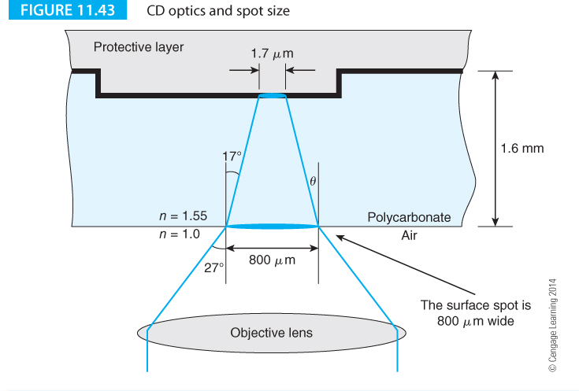
Computer Organization and Architecture: Themes and Variations, 1st Edition Clements
Figure 11.43 demonstrates the how the effects of surface contamination on a CD are reduced. Light from a laser is focused onto the data-carrying surface of the disk. The size of the spot on the pits and lands is 1.7 μm, whereas the size of the spot on the upper clear surface of the disk is 800 μm. The spot on the clear surface is nearly 500 times larger than the spot on the pits and land. This means that the system is relatively tolerant of surface contamination because slight imperfections are out of focus.

Slide 99
Computer Organization and Architecture: Themes and Variations, 1st Edition Clements
Disk Speed
The speed of an audio CD is governed by the speed at which data is required from the disc.
This speed corresponds to a data rate of 150 Kbits/s and is called 1X. At this speed, the surface of the disk moves under the read head at 1.25 m/s.
Because computer users want to read data as fast as possible, CD drives have become faster since their introduction.
A 4X drive provides data at four times the rate of a standard audio disc. Drives operating at 48X are now commonplace.
However, the test results published by organizations that benchmark drives demonstrate that these drives don’t provide the sustained data rates you might expect.
A 48X disk is not 48 times faster than a 1X disc.

Slide 100
Computer Organization and Architecture: Themes and Variations, 1st Edition Clements
First-generation CD drives operated at a constant linear velocity, CLV, unlike the hard disk. A constant liner velocity means that the speed of the surface of the disk under the read head is constant.
A hard disk operates at a constant angular velocity. Since the radius of the tracks at the center and edge of the disk are markedly different, the rotational speed required to read the track at a constant rate varies as the disk is read.
This feature limits the speed of the CD ROM drive.
Modern CD ROM drives have largely abandoned pure CLV because it is quite difficult to implement at high rotational speeds.
Some drives use a dual mode in which their angular velocity is constant when reading tracks close to the center, whereas their linear velocity is constant when reading tracks closer to the outer edge.

Slide 101
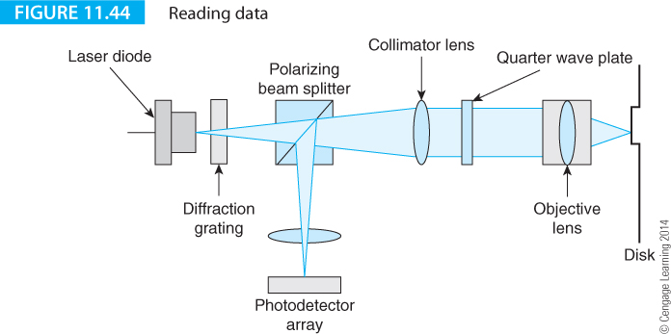
Computer Organization and Architecture: Themes and Variations, 1st Edition Clements
The Optical Read-head
Figure 11.44 illustrates the path taken by the light from the laser to the surface of the disc and then back to the photoelectric sensors. Light from the laser is focused to a spot on the disk.
Light from the spot is reflected back along the same path; the amount of light reflected depends on whether the spot is hitting a pit or land.

Slide 102
Computer Organization and Architecture: Themes and Variations, 1st Edition Clements
When the light returns from the disc, it hits a beam splitter and some of it is reflected down to the sensor where it is detected. A photodiode measures the amount of light being reflected from the surface of the disk.
If the light from the surface of the disk is coming from a bump, some of the light has traveled a further λ/2 and is 180° out of phase resulting in a fall in the signal level at the detector.

Slide 103
Computer Organization and Architecture: Themes and Variations, 1st Edition Clements
Focusing and Tracking
To read data reliably, an optical drive’s read head must follow the spiral track accurately.
It is easy to move the device optics radially on runners to step in or out along a radius.
It is harder to move the beam to the required spot with the necessary precision.
This applies to movement in the X-Y plane when seeking a track and in the Z plane when focusing.
The objective lens in the read head is mounted on gimbals and can move in two planes; left and right for tracking, and in and out for focusing.
A magnetic field from an electromagnet is used to position the lens to perform the fine tracking and focusing.

Slide 104
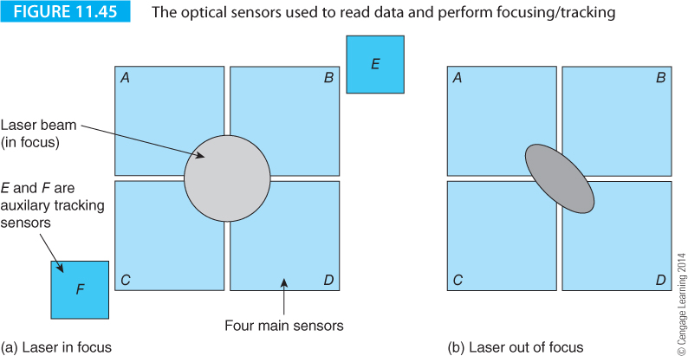
Computer Organization and Architecture: Themes and Variations, 1st Edition Clements
Figure 11.45 illustrates the optical sensors. Light from the laser passes through a diffraction grating, a transparent material indented with parallel lines. The diffraction grating splits the beam into a main beam and two side beams.
Sensors A, B, C, and D pick up the main spot.
Sensors E and F pick up the two side beams. The outputs of the two side beam sensors are subtracted to get track_{error} = E – F. If the beam is centered, the tracking error is zero. If track_{error} > 0 the beam must be moved left, and if track_{error} < 0 the beam must be moved right.

Slide 105
Computer Organization and Architecture: Themes and Variations, 1st Edition Clements
The main beam falls on sensors A, B, C, and D where the sum of the outputs of these sensors is used to regenerate the data from the disk. Differences in outputs between pairs of sensors are used to focus the spot.
In Figure 11.45 the beams from the diffraction grating pass through a collimating lens that makes the beams parallel, a quarter wave plate, and an objective lens that focuses the beams onto the disk. These beams are reflected back along the same path they took, and then through the beam splitter to the six photo sensors.

Slide 106
Computer Organization and Architecture: Themes and Variations, 1st Edition Clements
The objective lens is cylindrical rather than spherical, which introduces astigmatism in the focusing; that is, the focal point is different in the vertical and horizontal planes. If the beam is in focus, the spot is circular and all four central sensors receive equal amounts of energy. If the objective is too close to the surface, the beam is elliptical, as
Figure 11.45b demonstrates, and the signal (A+D) is greater than (B+C). The difference can be used to move the lens back from the disk. If, however, the lens is too far away from the surface, the effect of the astigmatism is to rotate the elliptical spot by 90⁰ and make (B+C) greater than (A+D).

Slide 107
Computer Organization and Architecture: Themes and Variations, 1st Edition Clements
Low-level Data Encoding
The encoding of data on a disc is subject to several severe constraints, the most important of which concerns the distribution of energy in the spectrum of the signal from the optical pickup.
In particular, there should be no DC component in the signal; that is, its average value must be zero.
The low-level data encoding must be designed to control the number of consecutive zero bits or one bits, and allow the clock signal to be regenerated from the data signal.
Source data is stored in units of eight-bit bytes.
These data bytes are each encoded into fourteen bits by means of 8-to-14-bit modulation, EFM. Each 14-bit code can represent 2¹⁴ = 16,376 different values, although only 2⁸ = 256 of these values are used.
EFM is a form of run length limiting code that reduces the bandwidth of the signal.

Slide 108
Computer Organization and Architecture: Themes and Variations, 1st Edition Clements
The EFM ensures that there are no more than ten and no less than two consecutive zeroes in the data stream on the disc.
In fact, there are 267 legal 14-bit patterns conforming to the rule: the number of consecutive zeros in the data stream must be between three and nine, inclusive.
This means that there are 267 – 256 = 19 bit patterns that are legal from the modulation mechanism, but that do not describe a valid data byte.
Some of these codes can, therefore, be used as special markers in the data stream.

Slide 109
Computer Organization and Architecture: Themes and Variations, 1st Edition Clements
Unfortunately, it is possible for the end of one group and the beginning of the next group to be misinterpreted as a valid code word.
To stop this happening, a 3-bit delimiter is placed between each group of 14 bits.
These three bits are called merging bits. The three bits chosen to form the merging pattern are not always the same.
The specific merging pattern is selected to ensure that the average number of 1s and 0s remains approximately the same (this constraint ensures that there is no DC component in the data from the optical head).

Slide 110
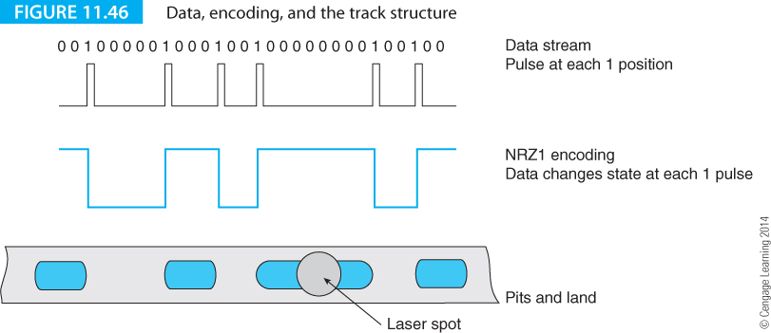
Computer Organization and Architecture: Themes and Variations, 1st Edition Clements
A logical 1 value in the data is interpreted as a change of state in the signal from the disk (i.e., a transition from land to pit or vice versa) so that the 1s are represented by the starts and ends of recorded pits.
Figure 11.46 illustrates the relationship between the data stream and the disk surface.

Slide 111
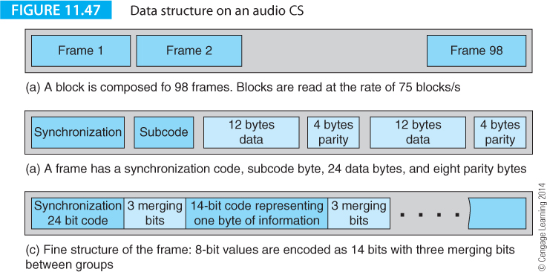
Computer Organization and Architecture: Themes and Variations, 1st Edition Clements
Figure 11.47 illustrates the three levels of structure on an audio CD. In 11.47(a) the block is composed of 98 frames. Each frame contains a single-byte subcode that contains information about the current track etc.
Figure 11.47(b) shows the frame structure with its 24 bytes of audio data, synchronizing header, subcode bytes and the parity check bytes generated by the Reed Solomon encoder. This Figure is misleading because the order of the data is scrambled by the CIRC coder.

Slide 112
Computer Organization and Architecture: Themes and Variations, 1st Edition Clements
Re-writable CDs
To make CD-RW technology compatible with existing CD drives, it was necessary to find a means of creating and deleting areas of differing reflectivity along the track of a disc.
Two candidate technologies were phase-change and magneto-optical. Panasonic and others pioneered magneto-optical storage and such devices are widely used today.
Phase-change technology has been universally adopted for CD-RW devices.
Increasing the power of a tightly focused laser beam locally heats the surface of the data-carrying layer.
This layer contains a compound of silver, indium, antimony and tellurium that exists in two stable states, a crystalline state and an amorphous state.
When this material is crystalline, it reflects the laser light better than when it is amorphous.

Slide 113
Computer Organization and Architecture: Themes and Variations, 1st Edition Clements
The CD-RW disc itself is similar to the conventional CD. The substrate is a 1.2 mm polycarbonate disc and the track (i.e., spiral groove) is molded on the disk with the time information.
The recording layer is sandwiched between two dielectric layers to control the thermal characteristics of the phase-change layer when it is heated during the writing or erasing process.
A reflective layer is provided behind the data and dielectric layers.
The laser in a CD-RW drive operates at three powers. During reading, it provides the beam that detects the edges of the pits and operates in its lowest power mode.
During writing, the laser operates in its highest power mode when it heats the recording layer sufficiently to create an amorphous state. The write power level heats the surface locally to about 600⁰C and the compound melts. When it cools rapidly, the liquid freezes and shrinks to create a “pit”.

Slide 114
Computer Organization and Architecture: Themes and Variations, 1st Edition Clements
When the CD-RW drive is erasing data, the laser operates in a lower power mode than its write mode and the laser heats the surface sufficiently to turn the data layer into its crystalline state.
The phase-change material is heated to about 200⁰ C where it crystallizes and the atoms take up an ordered state.
There is a limit to the number of write and erase cycles that the material can undergo and still continue to provide two optically distinguishable states.
CD-RW is still a read-mostly medium rather than a true read/write medium.

Slide 115
Computer Organization and Architecture: Themes and Variations, 1st Edition Clements
Magneto-optical Storage
An alternative to the phase-change technology is magneto-optical recording. Magneto-optical systems are not fully compatible with conventional CD drives and the rise of the low-cost CD-RW drive has led to a decline in MO technology.
Recall that the Curie temperature defines the point at which a magnetic material loses its magnetization.
Some substances have a Curie point of 200⁰ C, which means that they can be demagnetized by heating with a laser.

Slide 116
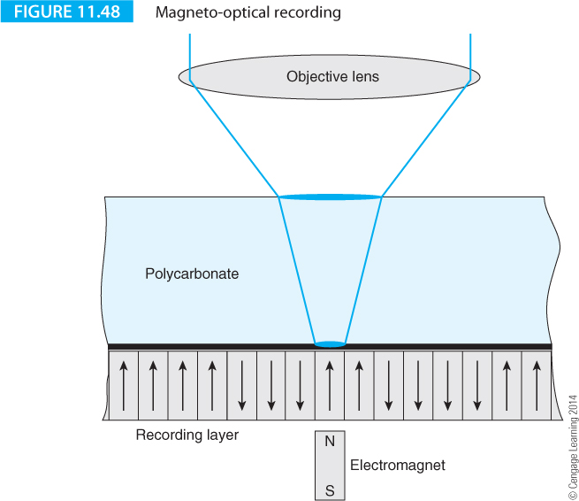
Computer Organization and Architecture: Themes and Variations, 1st Edition Clements
Figure 11.48 illustrates the principle of a MO system. The data-carrying surface of the disc is a ferromagnetic material with a low Curie point. In normal operation, the domains on the surface are magnetized perpendicular to the disc’s surface.
If the surface is heated by a laser, it is demagnetized. However, because there is an electromagnet under the disc, applying a field will magnetize the surface when it cools.

Slide 117
Computer Organization and Architecture: Themes and Variations, 1st Edition Clements
An MO disc can be read because there is an interaction between magnetism and optics. When a polarized light passes through a magnetic material, a change in the polarization of the light takes place (the Kerr effect).
A similar optical system to that in a CD can be used to read MO discs. When light is reflected from the disk, its plane of polarization is rotated by about 0.5⁰ if the surface is magnetized in one direction, and by 0.5⁰ in the other direction if the magnetization is reversed. Consequently, there is a difference of 1⁰ in the polarization of the light from the two magnetic states.

Slide 118
Computer Organization and Architecture: Themes and Variations, 1st Edition Clements
The DVD
The DVD is a development of the compact disc that means Digital video disc or Digital versatile disc.
The DVD was designed to store a movie. Unlike the CD-ROM, the DVD is available in several capacities depending on whether there are one or more data-carrying layers.
DVD technology was developed in the early 1990s by a group of companies including Toshiba, Time Warner, Sony and Philips.
Some of the leading players in the development of DVD technology had close links with Hollywood, which strongly influenced the emerging standard. In particular, the DVD was designed to provide 133 minutes of encoded video information (sufficient to cover most mainstream movies).
The DVD provides high-quality sound and audio and includes up to three separate audio channels, allowing the same DVD to be used with audiences of different nationalities.

Slide 119
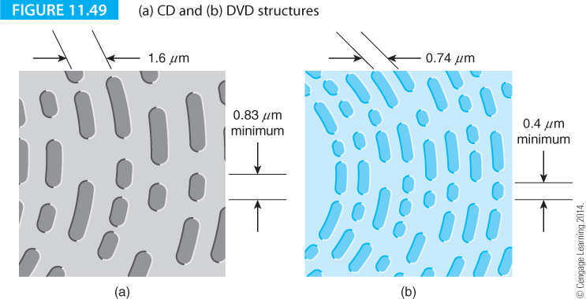
Computer Organization and Architecture: Themes and Variations, 1st Edition Clements
DVD technology is virtually the same as CD technology.
In fact, you could say that the DVD is the CD constructed with technology that’s advanced and matured over ten years.
The pits on DVD discs are packed tightly and the minimum pit size is 0.4 μm rather than 0.8 μm used on a CD. The laser light wavelength is reduced from 780 nm to 640 nm. The track spacing is reduced from 1.6 μm to 0.75 μm. Figure 11.49 illustrates the structure of CD and DVD tracks.

Slide 120
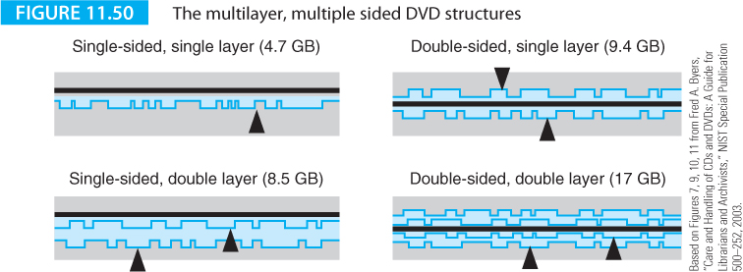
Computer Organization and Architecture: Themes and Variations, 1st Edition Clements
The thickness of the DVD disc is 0.6 mm, or half that of a CD disc.
The DVD is made double sided by bonding together two 0.6 mm discs to create a double-sided 1.2 mm disc.
Moreover, it is possible to have two different data layers in the same disc.
DVD supports the following four basic formats illustrated by Figure 11.50.

Slide 121
Computer Organization and Architecture: Themes and Variations, 1st Edition Clements
Recordable DVDs
Recordable DVD technology didn’t settle down as rapidly as CDs where the CD, CD-R, and CD-RW followed each other with a reasonable degree of backward compatibility.
Within a few years the DVD reader was followed by the DVD-RAM, DVD-RW, DVD+RW and DVD-R.
DVD-R is a write-once medium with a capacity of 4.7 or 9.4 GB that can be used in most compatible DVD drives.
It first appeared in 1997 with a lower capacity 3.95 GB version. In 1989 the first rewritable device appeared, the DVD-RAM, that relied on both phase-change and magneto-optical techniques to write data to the disc.
First generation devices had a 2 GB capacity but that rose to 4.7 GB by 1999.This system was not compatible with other DVD formats.

Slide 122
Computer Organization and Architecture: Themes and Variations, 1st Edition Clements
Blu-ray
Just as the DVD replaced the CD, Blu-ray technology is replacing the DVD. Blu-ray was driven by the introduction of high definition television, HDTV, that required more storage capacity than the DVD could provide.
Without a new storage medium, high definition home cinema would have been impossible (other than via off air broadcasting). Alas, two different solutions to the problem of increasing optical media capacity were proposed: HD DVD and Blu-ray.
Both systems were launched, each backed by media giants. Blu-ray was championed by Sony, Panasonic, Philips, LG, Pioneer and Apple. HD DVD was championed by Toshiba, Hitachi, Microsoft, and NEC.

Slide 123
Computer Organization and Architecture: Themes and Variations, 1st Edition Clements
Two incompatible formats provided an echo of the struggle between the VHS and Betamax standards for VCR tapes decades earlier. Two formats would have forced the consumer to make a choice and stores to stock films in each of the formats.
Ultimately, the major studios had the greatest bargaining power in the battle of standards. Sony Pictures, MGM, Disney, and 20th Century Fox selected Blu-ray and only Universal Studios (with about 9% of the market) chose HD DVD.
Sony also chose Blu-ray for its popular PlayStation 3 gaming console (with 3.2 million consoles in the USA alone) to increase the demand for Blue-ray products. Another nail in the coffin of HD DVD was Wal-Mart’s promotion of Blue-ray.
Blu-ray prevailed and the world was spared a long-lasting format battle.

Slide 124
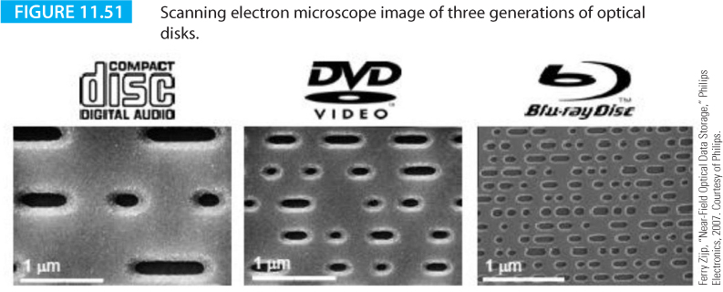
Computer Organization and Architecture: Themes and Variations, 1st Edition Clements
Blu-ray achieves its high storage density of 25 GB (i.e., 5.3 times that of DVD) by using a higher frequency laser with a wavelength of 405 nm. The visible spectrum extends from 620 nm (red) to 450 nm (violet) which means that the Blu-ray laser is blue/violet and hence its name.
The DVD laser is 650 nm (red) and the CD laser at 780 nm falls in the infra-red spectrum. Blue-ray disk are physically different to CDs and DVDs because the Blu-ray data layer is below a front cover layer of only 0.1 mm.
The numerical aperture of lenses used to focus the beam in Blu-ray systems is higher (0.85) than for DVD (0.6) and CD (0.45). Recall that a high numerical aperture allows a smaller spot size.

Slide 125

Computer Organization and Architecture: Themes and Variations, 1st Edition Clements
Like DVD, Blu-ray supports dual-layers to provide a capacity of 50 GB.
Figure 11.51 provides images of the three generations of recording media demonstrating their relative densities.

