Slide 1
Computer Systems Architecture: Themes and Variations
Chapter 7
Processor Control

Slide 2
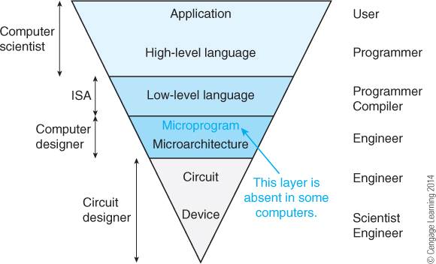
Processor Control
Application Level—The computer appears as a device that performs a function.
High-Level Language The computer appears to be machine independent and executes a high-level language. All computers executing the same language are identical and differ only in terms of performance.
Low-Level Language—The computer is architecture dependent and the machine code will run only on one particular class of computer.
Microarchitecture—This level represents the physical organization of the computer in terms of registers, functional units, and buses. The microarchitecture may be unique to a particular instance of a microprocessor (i.e., two microprocessors share the same low-level language but different microarchitectures). Normally, this level is not accessible by the end user. However, modern programmable logic does allow users to modify the microarchitecture of processors constructed from programmable logic.
This chapter is concerned with the microarchitecture level.
Gate The individual gates that determine the speed of the processor.
Device Physics Level—Device physics is determined by the electronic properties of the material used to fabricate the gates.

Slide 3
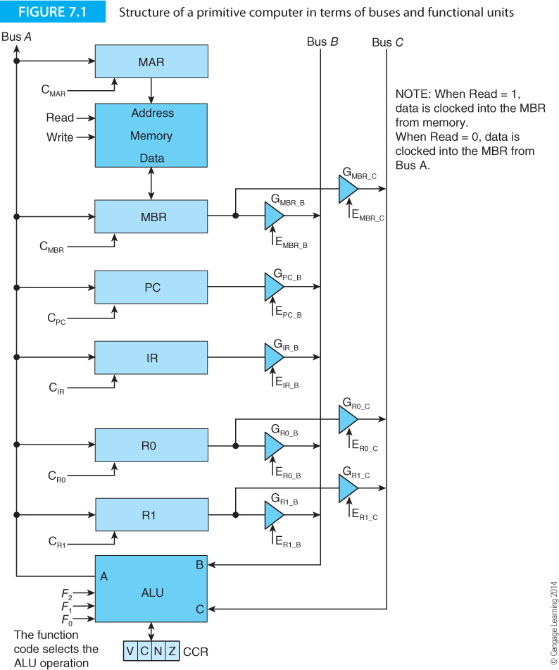
Generic Digital Processor
Figure 7.1 gives the structure of a very simple generic processor. It is intended to demonstrate how an instruction can be read from memory and executed.
Data from registers can be placed on buses A and C by enabling the appropriate tristate gates.
The ALU generates a function of the data on buses A and B and puts the result on bus C.
The registers can be clocked and latch data from bus C.
In order to interpret a machine level operation, all we need do is generate the appropriate sequence of tri-state enables, ALU function codes, and register clocks (as well as memory read or write signals).

Slide 4
Generic Digital Processor
Consider the implementation of the operation LOAD R0,M.
M is a memory location (currently in the instruction register).
E_{IR_B} = 1, F₂,F₁,F₀ = 0,0,0, C_{MAR;} Copy IR to MAR
Read = 1, C_{MBR ;} Read memory
and copy data to MBR
E_{MBR_B} = 1, F₂,F₁,F₀ = 0,0,0, C_{R0 ;} Copy MBR to R0

Slide 5
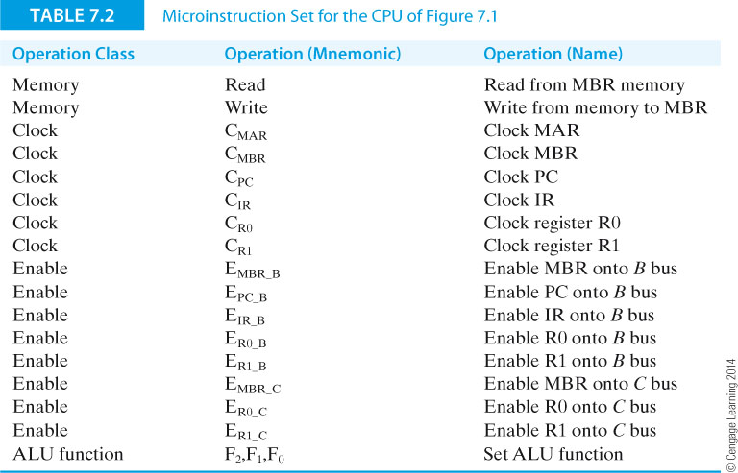
Generic Digital Processor
Table 7.2 describes the microinstructions that have been implemented.

Slide 6
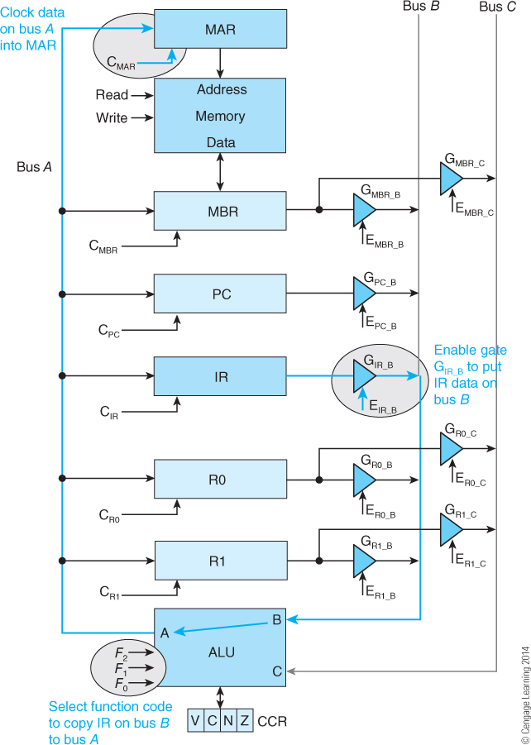
Microprogramming – The Detail
This figure is a copy of Figure 7.1 except that the paths that implement the first microoperation of the load instruction are highlighted. This micro-operation copies the instruction address in the instruction register into the memory address register, where it is used to access the actual instruction from memory. In order to do this, the address must be gated from the IR onto Bus B. Then the ALU function is set to pass through (input P to output R), and finally the memory address register is clocked to capture the address on Bus A.

Slide 7
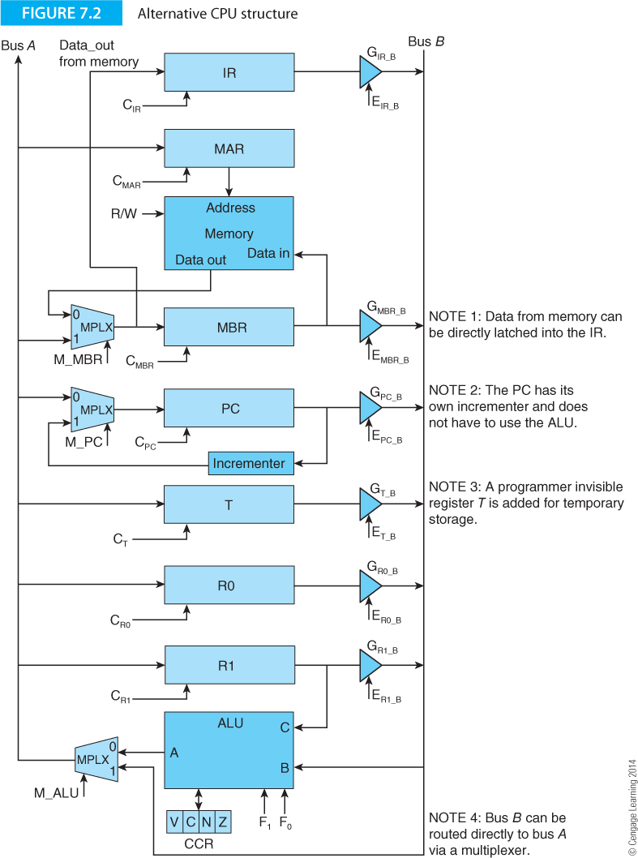
A Second Generic Digital Processor
Figure 7.2 describes the architecture of a system with just two buses.
Note the use of multiplexers to switch data from one of two (or more points) to a single point.
Note also that the PC has been given its own dedicated incremented to avoid using the ALU.

Slide 8
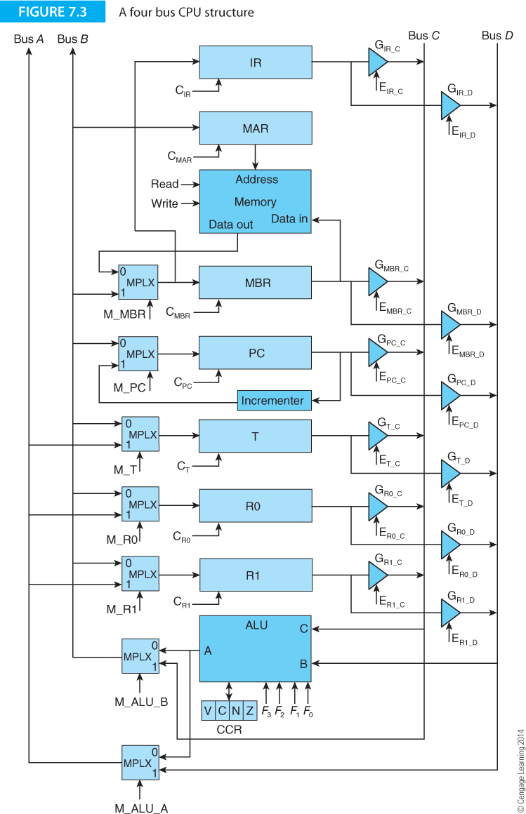
A Third Generic Digital Processor
Figure 7.3 describes the architecture of a system with four buses.
Adding extra buses can increase efficiency (speed) at the cost of complexity.
We have also added a temporary scratchpad register T that can be used to implement more complex instructions that have an intermediate step.

Slide 9
Generating Microinstructions
Figures 7.1 to 7.3 provide primitive computer structures that are controlled by microinstructions (bus enables, register clocks, memory control, and ALU function controls).
We need a method of taking an instruction like ADD R1,R2 that adds register R2 to register R1 and generating the signals necessary to implement this operation.
Because an instruction may require several steps, we need to be able to create sequential signals. In the previous example, we had
Time 0 E_{IR_B} = 1, F₂,F₁,F₀ = 0,0,0, C_{MAR}
Time 1 Read = 1, C_{MBR}
Time 2 E_{MBR_B} = 1, F₂,F₁,F₀ = 0,0,0, C_{R0}
One way of generating these signals is to design a special computer (a microprogram sequencer) whose input of program is a machine-level instruction and whose output is the required sequence of microoperations.

Slide 10
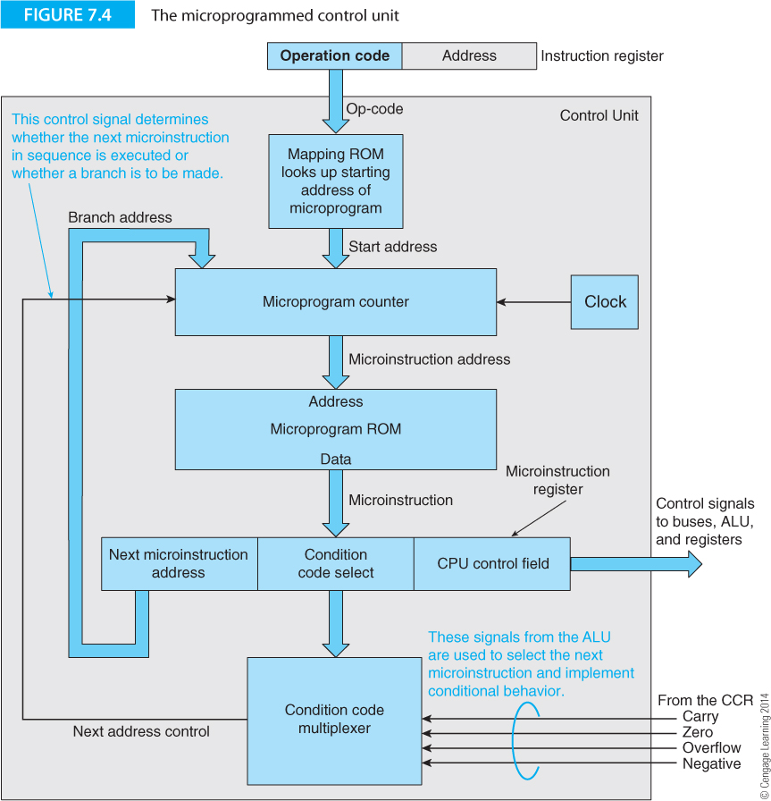
Control Unit
The mapping ROM translates an op-code into the location of the first microprogram instruction of the of the machine instruction being executed.
This is loaded into the microprogram counter and used to select the first microinstruction word (which includes all the control signals).
At each clock pulse the microprogram counter is incremented and the next set of microinstructions generated.
The microinstruction has a next address field that controls sequencing. The next microinstruction may be generated, or a jump to a microsubroutine, or a jump to the next fetch cycle, or a jump to an address conditional on the sate of the CCR.

Slide 11
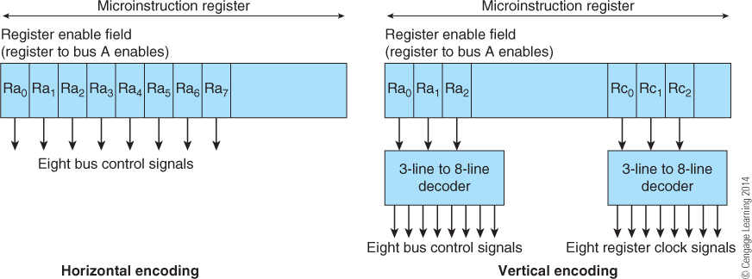
Horizontal and Vertical Microprogramming
In horizontal microprogramming each bit of the microinstruction directly controls the CPU (i.e., register enables, clocks, ALU function).
In vertical microprogramming, various fields of the microinstruction are further decoded by logic or look-up ROMs.
Horizontal microprogramming is faster and more versatile that vertical microprogramming but requires more bits in the control ROM.
Vertical microprogramming is slower and less flexible but has a more compact control ROM.

Slide 12
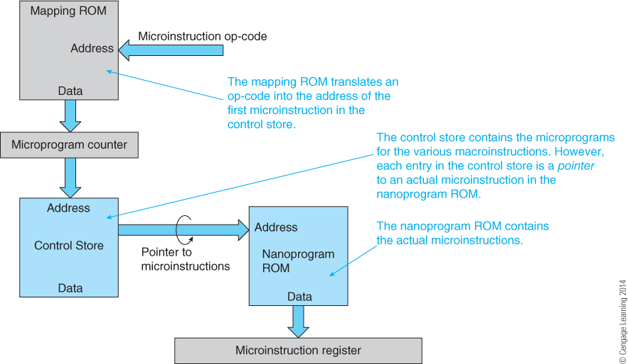
Nanoprogramming
In conventional microprogramming, the microprogram ROM supplies an actual microinstruction word whose bits directly control the CPU.
In nanoprogramming the microprogram ROM contains pointers. Each pointer points to the actual microinstruction in ROM.
Nanoprogramming reduces the size of the microprogram ROM because the pointers are not as wide as microinstructions (typically 8 bits rather than 200). Nanoprogramming works because there are usually only a relatively small number of unique microinstructions.

Slide 13
Nanoprogramming Example
A computer has an 8-bit op-code and 200 unique machine-level instructions, each requiring four 150-bit-wide microinstructions. Only 120 microinstructions are unique.
(a) No nanoprogramming
Two hundred machine-level instructions using four microinstructions = 200 x 4 = 800 microinstructions.
The mapping ROM uses an 8-bit op-code to select one of 800 microinstructions which requires a 256 word x 10-bit ROM (2,560 bits). The mapping ROM is ten bits wide because 2¹⁰ = 1,024.
The control store requires 800 words x 150 bits = 120,000 bits. The total number of bits is the control store plus the mapping ROM = 120,000 + 2,560 = 122,560 bits.
Nanoprogramming
There are 120 unique microinstructions each of which is 150 bits wide in the nanoprogram ROM.
Storage capacity of 120 x 150 = 18,000 bits.
There are 120 unique microinstructions which require a 7-bit address to select one of them (2⁷ = 128). The control store contains 800 microinstructions, each requiring a 7-bit pointer which takes 800 x 7 = 5,600 bits.
The required storage using nanoprogramming is 2,560 bits (mapping ROM) + 5,600 bits (control store) + 18,000 bits (nanoprogram store) = 26,160 bits which reduces the storage by about 80%.

Slide 14
RISC Organization
We now look at the information flow in a RISC processor. Figure 7.5 describes the instruction format of a simple hypothetic RISC (load and store) architecture. Below are some instructions that we will examine.
Assembly form RTL definition
LDR D,(S1,S2) [D] ← [M([S1] + [S2])] Register indirect with double indexing
LDR D,(S1,#L) [D] ← [M([S1] + L)] Register indirect with literal offset
STR (S1,#L),S2 [M([S1] + L)] ← [S2] Register indirect with literal offset
ADD D,S1,S2 [D] ← [S1] + [S2] Register to register
ADD D,S1,#L [D] ← [S1] + L Register to register with literal operand
BEQ L [PC] ← [PC] + 4 + L This is a relative conditional branch
JMP (S1,#L) [PC] ← [S1] + L Jump to a computed address

Slide 15
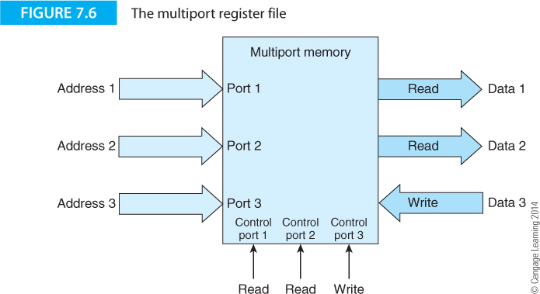
Multiport Register File
One of the key components of a modern processor is its register file.
The register file comprises its user-accessible internal general-purpose register set. This register file has multiple ports allowing multiple reads and (sometimes) writes. For example, the structure of Figure 7.5 may be able to perform two simultaneous register reads and one register write.

Slide 16
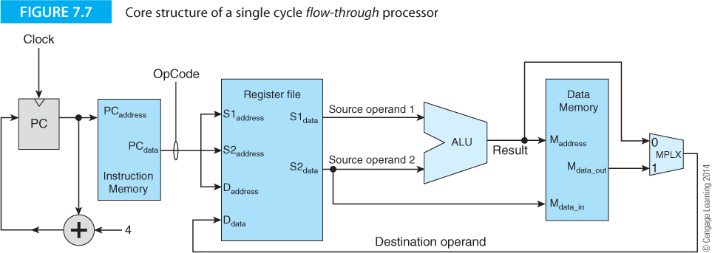
RISC Organization
We begin by describing a flow-through architecture. That is, it is not pipelined and an instruction flows through the processor (starting with the PC).
Assume that the program counter, PC contains the address of the next instruction to be executed.

Slide 17
RISC Organization
The instruction (program) and data memory are shown as separate entities for convenience even though they may be the same memory.

Slide 18
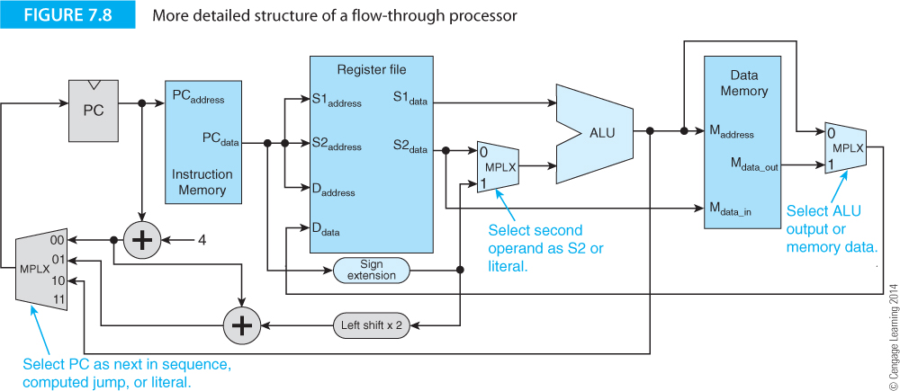
RISC Organization
Figure 7.8 gives a more detailed overview of the processor.
A three-way multiplexer at the PC input allows three sources of next-address.
A multiplexer at the ALU input allows literals to flow to the ALU.

Slide 19
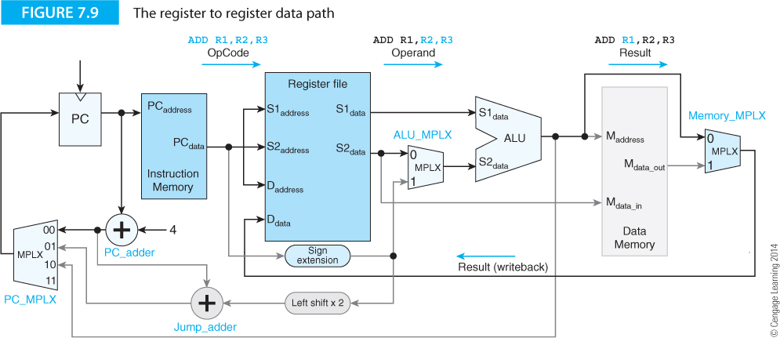
Register-to-register instructions
Figure 7.9 demonstrates the register-to-register instruction data paths.
The instruction use its two source instruction addresses to look up the source operands. These are operated on by the ALU and the result fed back to the register file via the data memory multiplexer.

Slide 20
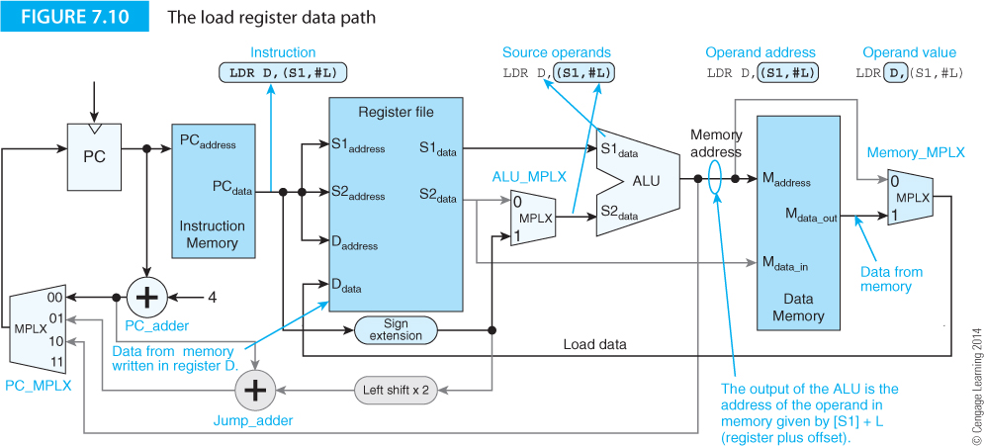
Load register instructions
Figure 7.10 demonstrates the load register instruction data paths
The output of the ALU is a computed address. That accesses data memory. The output of the data memory is fed to the register file via the data memory multiplexer.

Slide 21
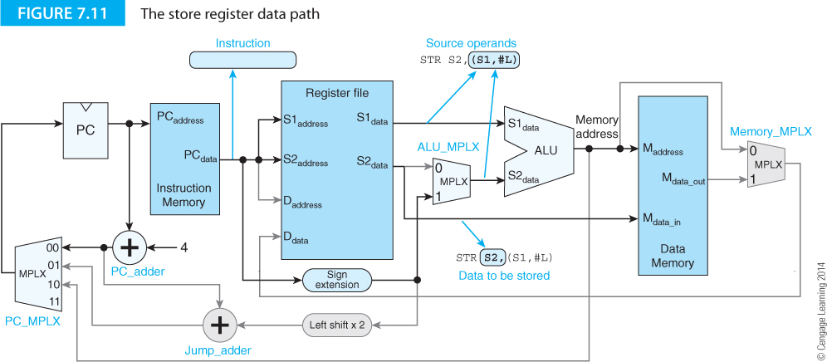
Store register instructions
Figure 7.11 demonstrates the store register instruction data paths
The output of the ALU is a computed address. That accesses data memory. The source 2 output of the register file (the data to be stored) is fed to the memory.

Slide 22
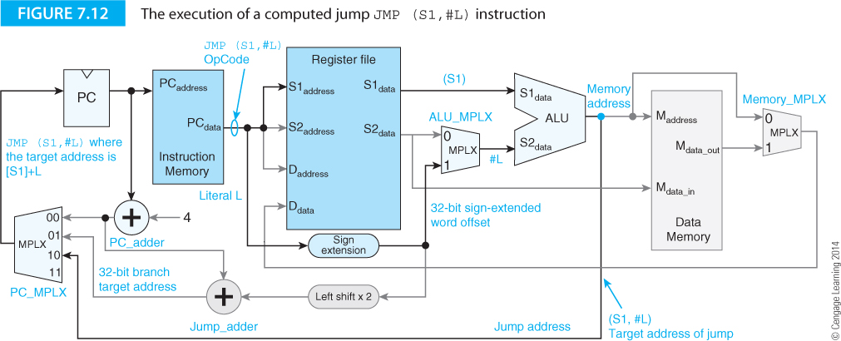
Computed jump instructions
Figure 7.12 demonstrates the computed jump instruction data paths
A computed jump calculates the destination address (S1,#L) by adding the source operand from the register file to a literal from the instruction register. The computed address from the ALU is fed to the program counter via the PC multiplexer.

Slide 23
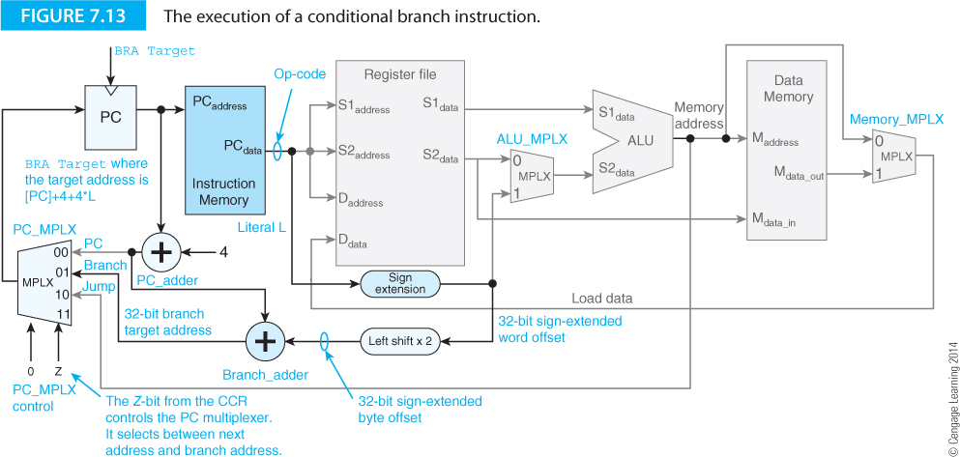
Conditional branch instructions
Figure 7.13 demonstrates conditional branch instruction data paths
A conditional branch instruction uses a relative address. The contents of the program counter are added to the sign-extended and shifted offset in the instruction. This is fed to the program counter via the PC multiplexer. The condition codes are used to determine whether the PC multiplexer supplies the next address or the computed address.

Slide 24
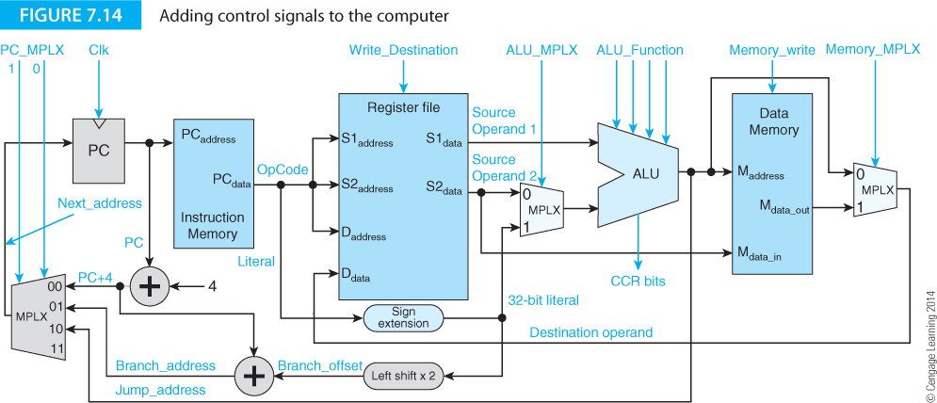
Controlling the computer
Figure 7.14 shows some of the control signals (i.e., microoperation signals) that are needed to control this computer.

Slide 25
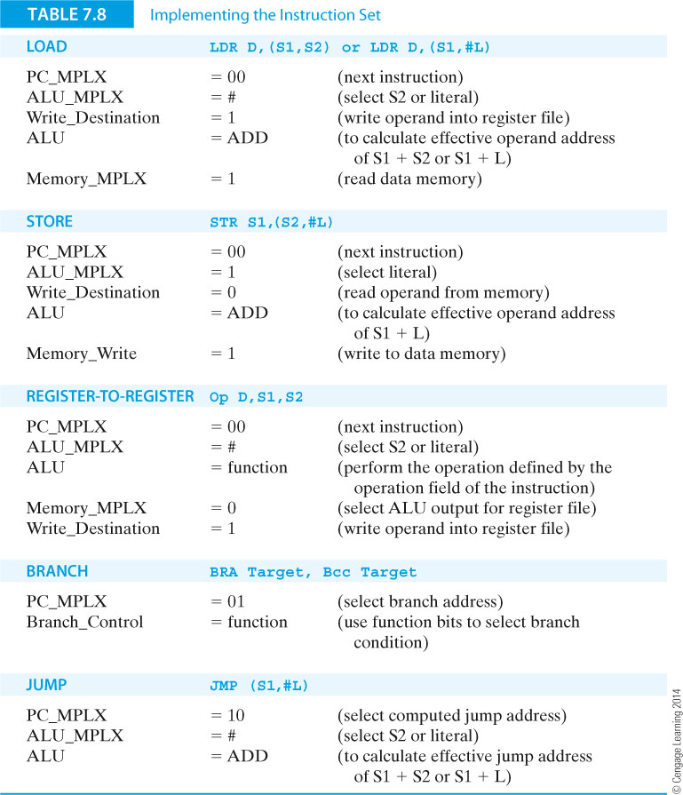
Controlling the computer
Table 7.8 illustrates some of the control signal patterns for this hypothetical computer.

Slide 26
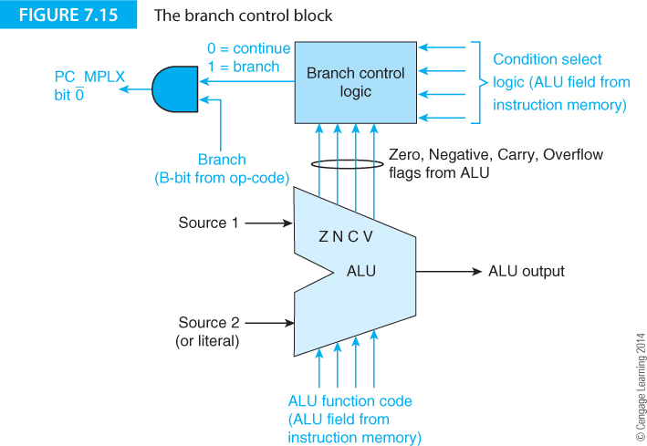
Controlling the computer
Figure 7.15 shows further details of the type of logic that may be used to implement conditional branches.

Slide 27
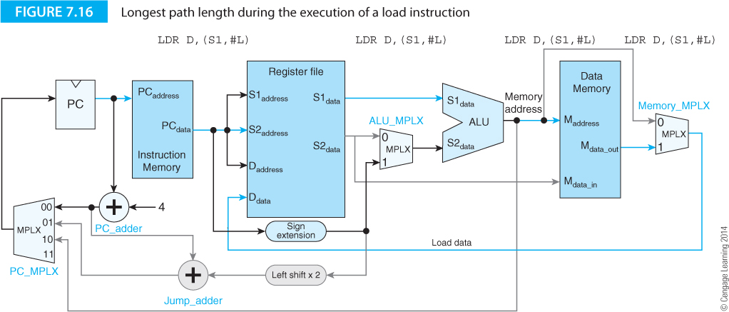
Controlling the computer
Figure 7.14 shows some of the control signals (i.e., microoperation signals) that are needed to control this computer.

Slide 28
Pipelining
Pipelining is the overlapping of instruction execution (i.e., beginning to execute a new instruction before one or more earlier instructions have been executed to completion).
Although once associated with RICS processors, all modern processor are pipelined.

Slide 29
The Classic Model of Instruction execution
The execution of an instruction can be divided into steps of phases; typically 5 (but this can vary from 3 to over 30).
Instruction Fetch—Read the instruction ADD R0,R1,R2 from the system memory and increment the program counter.
Instruction Decode—Decode the instruction read from memory during the previous phase. The nature of the instruction decode phase is dependent on the complexity of the instruction set. A regularly encoded instruction can be rapidly decoded with two levels of gating, whereas a complex instruction format might require ROM-based look-up tables to implement the decoding.
Operand Fetch—The operands specified by the instruction are read from registers R1 and R2 in the register file and latched into flip-flops.
Execute—The operation specified by the instruction is carried out.
Operand Store—The result of the execution phase is written into the operand destination. This may be an on-chip register or a location in external memory. In this case the result is stored in register R0.

Slide 30
Pipelining
Examples of the pipeline states of two early RISC processors. Consecutive instruction execution is shown. Note how overlap occurs.
The RISC I pipeline overlapped the instruction fetch phase with the operand fetch, execute and operand store phase of the previous instruction. As you can see, this overlap potentially doubles the speed of the processor at the same clock rate.

Slide 31
Pipelining
Figure 7.20 demonstrates pipelining with five stages.
When the pipeline is full, up to five instructions can be in the pipeline and a potential fivefold increase in speed possible.
Once the pipeline is full, an instruction is completed every clock cycle.

Slide 32
Pipelining
Figures 7.22 and 7.32 demonstrate two pipeline structures.
Figure 7.22 also demonstrate that it is possible to have multiple pipes with one for each class of instruction.

Slide 33
Pipelining Speedup
If a pipeline has n stages and executes i instructions, the speed up (speed increase relative to no pipeline) is given by
As the length of the stream of instructions increases, the value S approaches n; that is the speedup is proportional to the number of stages.

Slide 34
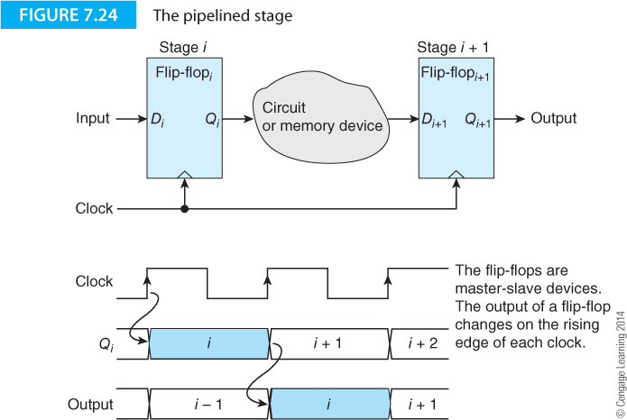

Slide 35
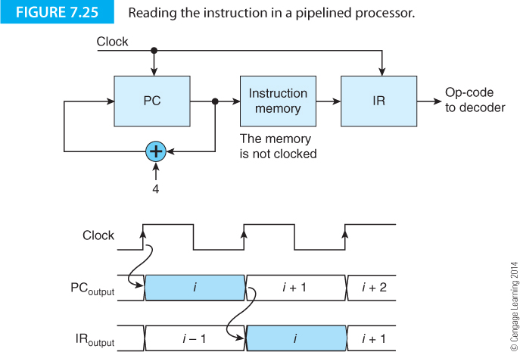
Implementing pipelining
The key to pipelining is to construct a barrier between the stages of the pipeline that holds the incoming data constant during the current clock cycle .
Figure 7.25 illustrates this concept. A register is placed at the output of the instruction memory. When the program counter is clocked, a new PC value appears at its output to access memory and retrieve the next instruction. On the next clock cycle, that instruction is latched in the instruction register while the next PC value is looking up the next instruction.

Slide 36
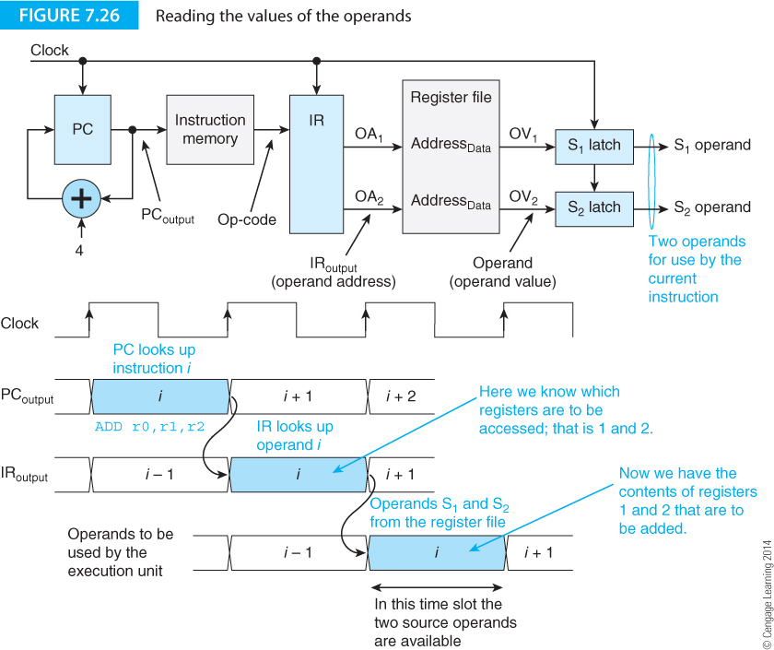
Implementing pipelining
Figure 7.26 extends the pipeline to include the register file and operand latches.

Slide 37
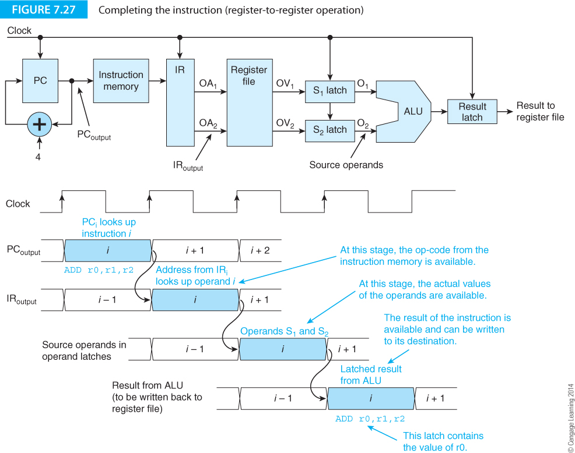
Implementing pipelining
Figure 7.27 extends the pipeline to include the ALU and result latch.

Slide 38
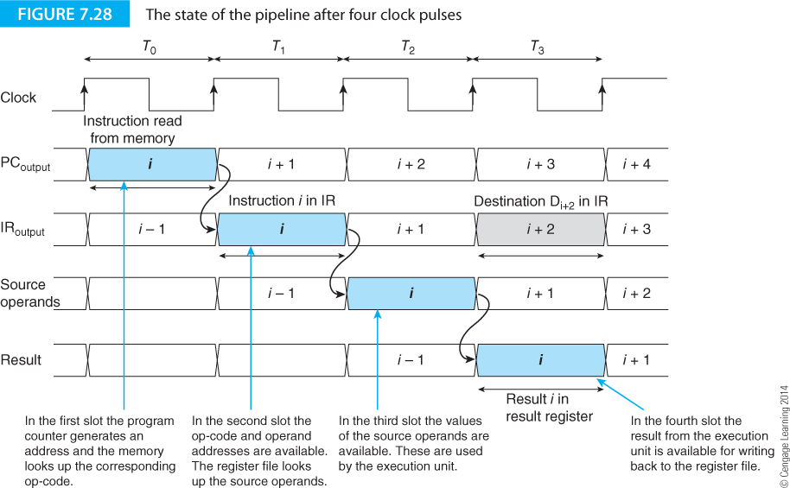
Implementing pipelining
Figure 7.28 shows the timing diagram of the execution of an instruction which is completed in four clock cycles.

Slide 39
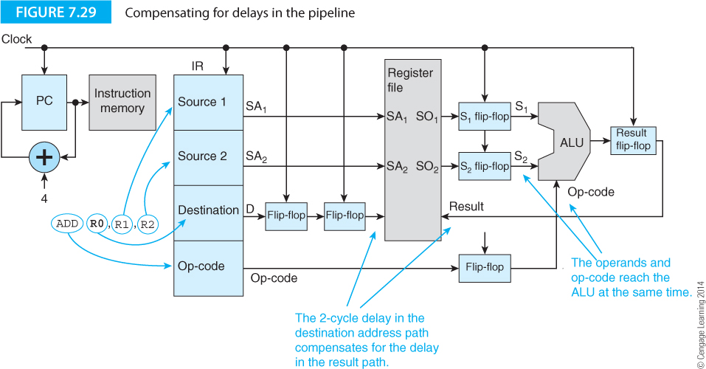
Implementing pipelining
The pipelined structures we has described have a flaw that needs fixing. Information travels down the pipeline at different rates. Operands do not get to the ALU until one clock after the op-code (because the operands have to be looked up in the register file).
It is necessary to delay the op-code from the IR with a latch.
Similarly the destination operand address has to be delayed by two clocks.

Slide 40
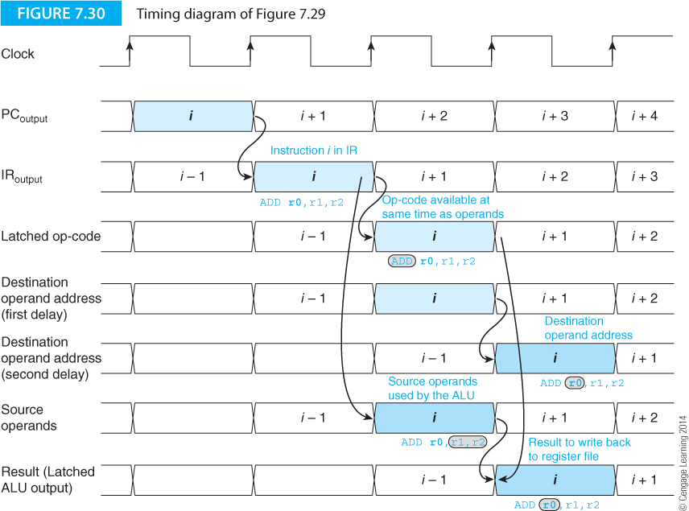
Implementing pipelining
Figure 7.30 demonstrates the effect of delaying the op-ci
ode and the operand destination address.

Slide 41
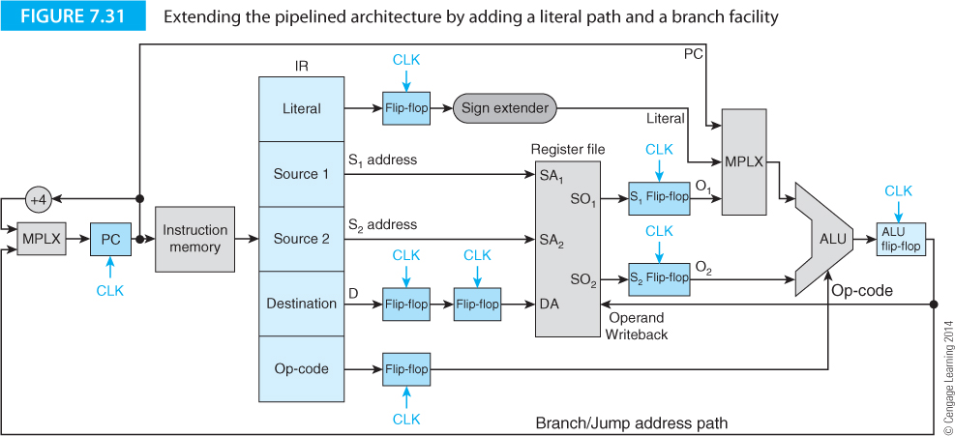
Implementing pipelining
Figure 7.31 shows how a literal path can be added to allow literal operands. A sign extender extends literals to 32 bits and a multiplexer chooses between a literal, the PC, or a memory operand as an input to the ALU.
Computed branching is supported via a path from the destination register to the PC.

Slide 42
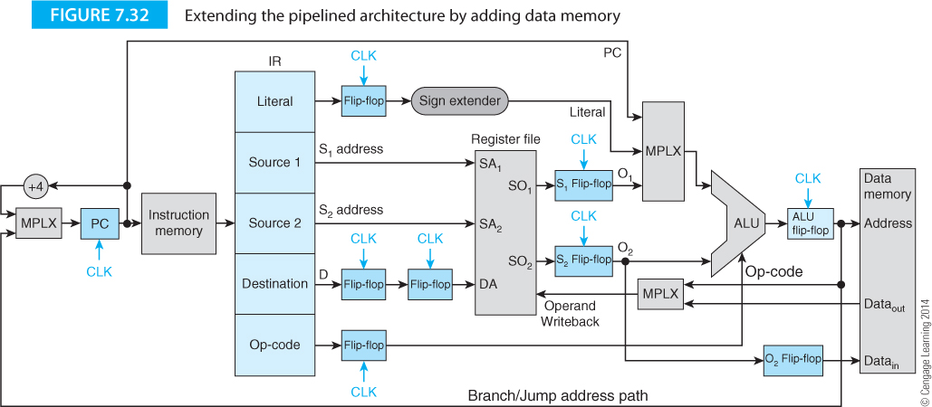
Implementing pipelining
Figure 7.32 extends the processor to include external memory.

Slide 43
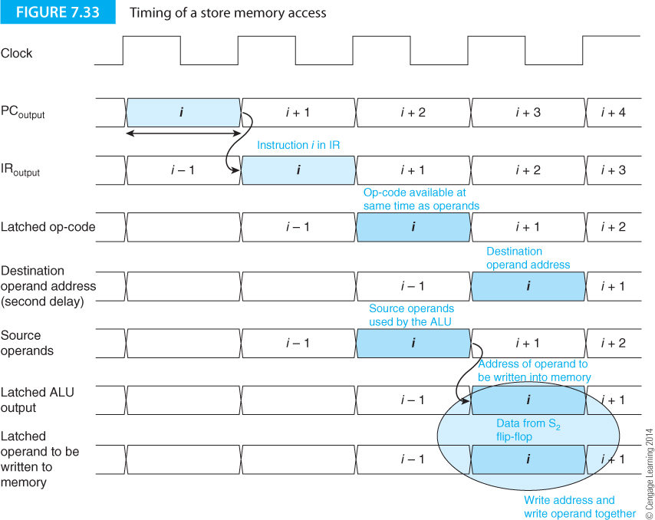

Slide 44
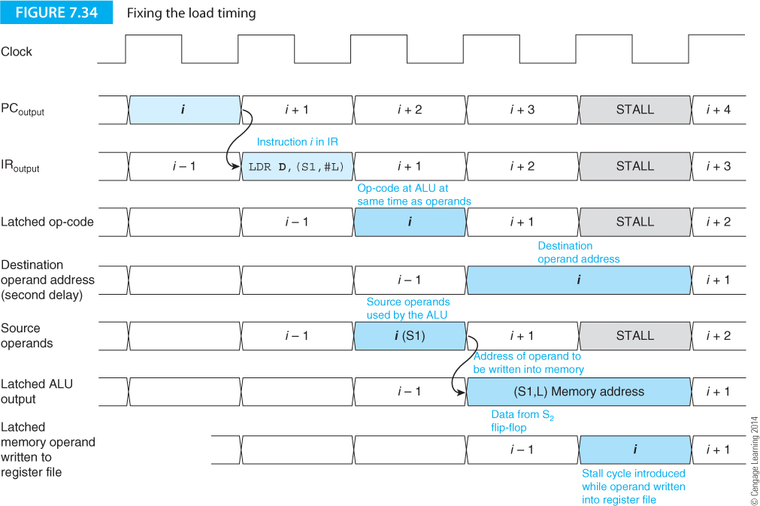

Slide 45
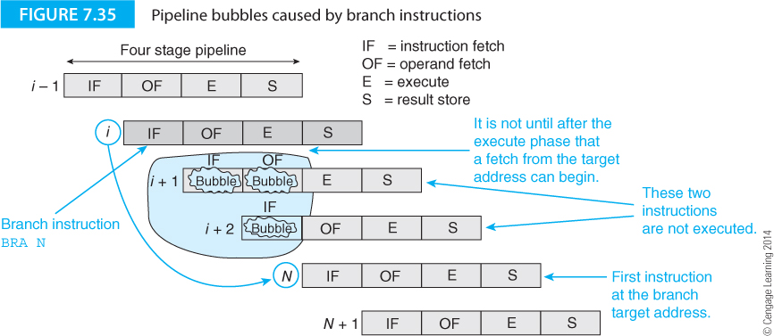
Pipelining – the problems
Pipelining comes at a price.
Consider the four state pipeline of Figure 7.35 where an unconditional BRA N instruction changes the flow of control.

Slide 46
Pipelining – the problems
After the BRA N instruction has been read into the pipeline, it is not until the third instruction that the new target address N has been accessed. The previous two instructions, i+1 and i+2 have been drawn into the pipeline needlessly.
This constitutes a bubble and two clock cycles are wasted.
The branch instruction (and other instructions that have a similar effect) degrade the performance of all pipelined computers and the theoretical maximum performance of one cycle per instruction cannot be reached.

Slide 47
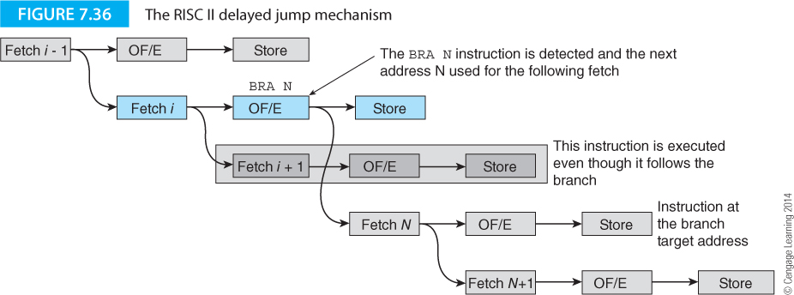
Delayed branches
One way of reducing the effect of pipeline bubbles is called the delayed branch.
The instruction following a branch is always executed. This means that one of the lost time slots is used. However, it is efficient only if an instruction can be found to fill the delay slot.
Delayed branching is less popular today because it is more difficult to implement in superscalar processors where instructions are executed out-of-order.
Figure 7.36 illustrates the delayed branch concept.

Slide 48
Data Hazards
Data dependency arises when the outcome of the current operation is dependent on the result of a previous instruction that has not yet been executed to completion. Data hazards arise because of the need to preserve the order of the execution of instructions. Consider the following fragment of code.
ADD R2,R1,R0 [R2] ← [R1] + [R0]
SUB R4,R5,R6 [R4] ← [R5] - [R6]
AND R9,R5,R6 [R9] ← [R5] . [R6]
This code does not present any data hazards. In fact, you could change the order of the instructions or even execute them in parallel without changing the meaning (semantics) of the code.

Slide 49
Data Hazards
RAW Read after write (also called true data dependency)
WAW Write after write (also called output dependency)
WAR Write after read (also called anti data dependency)
Here, we are interested in RAW hazards where an operand is read after it has been written.

Slide 50
Data Hazards
Consider
X = (A + B)AND(A + B - C)
Assuming that A, B, C, X and two temporary values, T1 and T2, are in registers, we can write
ADD T1,A,B ;[T1] ← [A] + [B] ;T1 will not be available for 4 cycles
SUB T2,T1,C ;[T2] ← [T1] - [C] ; T1 has not yet been generated
AND X,T1,T2 ;[X] ← [T1] . [T2] ; T2 has not yet been generated

Slide 51
Data Hazards
Consider
X = (A + B)AND(A + B - C)
Assuming that A, B, C, X and two temporary values, T1 and T2, are in registers, we can write
ADD T1,A,B ;[T1] ← [A] + [B] ;T1 will not be available for 4 cycles
SUB T2,T1,C ;[T2] ← [T1] - [C] ; T1 has not yet been generated
AND X,T1,T2 ;[X] ← [T1] . [T2] ; T2 has not yet been generated

Slide 52
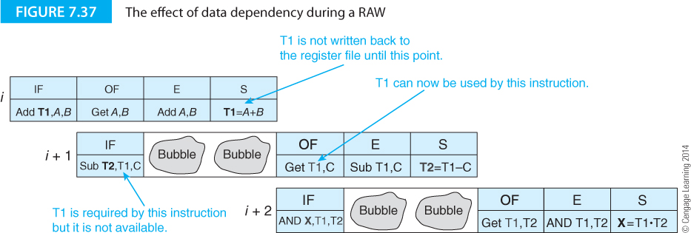
Data Hazards
ADD T1,A,B ;[T1] ← [A] + [B] ;T1 will not be available for 4 cycles
SUB T2,T1,C ;[T2] ← [T1] - [C] ; T1 has not yet been generated
AND X,T1,T2 ;[X] ← [T1] . [T2] ; T2 has not yet been generated

Slide 53
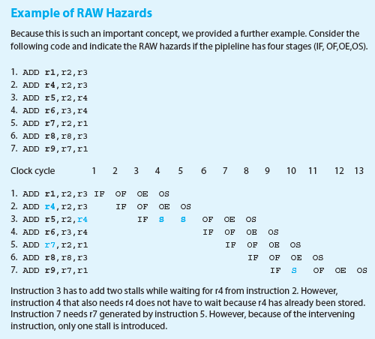

Slide 54
Write after read (WAR)
This is not a n issue with pipelined processors. Consider the following sequence.
ADD R1,R2,R3
SUB R2,R4,R5
R2 is read early in cycle I and written to late in cycle i+1. There is no dependency.

Slide 55
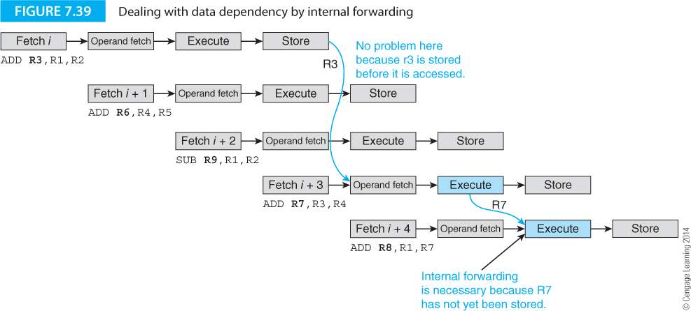
Internal forwarding
1. ADD R3,R1,R2 ;[R3] ← [R1] + [R2]
2. ADD R6,R4,R5 ;[R6] ← [R4] + [R5]
3. SUB R9,R1,R2 ;[R9] ← [R1] - [R2]
4. ADD R7,R3,R4 ;[R7] ← [R3] + [R4] RAW hazard R7 is by next instruction
5. ADD R8,R1,R7 ;[R8] ← [R1] + [R7]
Internal forwarding is a technique used to forward an operand to its destination as soon as it is generated, rather than writing it to memory and then reading it back.

Slide 56
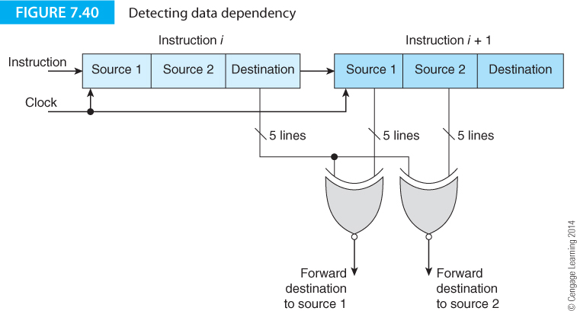
Internal forwarding
Conceptual logic used to detect RAW data dependencies.

Slide 57
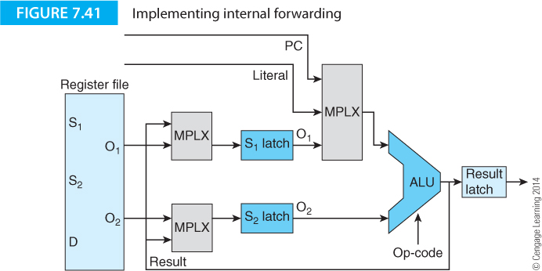
Internal forwarding
Additional logic required to implement internal forwarding.

Slide 58
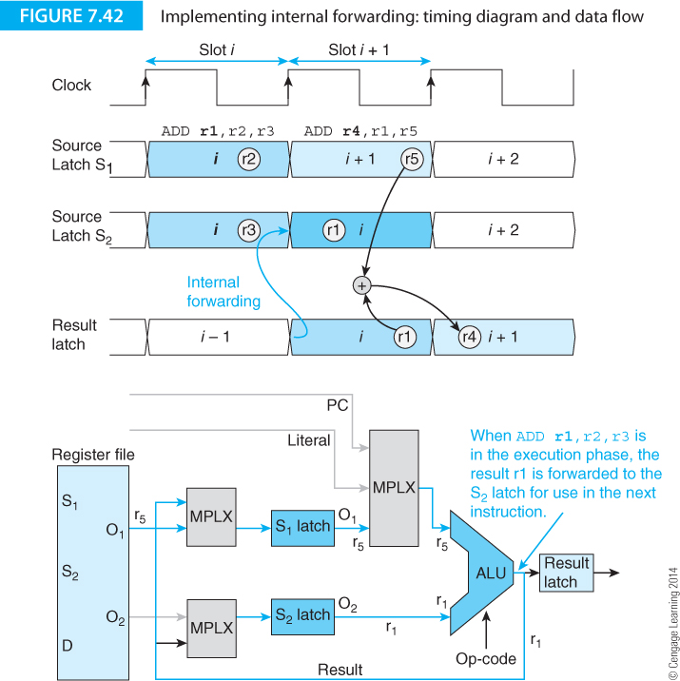
Internal forwarding
Timing of internal forwarding.

Slide 59
Branches and the Branch Penalty
We need to understand the cost of branches before we begin to look for ways of reducing their impact. The cost of a branch is measured in terms of the lost cycles created by a branch.
ISSUES
Branch direction (forward or backward)
Type (conditional or unconditional)
Compile time and run time (number of branches in the code vs. the number execute in a run)

Slide 60
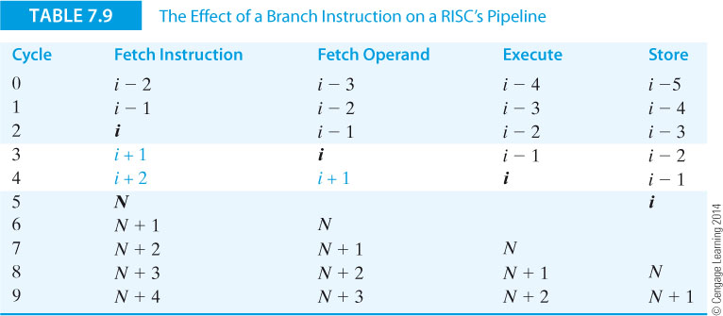
Branches and the Branch Penalty
Table 7.9 illustrates the effect of a branch (taken) on the pipeline

Slide 61
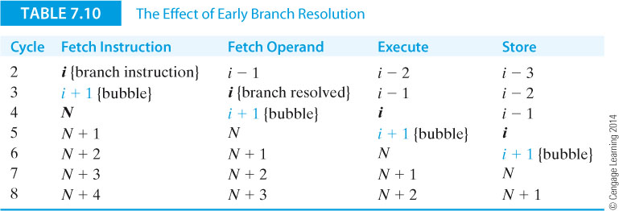
Branches and the Branch Penalty
Table 7.10 demonstrates early branch resolution. The branch is detected during the operand fetch phase and the target instruction fetched in the next cycle. Only one cycle is lost.
Clearly, the early the early detection/resolution of a branch is important.

Slide 62
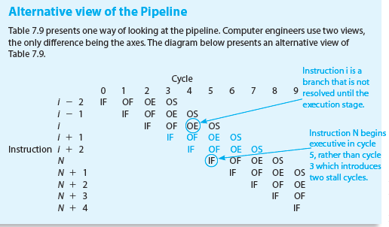

Slide 63
The cost of branches
Assume:
Each non-branch instruction is executed in one cycle.
2. The probability that a given instruction is a branch is p_{b}.
3. The probability that a branch instruction will be taken is p_{t}.
4. If a branch is taken, the additional penalty is b cycles.
5. If a branch is not taken, there is no penalty and only 1 cycle is required.

Slide 64
The cost of branches
The probability that an instruction is not a branch instruction is 1 - p_{b}.
The average number of cycles required by an instruction during the execution of a program is the sum of the cycles taken for non-branch instructions, plus the cycles taken by branch instructions that are taken, plus the cycles taken by branch instructions that are not taken.
T_{ave} = (1 – p_{b})·1 + p_{b}·p_{t}·(1 + b) + p_{b}(1 – p_{t})·1 = 1 + p_{b}p_{t}b.
If we replace p_{b}p_{t} by p_{e} (the effective probability of a branch), the average number of cycles per instruction is given by 1 + p_{e}b. The efficiency of a RISC processor can be defined as:

Slide 65
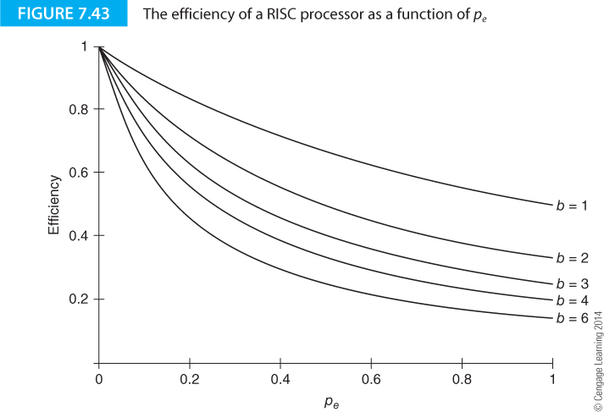
RISC efficiency as a function of effective branch probability.
Note that efficiency drops off rapidly at the effective probability of a branch increases from 0.

Slide 66
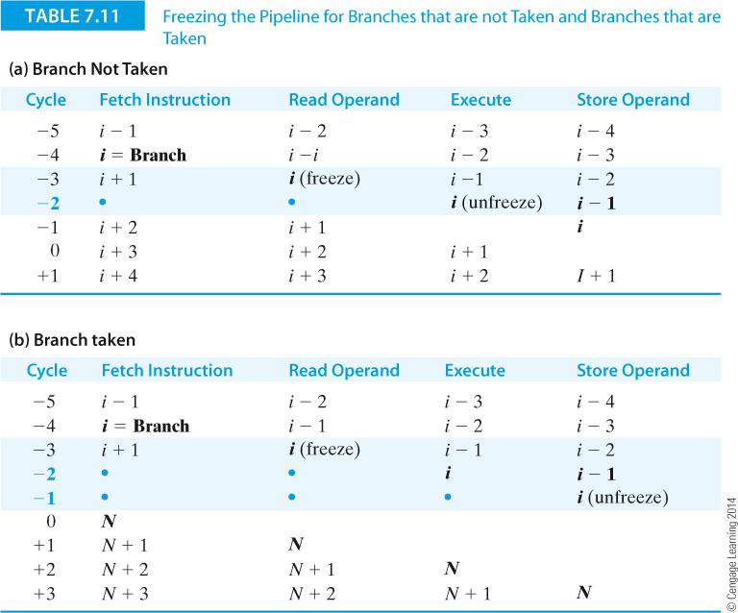
Dealing with branches – taken and not taken
Table 7.11 shows the effect of freezing the pipeline when a branch is detected and then unfreezing when it is resolved as taken or not taken.

Slide 67
Dealing with branches – taken and not taken
Table 7.12 demonstrates the effect of the delayed branch,
When a branch is not taken, the branch penalty is zero because instruction i+1 is executed and the pipeline is not held up assuming the pipeline is not frozen. When a branch is taken, only two cycles are lost because instruction i+1 is always executed.
T_{ave} = 1·(1 – P_{b}) + 1·P_{b}(1 – P_{t}) + 3·P_{b}P_{t} = 1 + 2·P_{b}P_{t}.

Slide 68
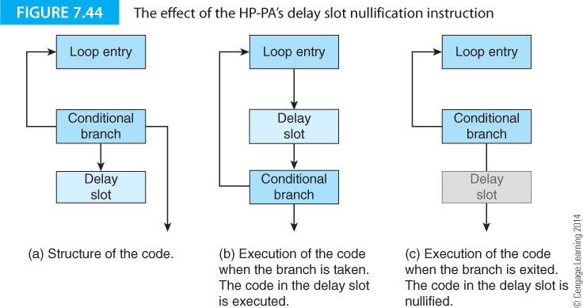
Example of dealing with branches
Figure 7.44 demonstrates the HP-PA processor’s slot demonstrates the effect of its delayed branch mechanism. An instruction in the delay slot at the end of the loop is executed as part of the loop. When an exit is made, the instruction is not executed.

Slide 69
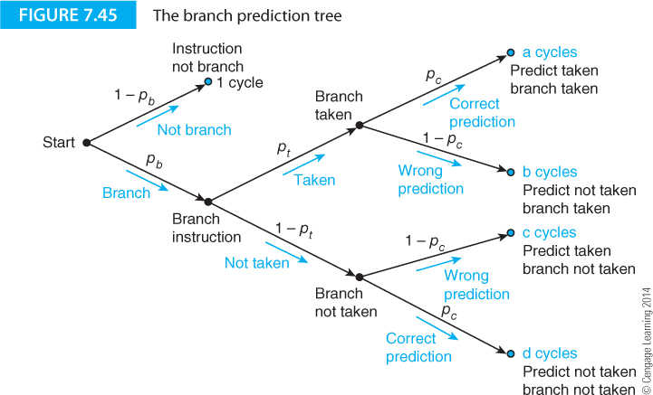
Branch prediction
Suppose we predict whether a branch is going to be taken. If we predict not taken, we can continue normally. If we predict taken we can fetch the instruction at the target address. Figure 7.45 provides the probability tree for branching with prediction.

Slide 70
(1 – p_{b}) = probability that an instruction is not a branch.
(1 – p_{t}) = probability that a branch will not be taken.
(1 – p_{c}) = probability that a prediction is incorrect.
Average cycles per branch is given by following each path through the trellis from the start and multiplying the probabilities and cost together, and then summing all paths,
C_{ave} = a⋅(p_{t}⋅p_{c}) + bp_{t}⋅(1 – p_{c}) + c⋅(1 – p_{t})⋅(1 – p_{c}) + d⋅(1 – p_{t})⋅p_{c}

Slide 71
Assume a = d = N and b = c = B
(1 – p_{b}) + p_{b}·(N·p_{t}·p_{c} + B·p_{t}·(1 – p_{c}) + B·(1 – p_{t})·(1 – p_{c}) + N·(1 – p_{t})·p_{c})
= (1 – p_{b}) + p_{b}·(N·p_{c} + B·(1 – p_{c})).
Assume no penalty for a correct prediction (i.e., N = 1), we get:
(1 – p_{b}) + p_{b}·(1·p_{c} + B·(1 – p_{c})).

Slide 72
Static and Dynamic prediction
Static prediction always makes the same decision for a given type of branch. Some architectures have a bit in the op-code that is set/cleared by the compiler to tell the processor whether to assume taken or not taken.
Static prediction means that a given branch instruction is always treated in the same way and the same prediction made.
Dynamic prediction uses a learning mechanism that adopts to the current environment; that is, the predictor observes the execution of the code and continually updates its decision (take or not take).

Slide 73
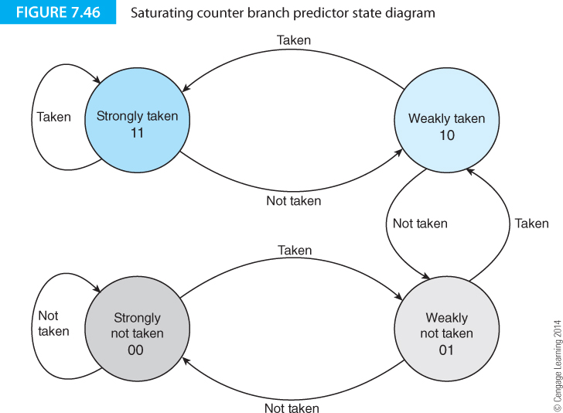
Dynamic prediction
Figure 7.46 illustrates a simple dynamic branch predictor. This has four states and the decision to take a branch or not take it is based on the current state.
The actual outcome of a branch is used to determine the next state.

Slide 74
Dynamic prediction
This is a saturation counter. That is it counts up from state 0 to 1 to 2 to 3.
In state 0 it can either stay in state 0 or move to state 1.
In state 3 it can move dawn to state 2 or stay in state 3.
A taken branch causes to state machine to increase the state and a not-taken branch causes the state machine to decrease the state.

Slide 75
Dynamic prediction
When the state machine is in states 00 and 01 it predicts branch not taken and when in states 01 and 11 it predicts branch taken.
The following example gives a sequence of actual branches and the corresponding next state. Assume that the initial state of the system is 00.
Branch N N N T N T T T
Next state 00 00 00 01 00 01 10 11

Slide 76
Dynamic prediction
Branch N N N T N T T T
Next state 00 00 00 01 00 01 10 11
This state machine has a memory and it does not change its prediction when there is on anomalous branch.
If the sequence is T T T N T T, the not taken branch does not change the direction of the prediction.

Slide 77
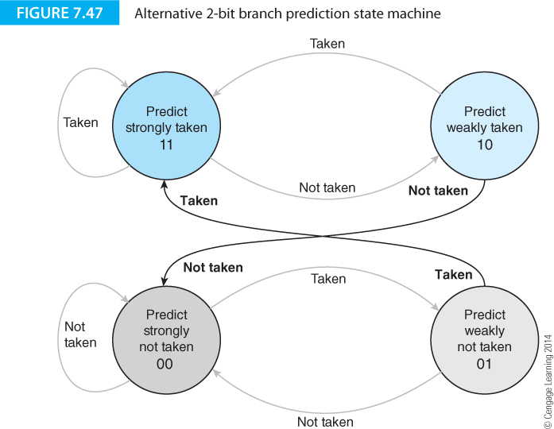
Other state machines
Many possible state machines can be used to predict branch direction. Figure 7.47 demonstrate one of the possible variations.

Slide 78
The magic of branch prediction
Branch prediction mechanisms (and there are many) are heuristic rather than analytic. It is not, in general possible to predict branch outcomes in all cases.
In a program that runs without interruption using a simple loop that is executed many times, prediction is simple and reliable. In a system with complex operating system interactions, complex software and multiples branches, the situation is not so simple.
It seems intuitive to suggest that a branch prediction mechanism should take account of the locality of a branch (where it is in the program) and its past behavior (history).
The very simple state machine we have described is a bases only on branch history for all branches wherever they occur.

Slide 79
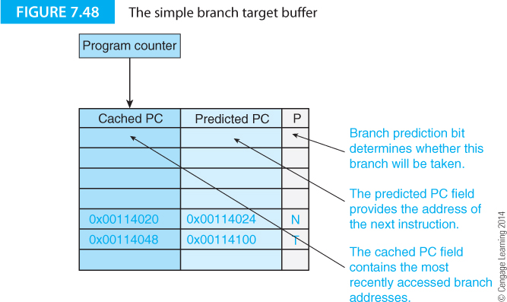
The Branch Target Buffer
The branch target buffer keeps a record of recent branch decisions. It may take the form of a simple shift register that records taken/not taken, or it may be in a the more sophisticated form of a cache memory. A cache memory holds frequently accessed data items.

Slide 80
The Branch Target Buffer
Table 7.14 illustrates the operation of the branch target buffer.
Table 7.14a shows the timing when the outcome of a branch is correctly predicted. The cached next address can be used to fetch the next without having to wait for the outcome of the branch or the calculation of the target address. Consequently, there is no branch penalty.

Slide 81
The Branch Target Buffer
Figure 7.48 illustrates a branch target buffer. Branch addresses are cached. Only a small number of branches can be cached. Old branches have to be ejected once the cache is full.
The PC address is applied to the BTB. If a hit occurs (i.e., the address has been cached), the BTB supplies the predicted target address. This may be the next sequential address (predict not taken) or the target address (predict taken).

Slide 82
The Branch Target Buffer
Figure 7.49 illustrates an extension of the branch target buffer.
As well as caching the predicted target address, the actual op-code at the mispredicted address is included.
If a misprediction is made, the PC has to be reloaded. However, the op-code at the mispredicted address is immediately available for execution.

Slide 83
Branch pattern history
Figure 7.50 illustrates the concepts of a branch pattern history
A branch is detected and its outcome, taken or not taken is fed into a shift register.
The word in the shift register corresponds to the recent branch pattern history. This can be used to predict the outcome of the next branch.
Note that the branches can be anywhere in the code.

Slide 84
Using the branch pattern history
Figure 7.51 uses the branch pattern history to index in a table. The table contains an array of simple 2-bit saturating counter state machines.
In this example, the previous three branches have been taken, not taken, taken. This indexes into entry 101 of the array of state machines. That state machine is used to predict the branch outcome and is then updated accordingly.

Slide 85
Two-axis branch prediction
A more sophisticated branch prediction technique uses two axes: the branch pattern history and the position of the branch in the code. Figure 7.52 illustrates this concept.
Here there are four columns of 2-bit state machines. The actual column is selected by the branch pattern history (only 4 used here for convenience).
The row is selected by the location of the branch in the program. In this case it is the three-least significant bits of the instruction address.

Slide 86
Two-axis branch prediction
Note the complexity of the arrangement. The predication of the outcome of a branch depends on the branch pattern history, the location of the branch in the program, and the current state of the corresponding state machine.
Moreover, any location in the matrix can be accessed by many different patterns of computer activity as the branch pattern history and location information are not unique.

Slide 87
Two-axis branch prediction
There are many variations on a theme of branch prediction. Figure 7.53 illustrates some of the basic concepts.
The outcome of a branch may be predicted on a global or local basis. The branch pattern history is global if it is the history of all possible branches. It is local if it is the history of a specific branch.

