Slide 1


Chapter 9
Computer Organization and Architecture: Themes and Variations, 1st Edition Clements
Computer Systems Architecture

Slide 2
Computer Organization and Architecture: Themes and Variations, 1st Edition Clements
Cache Memory and Virtual Memory

Slide 3
Computer Organization and Architecture: Themes and Variations, 1st Edition Clements
Cache Memory
Cache memory is one of the simplest notions in computing.
You place your most-frequently accessed data in very fast memory, the cache.
When the computer accesses this data, it retrieves it far more rapidly than data in the main store.
Cache memory is located within microprocessors or on the motherboard. It is managed automatically by the electronics of the motherboard.
However, users need to be aware of the consequences of using cache memory (i.e., how to optimize its use).

Slide 4
Computer Organization and Architecture: Themes and Variations, 1st Edition Clements
Virtual Memory
Virtual memory systems map addresses generated by the VPU onto the available memory space and free the programmer from worrying about where to put data.
When a request is made for data that is not in memory, the virtual memory system locates it on disk and moves it to memory. As in the case of cache, this process is invisible to the programmer.
The translation of CPU addresses into actual memory addresses is performed by hardware within the CPU. The management of virtual memory is one of the principle functions of the operating system.

Slide 5
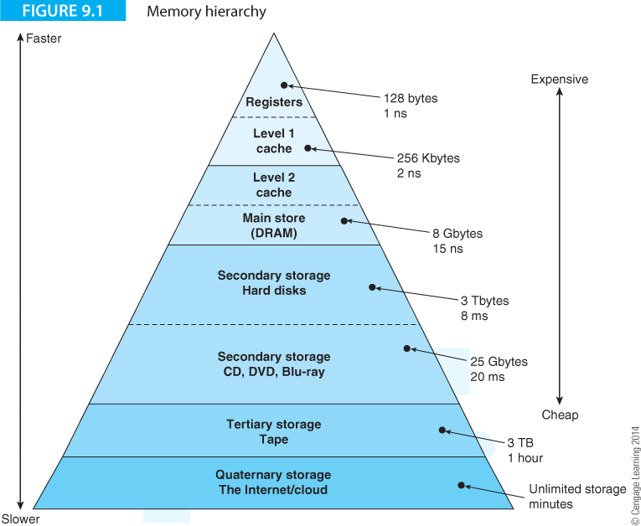
Computer Organization and Architecture: Themes and Variations, 1st Edition Clements
Memory Hierarchy
No aspect of a computer is as wide-ranging as memory. The access time of the slowest memory is 10¹² times slower than that of the fastest. Similarly, the cost per bit and the density of memory technologies also cover very wide ranges.

Slide 6
Computer Organization and Architecture: Themes and Variations, 1st Edition Clements
Figure 9.1 illustrates the memory hierarchy in a computer, with fast, expensive and low quantity registers at the top and large, slow, cheap mass storage at the bottom.

Slide 7
Computer Organization and Architecture: Themes and Variations, 1st Edition Clements
Cache and virtual memory is all about making the memory hierarchy appear as a large fast memory.

Slide 8
Computer Organization and Architecture: Themes and Variations, 1st Edition Clements
History of Cache Memory
Cmemory was proposed by Maurice Wilkes and Gordon Scarott in 1965. Cache memory was in use in the 1970s..
In the early days of microprocessors, cache memories were small or non-existent. The Motorola 68020 had a 256 byte instruction-only cache that improved the execution time of small loops. Motorola’s 68030 had 256-byte split instruction and data caches, and the 68040 had two 4096-byte caches.
In the Intel world, the 80386 used off-chip cache. The 80468 had an 8 KB on-chip cache. 80486-based systems introduced second level L2 265 KB caches of on the motherboard. Intel’s Pentium Pro included L2 cache in the same package as the processor (i.e., in the CPU housing but not on the same silicon die). By 2010 Intel was producing i7 chips with 8 MB of on-chip cache (although Intel’s Xeon had 16 MB of L2 cache when it was launched in 2008).
Intel’s quad-core Itanium processor 9300 series had a 24 Mbyte L3 cache in 2010. To put this into context, the Itanium cache has 24 times the total memory of first-generation PCs.

Slide 9
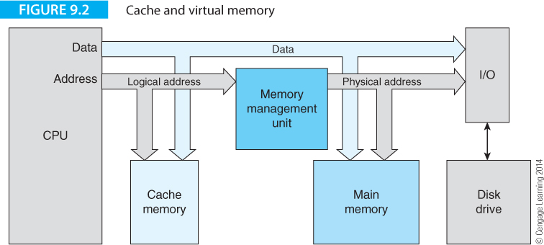
Computer Organization and Architecture: Themes and Variations, 1st Edition Clements
Figure 9.2 illustrates the notion of cache and virtual memory.
An address from the CPU goes to the fast cache memory which tries to access the operand.
If the data is in the cache, it is accessed from the cache.
If the data is in the slower main memory, it is loaded both into the computer and the cache.

Slide 10
Computer Organization and Architecture: Themes and Variations, 1st Edition Clements
Sometimes, the data isn’t in main memory; it’s on the hard disk.
When the data is on disk, the virtual memory mechanism copies it from disk to the main memory.
The data that is transferred from disk to main memory may go almost anywhere in the main memory. The memory management unit, MMU, translates the logical address from the computer into the physical address of the data.

Slide 11
Computer Organization and Architecture: Themes and Variations, 1st Edition Clements
Importance of Cache Memory
It is impossible to over stress the importance of cache memory in today’s world. The ever widening gap between the speed of processors and the speed of DRAM has made the use of cache mandatory.
Suppose a high-performance 32-bit processor has a superscalar design and can execute four instructions per clock cycle at 1,000 MHz (i.e., a cycle time of 1 ns). In order to operate at this speed, the processor requires 4 x 4 = 16 bytes of data from the cache every 1 ns.
If data is not in cache and it has to be fetched from 50 ns DRAM memory over a 32-bit bus, it would take 4 x 50 ns = 200 ns to fetch four instructions.
This corresponds to the time it would normally take to execute 4 x 200 = 800 instructions.

Slide 12
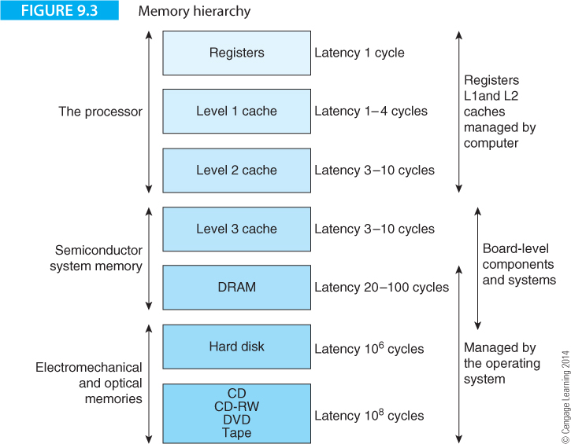
Computer Organization and Architecture: Themes and Variations, 1st Edition Clements
Figure 9.3 provides another illustration of the memory hierarchy.
Times are given in terms of the fundamental clock cycle time.

Slide 13
Computer Organization and Architecture: Themes and Variations, 1st Edition Clements
Figure 9.3 provides another illustration of the memory hierarchy.
Times are given in terms of the fundamental clock cycle time.

Slide 14
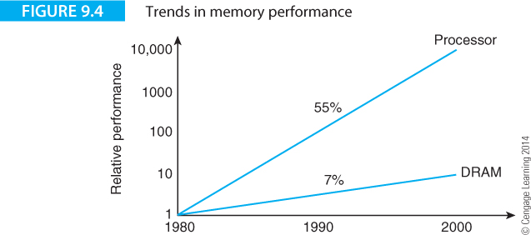
Computer Organization and Architecture: Themes and Variations, 1st Edition Clements
The Memory Wall
Year by year, the computer gets faster. An memory gets faster.
Alas, as figure 9.4 demonstrates, year by year the progress in CPU technology is greater than memory technology.
It is said that this will lead to the memory wall where progress in CPU technology is pointless because of the memory delay.

Slide 15
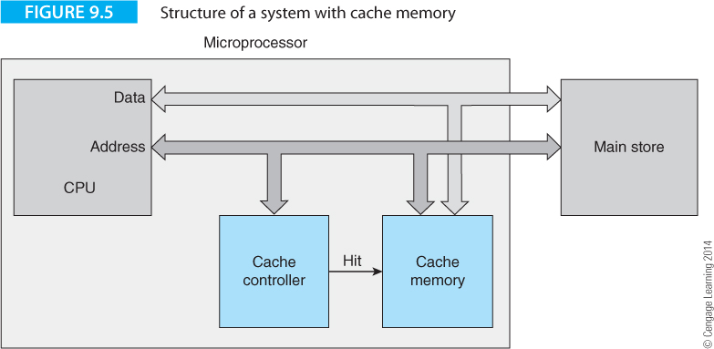
Computer Organization and Architecture: Themes and Variations, 1st Edition Clements
Figure 9.5 gives general structure of a cache memory.
A block of cache memory sits on the processor’s address and data buses in parallel with the much larger main store.
Data in the cache is also maintained in the main store (i.e., DRAM).
When the CPU accesses data, it takes less time to access cache data than data from main memory.

Slide 16
Computer Organization and Architecture: Themes and Variations, 1st Edition Clements
The key to cache memory is the principle of locality.
If memory elements were distributed randomly in memory so that the probability of accessing the next element was the same for every location, cache would not be possible.
If the cache were 10% of the size of main memory, only 10% of the accesses would be to cache. If the main memory access time is 50 ns and cache access is 5 ns that addition of cache would increase performance by 0.9 x 50 + 0.1 x 5 = 45 + 0.5 = 45.5 (a minimal improvement in performance).
In reality, data is not accessed at Random. In any program, 20% of the data might be accessed for 90% of the time.
If this data is cached, the access time is now 0.1 x 50 + 0.9 x 5 = 5 + 4.5 = 9.5 ns. In this case, cache is very effective.

Slide 17
Computer Organization and Architecture: Themes and Variations, 1st Edition Clements
The key to cache memory is the principle of locality.
This is, in practice, data is clustered.
There are two types of locality: spatial and temporal.
Spatial locality involves the clustering of data in space. For example, a math calculation may require the repeated use of X, Y, and Z. These variables may be accessed many times in the execution of a program.
Temporal locality occurs when elements are accessed frequently over a period of time; for example, within a loop.
Locality means that it is normally possible to find a subsection of a program or data that is frequently accessed. This data can be placed in high-speed memory.
For cache memory to be effective we have to ensure that about 90% of memory accesses to memory are to data in the cache.

Slide 18
Computer Organization and Architecture: Themes and Variations, 1st Edition Clements
Performance of Cache Memory
We need to know how much the addition of cache memory affects a computer’s performance before we can decide whether adding cache memory is cost-effective.
We begin with a simple model that omits the fine details of a real cache system; details that vary markedly from system to system
The model assumes that cache entries are all one word wide, whereas practical caches store a line (group of words).
The principal parameter of a cache system is its hit ratio, h, that defines the ratio of hits to all accesses, and is determined by statistical observations of the system’s operation.
The effect of locality of reference means that the hit ratio is usually very high, often in the region of 98%.

Slide 19
Computer Organization and Architecture: Themes and Variations, 1st Edition Clements
Performance of Cache Memory
Before calculating the effect of a cache memory on a processor’s performance, we need to introduce some terms.
Access time of main store t_{m}
Access time of cache memory t_{c}
Hit ratio h
Miss ratio m
Speedup ratio S
The speedup ratio is defined as the ratio of the memory system’s access time without cache to its access time with cache.
For N accesses to memory without cache the total access time is Nt_{m}.
For N accesses to a memory system with a cache, the access time is N(ht_{c} + mt_{m}).

Slide 20
Computer Organization and Architecture: Themes and Variations, 1st Edition Clements
Performance of Cache Memory
The miss ratio, m, is defined as m = 1 - h, since if an access is not a hit it must be a miss.
Therefore the speedup ratio for a system with cache is given by:
This expression assumes that all operations are memory accesses, which is not true because processors also perform internal operations.

Slide 21
Computer Organization and Architecture: Themes and Variations, 1st Edition Clements
Performance of Cache Memory
This expression assumes that all operations are memory accesses, which is not true because processors also perform internal operations.
If we are not interested in the absolute speed of the memory and cache memory, we can introduce a parameter, k = t_{c}/t_{m}, that defines the ratio of the speed of cache memory to main memory.
The speedup ratio in terms of h and k is given by

Slide 22
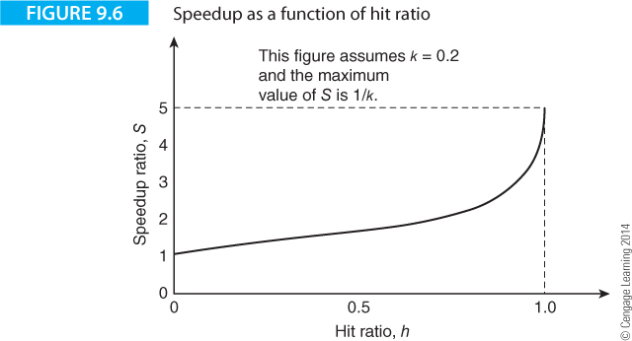
Computer Organization and Architecture: Themes and Variations, 1st Edition Clements
Figure 9.6 plots the speedup ratio S as a function of h, when k = 0.2. The speedup ratio is 1 when h = 0 and all accesses are made to the main memory. When h = 1 and all accesses are to the cache, the speedup ratio is 1/k.

Slide 23
Computer Organization and Architecture: Themes and Variations, 1st Edition Clements
Cache Complexity
Performance calculations involving cache memory are invariably simplified because of all the various factors that affect a real system.
Our calculations assume that information is obtained from cache a word at a time. In practice, whenever an element is not in cache, an entire line is loaded rather than a single entry. We also have to consider the difference between cache read and write operations, which may be treated differently.
Most systems have separate data and instruction caches to increase the processor CPU bandwidth by allowing simultaneous instruction and data transfers. These caches are written I-cache and D-cache, respectively.
We also assume a simple main memory system with a single access time. In practice, modern high-performance systems with DRAM have rather complex access times because information is often accessed in a burst and the first access of a burst of accesses may be longer than successive accesses.

Slide 24
Computer Organization and Architecture: Themes and Variations, 1st Edition Clements
Quantized Time
The speedup ratio achieved by real microprocessors is not as optimistic as the equation suggests.
A real microprocessor uses a clock and all operations take an integer number of clock cycles.
Consider the following example.
Microprocessor clock cycle time 10 ns
Minimum clock cycles per bus cycle 3
Memory access time 40 ns
Wait states introduced by memory 2 clock cycles
Cache memory access time 10 ns
Wait states introduced by cache 0
This data tells us that a memory access takes (3 clock cycles + 2 wait states) x 10 ns = 50 ns, and an access to cache takes 3 x 10 ns = 30 ns. The actual access times of the main memory and the cache don’t appear in this calculation.

Slide 25
Computer Organization and Architecture: Themes and Variations, 1st Edition Clements
Quantized Time
The actual access times of the main memory and the cache don’t appear in this calculation. The speedup ratio is given by
Assuming an average hit ratio of 95%, the speedup ratio is given by 1.61 (i.e., 161%).
This figure offers a modest performance improvement, but is less than that provided by calculating a speedup ratio based only on the access time of the cache memory and the main store (i.e., 2.46).

Slide 26
Computer Organization and Architecture: Themes and Variations, 1st Edition Clements
We have omitted the effect of internal operations that don’t access memory.
Let’s look at an example that gives the average cycle time of a microprocessor, taking account of non-memory operations as well as accesses to data in the cache or main memory store.
t_{ave cycle time} = F_{int}.t_{cyc} + F_{mem} [h.t_{cache} + (1 - h)(t_{cache} + t_{wait})]
where,
F_{int} = fraction of time the processor spends doing internal operations
F_{mem} = fraction of time processor spends doing memory accesses
t_{cyc} = processor cycle time
t_{wait} = wait-state time caused by cache miss
t_{cache} = cache memory access time
h = hit ratio
For example: t_{ave cycle time} = 70% x 10ns + 30% x [0.9 x 5ns + 0.1(5ns + 50ns)]
= 7ns + 3ns = 10.0ns

Slide 27
Computer Organization and Architecture: Themes and Variations, 1st Edition Clements
Real systems don’t move data to and from cache one word at a time.
The basic unit of cache storage is the line composed of about 4 to 64 bytes.
A miss results in a line of data being transferred from memory to the cache.
Hence, there is an additional penalty associated with a miss; that is, the time taken to refill a line.
Suppose the average time, in cycles, taken by a system is
Time_{average} = CPU_{use}.t_{CPU} + Memory_{use} [h.t_{cache} + (1 - h)(t_{memory})]
If the CPU spends 80% of the time accessing non-memory instructions, the CPU time is 1 cycle, the cache access time is 1 cycle, the memory access time is 10 cycles, and the hit ratio is 0.95, we get
Time_{ave} = 0.80 · 1 + 0.20 · 0.95 · 1 + 0.20 · (1 – 0.95) · 10
= 0.80 + 0.19 + 0.10 = 1.09 cycles

Slide 28
Computer Organization and Architecture: Themes and Variations, 1st Edition Clements
Suppose that, over time, the processor speeds up by a factor of ten, while the cache memory speeds up by a factor of five and the DRAM by a factor of two.
The ratio of CPU:Cache:DRAM access times is no longer 1:1:10 but 1:2:50.
The average time is now
Time_{ave} = 0.80 · 1 + 0.20 · 0.95 · 2 + 0.20 · (1 – 0.95) · 50
= 0.80 + 0.38 + 0.50 = 1.68 cycles
If we assume that, in the second case, the clock is running at ten times the clock in the first case, the speedup ratio is 10.9/1.68 = 6.488.
The clock and CPU are ten times faster, but the throughput has increased by a factor of only 6.
We revisit cache memory performance when we include the effect of write misses on the cache and when we look at the effect of misses on cache performance.

Slide 29
Other Ways of Looking at Performance
There are several ways of expressing the performance of cache memories.
Some writers express performance in terms of miss rates and penalties.
Some include CPU performance in the equations.
Sometimes difference in the way in which cache equations are expressed depends on the assumptions made about the system.
Below are several cache equations.
Memory stall cycles = Memory accesses x miss rate x miss penalty
t_{CPU} = (CPU execution cycles + Memory stall cycles) x t_{cyc}
AMAT = average access time = Hit time + (miss rate x miss penalty)

Slide 30
Computer Organization and Architecture: Themes and Variations, 1st Edition Clements
Cache Organization
If a cache holds only a tiny fraction of the available memory space, what data goes into it and where do you put it?
The fundamental problem of cache memory design is how to create a memory that contains a set of data elements that can come from anywhere within a much larger main store.
There are many ways of solving this mapping problem, although all practical cache systems use a set associative organization.
Before we describe this, we look at two possible cache organizations that will help us to understand the operation of the set associative cache.

Slide 31
Computer Organization and Architecture: Themes and Variations, 1st Edition Clements
Fully Associative Mapped Cache
The first question we need to ask when designing any memory system is, How large or small should be the basic unit of data be?
Main memories handle data in units that are equal to the fundamental wordlength of the machine; for example, a 64-bit machine with 64-bit registers uses 64-bit memory. If the computer wishes to read less than a full word, it reads a word and then ignores the bits it doesn’t want.
Although the computer can read a word from a cache memory, the word is not the basic unit of storage in a cache.
The unit of storage is the line that contains several consecutive words. Suppose a cache were organized at the granularity of a word. If an instruction were accessed, and it wasn’t currently in the cache, it would have to be fetched from the main store. However, the next instruction would probably cause a miss too. We need a bigger unit than the word.

Slide 32
Computer Organization and Architecture: Themes and Variations, 1st Edition Clements
Fully Associative Mapped Cache
A cache line consists of a sequence of consecutive words, allowing several consecutive instructions to be read from the cache without causing a miss.
When a miss does occur, the entire line containing the word being accessed is transferred from memory to the cache and a miss will not occur until all the words in this line have been accessed (unless an instruction is a branch and the computer has to access an instruction that hasn’t yet been cached).
The optimum line size for any system depends on the total size of the cache, the nature of the code, and the structure of the data.

Slide 33
Computer Organization and Architecture: Themes and Variations, 1st Edition Clements
Fully Associative Mapped Cache
We would like a cache that places no restrictions on what data it can contain; that is, data in the cache can come from anywhere within the main store.
Such a cache uses associative memory that can store data anywhere in it because data is accessed by its value and not its address (location).

Slide 34
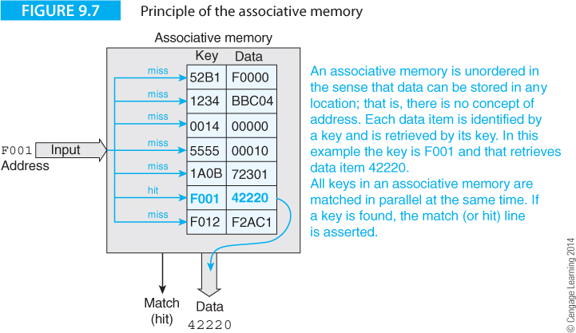
Computer Organization and Architecture: Themes and Variations, 1st Edition Clements
Figure 9.7 illustrates the concept of an associative memory.
Each entry has two values, a key and a data element; for example, the top line contains the key 52B1 and the data F0000.

Slide 35
Computer Organization and Architecture: Themes and Variations, 1st Edition Clements
The data is not ordered and an entry can go anywhere in the memory. The key is the primary means of retrieving the data.
An associative memory is accessed by applying a key to the memory’s input and matching it with all keys in the memory in parallel. If the key is found, the data at that location is retrieved

Slide 36
Computer Organization and Architecture: Themes and Variations, 1st Edition Clements
Suppose the computer applies the key F001. This key is applied to all locations in the memory simultaneously. Because a match takes place with this key, the memory responds by indicating a match and supplying the value 42220 at its data terminals.

Slide 37
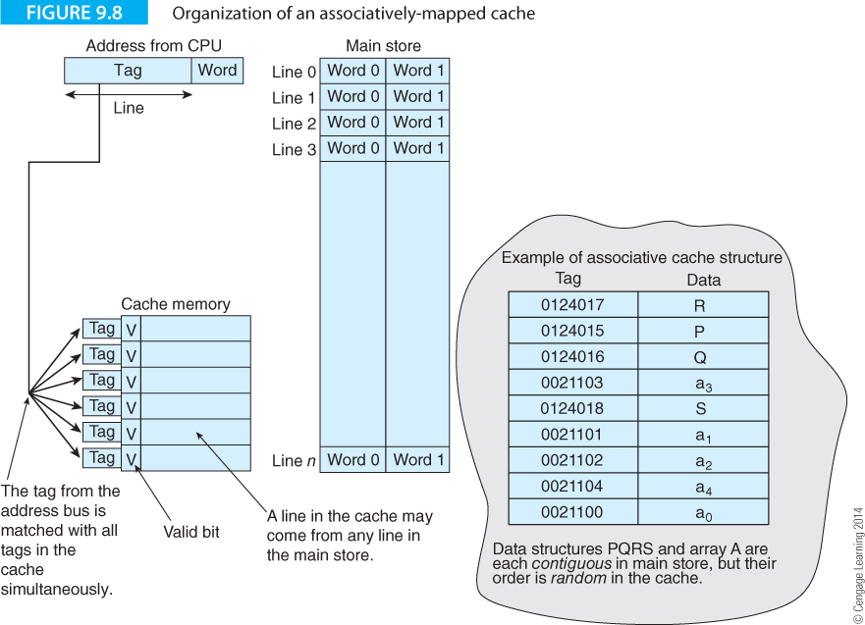
Computer Organization and Architecture: Themes and Variations, 1st Edition Clements
Figure 9.8 describes the associative cache that allows any line in the cache to hold data from any line in the main store.
The memory is divided into lines of two words.

Slide 38
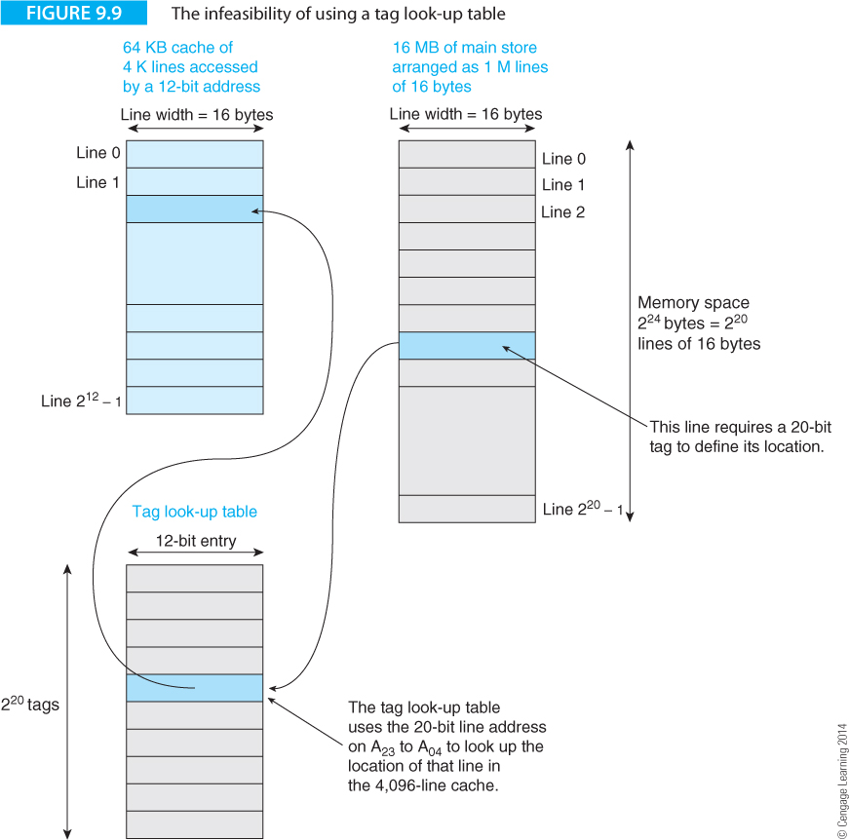
Computer Organization and Architecture: Themes and Variations, 1st Edition Clements
How do we build associative memory? Consider Figure 9.9 that uses a look-up table to obtain the address of a line in cache.

Slide 39
Computer Organization and Architecture: Themes and Variations, 1st Edition Clements
Unfortunately, the look-up table may be larger than the memory system itself! This scheme is impossible.

Slide 40
Computer Organization and Architecture: Themes and Variations, 1st Edition Clements
True associative memory requires that we access all elements in parallel to locate the line with the matching key.
This requires parallel access. If we have a million locations, we need to perform a million comparisons in parallel.
Current technology does not permit this (other than for very small associative memories).
Consequently, fully-associative memory cannot be economically constructed.
Furthermore, associative memories require data replacement algorithms because when the cache is full, it is necessary to determine which old entry is ejected when new data is accepted.

Slide 41
Computer Organization and Architecture: Themes and Variations, 1st Edition Clements

Slide 42
Computer Organization and Architecture: Themes and Variations, 1st Edition Clements
Direct Mapped Cache
The easiest way organize a cache memory employs direct mapping that relies on a simple algorithm to map data block i from the main memory into data block i in the cache.
In a direct mapped cache, the lines are arranged into units called sets, where the size of a set is the same size as the cache.
For example, a computer with a 16 MB memory and a 64 KB cache would divide the memory into 16 MB/64 KB = 256 sets.
To illustrate how direct-mapped cache works, we’ll create a memory with 32 words accessed by a 5-bit address that has a cache holding 8 words.
The line size will be two words.
The set size is memory size/cache size = 32/8 = 4.
A 5-bit address is s₁,s₀,l₁,l₀,w where the s bits define the set, the l bits define the line and the w bit defines the word.

Slide 43
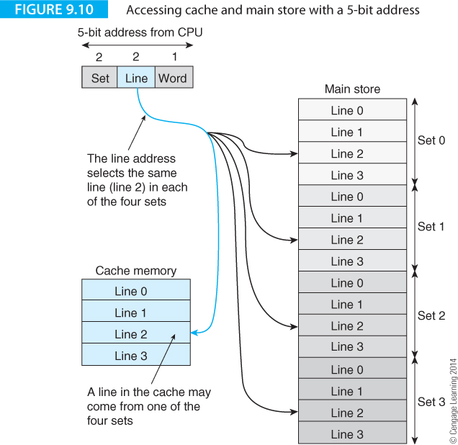
Computer Organization and Architecture: Themes and Variations, 1st Edition Clements
Figure 9.10 demonstrates how the word currently addressed by the processor is accessed in memory via its set address, its line address, and its word address.

Slide 44
Computer Organization and Architecture: Themes and Variations, 1st Edition Clements
This is a direct mapped cache because there is a direct relationship between the location of a line in cache and the location of the same line in memory.

Slide 45
Computer Organization and Architecture: Themes and Variations, 1st Edition Clements
When the processor generates an address, the appropriate line in the cache is accessed.
If the address is 01100, line 2 is accessed. There are four lines numbered two—a line 2 in set 0, a line 2 in set 1, a line 2 in set 2, and a line 2 in set 3.

Slide 46
Computer Organization and Architecture: Themes and Variations, 1st Edition Clements
Suppose that the processor accesses line 2 in set 1
‘How does the system know whether the line 2 accessed in the cache is the line 2 from set 1 in the main memory?

Slide 47
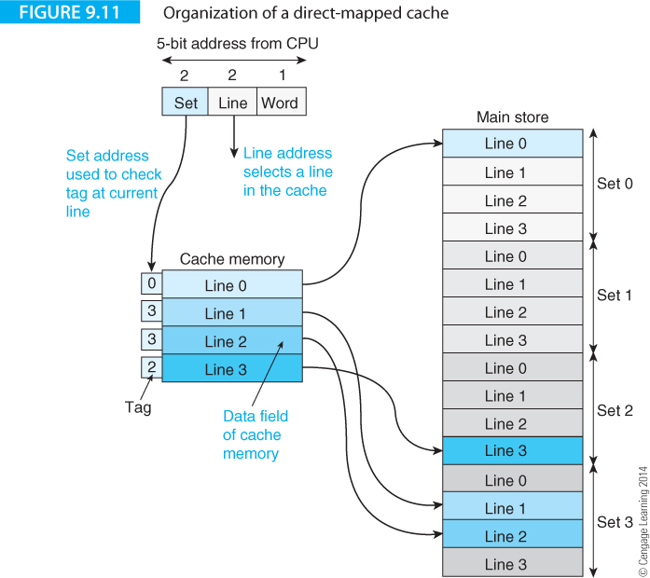
Computer Organization and Architecture: Themes and Variations, 1st Edition Clements
Figure 9.11 demonstrates how the ambiguity between lines is resolved by a direct mapped cache.
Each line in the cache memory has a tag or label that identifies which set that particular line belongs to.

Slide 48
Computer Organization and Architecture: Themes and Variations, 1st Edition Clements
When the processor accesses a memory location whose line address is 3, the tag belonging to line 3 in the cache is sent to a comparator. At the same time the set field from the processor is also sent to the comparator. If they are the same, the line in the cache is the requested line and a hit occurs. If they are not the same, a miss occurs and the cache must be updated.

Slide 49
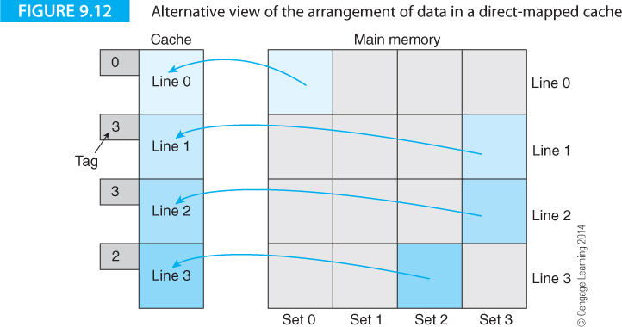
Computer Organization and Architecture: Themes and Variations, 1st Edition Clements
Another way of viewing a direct-mapped cache is provided by Figure 9.12 where the main store is depicted as a matrix of dimension set x line, in this case 4 lines x 4 sets. Alongside this matrix is the cache memory that has the same number of lines as the main memory. Lines currently in the cache corresponding to lines in the main store are shaded. This diagram demonstrates how a line in the cache can come from any one of the sets with the same line number in the main store.

Slide 50
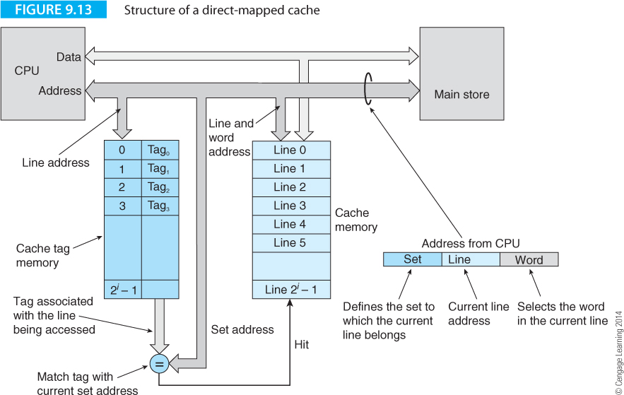
Computer Organization and Architecture: Themes and Variations, 1st Edition Clements
Figure 9.13 provides the skeleton structure of a direct-mapped cache memory system.
The cache tag RAM is a special device that contains a high-speed random access memory and a data comparator.

Slide 51
Computer Organization and Architecture: Themes and Variations, 1st Edition Clements
The cache tag RAM’s address input is the line address from the processor that accesses the location in the tag RAM containing the tag for this set. The data in the cache tag RAM at this location is matched with the set address on the address bus. If the set field from the processor matches the tag of the line being accessed, the cache tag RAM returns a hit.

Slide 52
Computer Organization and Architecture: Themes and Variations, 1st Edition Clements
The direct mapped cache requires no complex line replacement algorithm. If line x in set y is accessed and a miss takes place, line x from set y in the main store is loaded into the frame for line x in the cache memory. No decision concerning which line from the cache is to be rejected has to be made when a new line is to be loaded.
An advantage of direct-mapped cache is its inherent parallelism. Since the cache memory holding the data and the cache tag RAM are independent, they can both be accessed simultaneously. Once the tag field from the address bus has been matched with the tag field from the cache tag RAM and a hit has occurred, the data from the cache will also be valid.
The disadvantage of direct-mapped cache is its sensitivity to the location of the data to be cached. We can relate this to the domestic address book that has, say, half a dozen slots for each letter of the alphabet. If you make six friends whose surname begins with S, you have a problem the next time you meet someone whose name also begins with S. It’s annoying because the Q and X slots are entirely empty. Because only one line with the number x may be in the cache at any instant, accessing data from a different set but with the same line number will always flush the current occupant of line x in the cache.

Slide 53
Computer Organization and Architecture: Themes and Variations, 1st Edition Clements
Figure 9.14 illustrates the operation of very simple hypothetical direct-mapped cache in a system with a 16-word main store and an 8-word direct mapped cache.
Only accesses to instructions are included to simplify the diagram. This cache can hold lines from one of two sets.
We’ve labeled cache lines 0 to 7 on the left in black.
On the right we’ve put labels 8 to 15 in blue to demonstrate where lines 8 to 15 from memory locations are cached. The line size is equal to the wordlength and we run the following code.
LDR r1,(r3) ;Load r1 from memory location pointed at by r3
LDR r2,(r4) ;Load r2 from memory location pointed at by r4
BL Adder ;Call a subroutine
B XYZ ;
Adder ADD r1,r2,r1 ;Add r1 to r2
MOV pc,lr ;Return

Slide 54
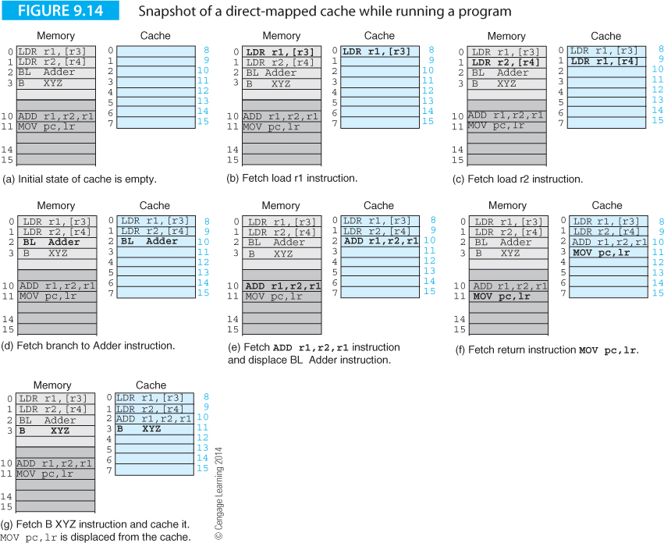
Computer Organization and Architecture: Themes and Variations, 1st Edition Clements

Slide 55
Computer Organization and Architecture: Themes and Variations, 1st Edition Clements
Figure 9.14 shows only instruction fetch cycles.
Figure 9.14(a) shows the initial state of the system.
Figures 9.14(b) to (d) show the fetching of the first three instructions, each of which is loaded into a consecutive cache location.
When the subroutine is called in Figure 9.14(d), a branch is made to the instruction at location 10.
In this direct-mapped cache, line 10 is the same as line 2.
Consequently, in Figure 9.14(e) the ADD overwrites the B instruction in line 2 of the cache.
This is called a conflict miss because it occurs when data can’t be loaded into a cache because its target location is already occupied.

Slide 56
Computer Organization and Architecture: Themes and Variations, 1st Edition Clements

Slide 57
Computer Organization and Architecture: Themes and Variations, 1st Edition Clements
In Figure 9.14(f) the MOV pc,lr instruction in line 11 is loaded into line 3 of the cache.
Finally, in Figure 9.14(g) the return is made and the B XYZ instruction in line 3 is loaded in line 3 of the cache, displacing the previous cached value.
Figure 9.14 demonstrates that even in a trivial system, elements in a direct mapped cache can be easily displaced.
If this fragment of code were running in a loop, the repeated displacement of elements in the cache would degrade the performance.

Slide 58
Computer Organization and Architecture: Themes and Variations, 1st Edition Clements
Example – Cache Size
A 4-way set associative cache uses 64-bit words. Each cache line is composed of 4 words. There are 8192 sets. How big is the cache?
The cache has lines of four 64-bit words; that is, 32 bytes/line.
There are 8192 sets giving 8192 x 32 = 2¹⁸ bytes per direct-mapped cache (256 KBs).
3. The associatively is four which means there are four direct-mapped caches in parallel, giving 4 x 256K = 1Mbyte of cache memory.

Slide 59
Computer Organization and Architecture: Themes and Variations, 1st Edition Clements
Set-associative Cache
The direct-mapped cache we’ve just described is easy to implement and doesn’t require a line-replacement algorithm.
However, it, doesn't allow two lines with the same number from different sets to be cached at the same time.
The fully associative cache places no restriction on where data can be located, but it requires a means of choosing which line to eject once the cache is full. Moreover, any reasonably large associative cache would be too expensive to construct. The set-associative cache combines the best features of both these types of cache and is not expensive to construct. Consequently, it is the form of cache found in all computers.
A direct mapped cache has only one location for each line i. If you operate two direct mapped caches in parallel, line i can go in either cache. If you have n direct mapped caches operating in parallel, line i can go in one of i locations. That is an n-way set-associative cache.

Slide 60
Computer Organization and Architecture: Themes and Variations, 1st Edition Clements
Set-associative Cache
In an n-way set-associative cache there are n possible cache locations that a given line can be loaded into.
Typically, n is in the range 2 to 8.
Figure 9.15 illustrates the structure of a four-way set-associative cache that consists of four direct-mapped caches operated in parallel. In this arrangement line i can be located in any of the four direct-mapped caches.
Consequently, the chance of multiple lines with the same line number leading to a conflict is considerably reduced. This arrangement is associative because the address from the processor is fed to each direct-mapped cache in parallel.
However, instead of having to perform a simultaneous search of thousands of memory locations, only two to eight direct-mapped caches have to be accessed in parallel. The response from each cache (i.e., a hit) is fed to an OR gate that produces a hit output if any cache indicates a hit.

Slide 61
Computer Organization and Architecture: Themes and Variations, 1st Edition Clements

Slide 62
Computer Organization and Architecture: Themes and Variations, 1st Edition Clements
Set-associative Cache
In an n-way set-associative cache there are n possible cache locations that a given line can be loaded into.
Typically, n is in the range 2 to 8.
Figure 9.15 illustrates the structure of a four-way set-associative cache that consists of four direct-mapped caches operated in parallel. In this arrangement line i can be located in any of the four direct-mapped caches.
Consequently, the chance of multiple lines with the same line number leading to a conflict is considerably reduced. This arrangement is associative because the address from the processor is fed to each direct-mapped cache in parallel.
However, instead of having to perform a simultaneous search of thousands of memory locations, only two to eight direct-mapped caches have to be accessed in parallel. The response from each cache (i.e., a hit) is fed to an OR gate that produces a hit output if any cache indicates a hit.

Slide 63
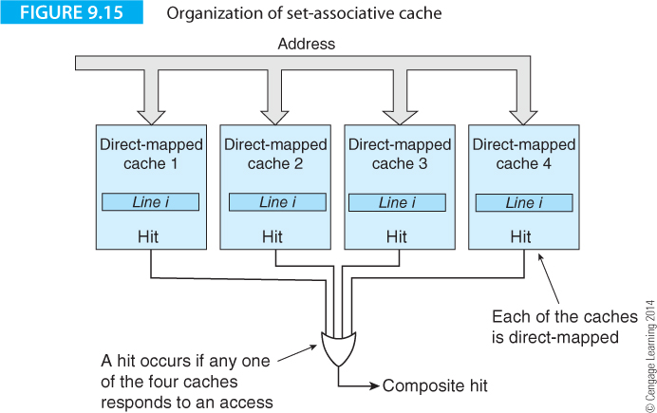
Computer Organization and Architecture: Themes and Variations, 1st Edition Clements
In an n-way set-associative cache there are n possible cache locations that a given line can be loaded into.
Typically, n is in the range 2 to 8.
Figure 9.15 illustrates the structure of a four-way set-associative cache that consists of four direct-mapped caches operated in parallel.

Slide 64
Computer Organization and Architecture: Themes and Variations, 1st Edition Clements
In this arrangement line i can be located in any of the direct-mapped caches. The chance of multiple lines with the same line number leading to a conflict is considerably reduced. This cache is associative because the address from the processor is fed to each direct-mapped cache in parallel.
Instead of performing a simultaneous search of many memory locations, only two to eight direct-mapped caches are accessed in parallel. The response from each cache (hit/miss) is fed to an OR gate that signals a hit if any cache indicates a hit.

Slide 65
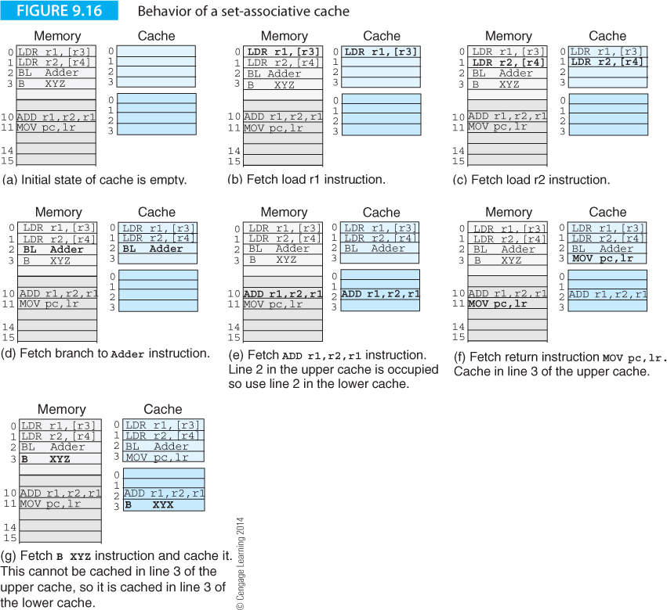
Computer Organization and Architecture: Themes and Variations, 1st Edition Clements
Figure 9.16 repeats the previous example with a set-associative cache that has 4 lines/cache, or 8 lines in total.
A a line may be cached in the upper (light blue) or lower (dark blue) direct-mapped cache.

Slide 66
Computer Organization and Architecture: Themes and Variations, 1st Edition Clements
Everything is the same until 9.16(e) when ADD r1,r2,r1 at address 10 is mapped onto line 2 (set size 4) currently occupied by BL Adder.
The corresponding location in the second cache in the associative pair is free and, therefore, the instruction can be cached in location 2 of the lower cache without ejecting line 2 from the upper cache.
In 9.16(f) the MOV pc,lr has a line 3 address and is cached in the upper cache. However, when the B XYZ instruction in line 3 of the main memory is executed, line 3 in the upper cache is taken and it is placed in line 3 in the lower cache.

Slide 67
Computer Organization and Architecture: Themes and Variations, 1st Edition Clements

Slide 68
Computer Organization and Architecture: Themes and Variations, 1st Edition Clements
Associativity
Table 9.1 from IDT demonstrates the effect of cache organization on the miss ratio. The miss ratio has been normalized by dividing it by the miss ratio of a direct-mapped cache, to demonstrate the results relative to a direct mapped-cache. A four-way set associative cache is about 30% better than a direct-mapped cache. Increasing the associatively has little further improvement on the cache’s performance.
Cache organization | Normalized miss ratio
Direct-mapped | 1.0
2-way set associative | 0.78
4-way set associative | 0.70
8-way set associative | 0.67
Fully associative | 0.66

Slide 69
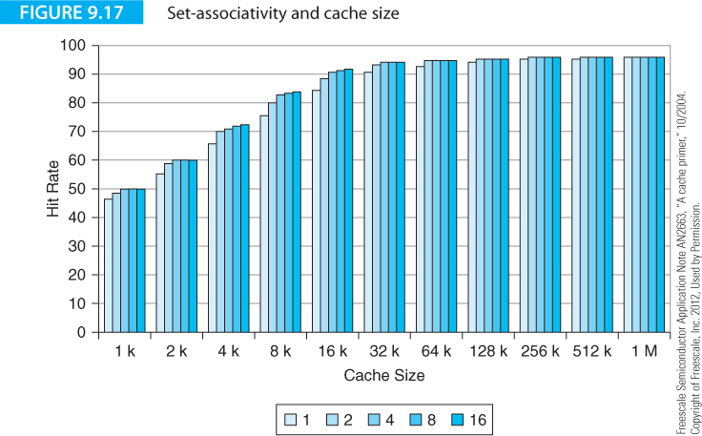
Computer Organization and Architecture: Themes and Variations, 1st Edition Clements
Figure 9.17 from a Freescale Semiconductor application note demonstrates the relationship between associativity and hit rate for varying cache sizes for a GCC complier.
The degree of associativity is a factor at only very small cache sizes. Once caches reach 256 KB, the effect of associativity becomes insignificant.

Slide 70
Computer Organization and Architecture: Themes and Variations, 1st Edition Clements
Categories of Miss
When calculating the efficiency of a cache system, we are interested in the hit rate because it’s the hits that make the cache effective.
When designing cache systems we are interested in the miss ratio because there is only one source of hits (the data was in the cache), whereas there are several sources of misses. We can improve cache performance by asking, "Why wasn't the data that resulted in the miss not already in the cache?“
Cache misses are divided into three classes, compulsory, capacity and conflict.
The compulsory miss cannot be avoided. A compulsory miss occurs because of the inevitable miss on the first access to a block of data. Some processors do avoid the compulsory miss by anticipating an access to data and bringing it into cache before it is required. When the data is eventually accessed, a compulsory miss doesn't take place because the data was already in the cache in advance of its first access. This is a form of pre-fetching mechanism.

Slide 71
Computer Organization and Architecture: Themes and Variations, 1st Edition Clements
Categories of Miss
Another cause of a miss is the capacity miss.
In this case a miss takes place because the working set (i.e., the lines that make up the current program) is larger than the cache and all the required data cannot reside in the cache.
Consider the initial execution of a program. All the first misses are compulsory misses because the cache is empty and new data is cached each time the address of a previously uncached line is generated.
If the program is sufficiently large, there comes a point when the cache is full and the next access causes a capacity miss.
Now the system has to load new data into the cache and eject old data to make room.

Slide 72
Computer Organization and Architecture: Themes and Variations, 1st Edition Clements
Categories of Miss
A third form of cache miss is the conflict miss.
This is the most wasteful type of miss because it happens when the cache is not yet full, but the new data has to be rejected because of the side effects of cache organization.
A conflict miss occurs in an m-way associative cache when all m associative pages already contain a line i and a new line i is to be cached. Conflict misses account for between 20% and 40% of all misses in direct mapped systems.
A fully associative cache cannot suffer from a conflict miss, because an element can be loaded anywhere in the cache.

Slide 73
Computer Organization and Architecture: Themes and Variations, 1st Edition Clements
Categories of Miss
Cache Pollution
A cache holds frequently used data to avoid retrieving it from the much slower main store.
Sometimes, an access results in a miss, a line is ejected and a new line reloaded. This line may never be accessed again takes up storage that could be used by more frequently accessed data. We call this effect cache pollution.

Slide 74
Computer Organization and Architecture: Themes and Variations, 1st Edition Clements
Pseudo-associative, Victim, Annex and Trace Caches
A variation on the direct mapped cache is the pseudo-associative cache. This uses a direct-mapped cache but gives conflict misses a second chance by finding alternative accommodation.
When a direct-mapped cache returns a conflict miss, the associative cache makes another attempt to store the data using a new address generated from the old address.
Typically, the new address is obtained by inverting one or more high-order bits of the current address.
Although this is an ingenious way of bypassing the direct-mapped cache’s limitation, it does require a second cache access following an initial miss.

Slide 75
Computer Organization and Architecture: Themes and Variations, 1st Edition Clements
Pseudo-associative, Victim, Annex and Trace Caches
A victim cache is a small cache that holds items recently expelled from the cache (i.e., the victims).
The victim cache is accessed in parallel with the main cache and is, ideally, fully associative.
Because it is so small, it is possible to construct a fully associative victim cache because the number of entries is very small.
A victim cache reduces the conflict miss rate of a direct-mapped cache because it can hold an item expelled by another item with the same line number.
The victim cache can also be used when the main cache is full and capacity misses are being generated. The victim cache holds data that has been expelled from the main cache, and does not waste space because data is not duplicated both in the main cache and the victim cache.

Slide 76
Computer Organization and Architecture: Themes and Variations, 1st Edition Clements
Pseudo-associative, Victim, Annex and Trace Caches
Another special cache is the annex cache. The victim cache sits at the exit and the annex cache sits at the entrance.
Whereas the victim cache gives data flushed from a cache a second chance, the annex cache requires that data that wants to go into the cache has to prove its worthiness.
Annex cache reduces cache pollution by preventing rarely accessed data entering the cache. A cache is operating inefficiently if frequently used data is expelled to make room for an item that is never accessed again.
On startup, all entries enter the cache in the normal way. After the initial phase, all data loaded into the cache comes via the annex. A line from the annex cache is swapped into the main cache only if it has been referenced twice after the conflicting line in the main cache was referenced.
Data is admitted into the annex cache only if it has demonstrated a right of residence indicated by temporal or spatial locality

Slide 77
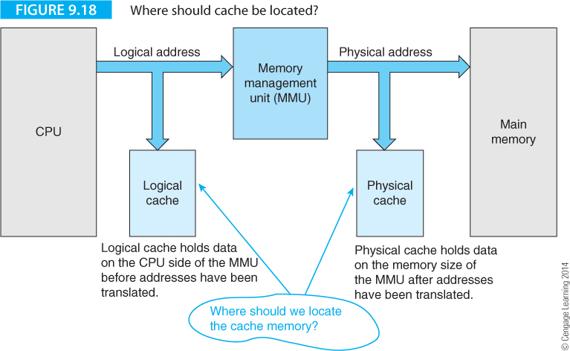
Computer Organization and Architecture: Themes and Variations, 1st Edition Clements
Physical v. Logical Cache
In a computer with memory management, cache memory can be located either between the CPU and the MMU, or between the MMU and physical memory. Figure 9.18 describes these alternatives.

Slide 78
Computer Organization and Architecture: Themes and Variations, 1st Edition Clements
Physical v. Logical Cache
If the data at the CPU’s data terminals is cached, the data is logical data and the cache is a logical cache.
If the data is cached after address translation has been performed by the MMU, the data is physical data and the cache a physical cache.

Slide 79
Computer Organization and Architecture: Themes and Variations, 1st Edition Clements
A physical data cache has a longer access time than a logical cache because the data cannot be accessed until the MMU has performed a logical-to-physical address translation.
A logical cache is faster than a physical cache because data can be accessed in the cache without having to wait for an address translation.

Slide 80
Computer Organization and Architecture: Themes and Variations, 1st Edition Clements
Suppose that in a multitasking system a context switch occurs and a new task is executed.
When the new task is set up, the operating system loads the appropriate address translation table into the MMU.
When the logical-to-physical address mapping is modified, the relationship between the cache's data and the corresponding physical data is broken; the data in the cache cannot be used and the logical cache has to be flushed. A physical cache doesn’t have to be flushed on such a context switch.
The penalty you pay for a physical cache is the additional time required to perform the logical-to-physical address translation before beginning the memory access.
In practice, if you make the cache page the same size as a memory page, you can perform a line search to the cache in parallel with the virtual address translation. Microprocessors generally use physical cache in order to reduce the need to flush the cache after a context switch.

Slide 81
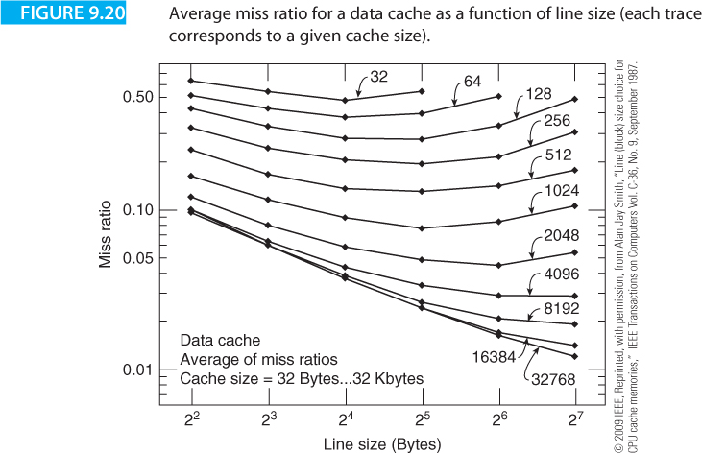
Computer Organization and Architecture: Themes and Variations, 1st Edition Clements
Line Size
The line is the basic unit of storage in a cache memory. An important question to ask is how big should a line be for optimum performance? A lot of work has been carried out into the relationship between line size and cache performance, sometimes by simulating the operation of a cache in software and sometimes by monitoring the operation of a real cache in a computer system .

Slide 82
Computer Organization and Architecture: Themes and Variations, 1st Edition Clements
Line Size
The optimum size of a line is determined by several parameters, not least of which is the nature of the program being executed.
The bus protocol governing the flow of data between the processor and memory also affects the performance of a cache.
A typical computer bus transmits an address to its main memory and then sends or receives a data word over the data bus—each memory access requires an address and a data element.
Suppose that the bus can operate in a burst mode by sending one address and then a burst of consecutive data values.
Clearly, such a bus can handle the transfer of large line sizes better than a bus that transmits a data element at a time. Another factor determining optimum line size is the instruction/data mix.
The optimum line size for code may not necessarily be the same as the optimum line size for data.

Slide 83
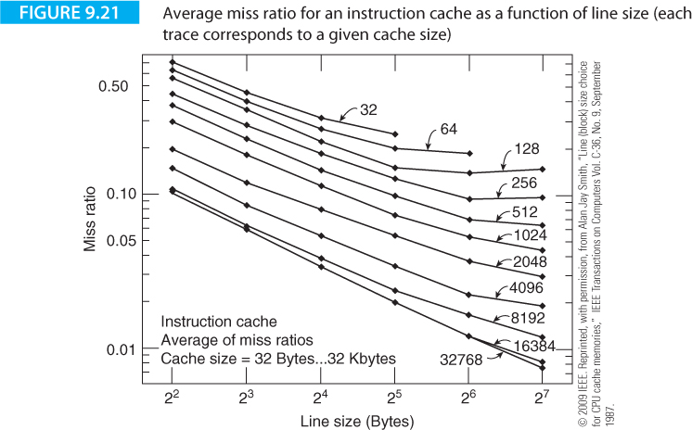
Computer Organization and Architecture: Themes and Variations, 1st Edition Clements

Slide 84
Computer Organization and Architecture: Themes and Variations, 1st Edition Clements
Fetch Policy
Several strategies can be used for updating the cache following a miss; for example, demand fetch, prefetch, selective fetch.
The demand fetch strategy retrieves a line following a miss and is the simplest option.
The prefetch strategy anticipates future requirements of the cache (e.g., if line i+1 is not cached it is fetched when line i is accessed).
There are many ways of implementing the prefetch algorithm. The selective fetch strategy is used in circumstances when parts of the main memory are non-cacheable.
For example, it is important not to cache data that is shared between several processors in a multiprocessor system—if the data were cached and one processor modified the copy in memory, the data in the cache and the data in the memory would no longer be in step.

Slide 85
Computer Organization and Architecture: Themes and Variations, 1st Edition Clements
Fetch Policy
Prefetching is associated with loops because they are repeated and you know what data you are going to need in advance. The simplest prefetching is to include a prefetch address ahead of an array access. Consider the evaluation of s = Σa_{i}.
for (i = 0; i < N; i++){
S = a[i] + S;
}
Following the example of Wiel and Lilja we will use the construct fetch (&address) to indicate a prefetch operation that issues an address.
for (i = 0; i < N; i++) {
fetch (&a[i+1]); /* perform the prefetch */
S = a[i] + S;
}
.

Slide 86
Computer Organization and Architecture: Themes and Variations, 1st Edition Clements
We generate the address of the next reference so that the item at location i+1 has been referenced by the time we go round the loop again.
We can improve on this code in two ways.
First, the initial element is not prefetched and, second, the loop is inefficient because there is only one active operation per cycle. Consider:
fetch (&a[0]; /* prefetch the first element */
for (i = 0; i < N; i=i+4) {
fetch (&a[i+4]; /* perform the prefetch */
S = a[i] + S;
S = a[i+1] + S;
S = a[i+2] + S;
S = a[i+3] + S;
}
In this case, four operations are carried out per cycle. We need do only one prefetch because the line of data loaded into the cache on each fetch contains the 16 bytes required to store four consecutive elements.

Slide 87
Computer Organization and Architecture: Themes and Variations, 1st Edition Clements
Multi-level Cache Memory
In the late 1990s memory prices tumbled, semiconductor technology let you put very complex systems on a chip, and clock rates reached 500 MHz.
Cache systems increased in size and complexity and computers began to implement two-level caches, with the first level cache in the CPU itself and the second level cache on the motherboard.
A two-level cache system uses a very high speed L1 cache, and a larger second level, L2, cache.
The access time of a system with a two-level cache is made up of the access time to the L1 cache plus the access time to the L2 cache plus the access time to main store; that is,
t_{ave} = h₁t_{c1} + (1 – h₁)h₂t_{c2} + (1 – h₁)(1– h₂)t_{m},
where h₁ is the hit ratio of the level 1 cache and t_{c1} is the access time of the level 1 cache. Similarly, h₂ and t_{c2} refer to the level 2 cache.

Slide 88
Computer Organization and Architecture: Themes and Variations, 1st Edition Clements
Multi-level Cache Memory
We obtain this condition by summing the probabilities:
t_{ave} = access time to level 1 cache + access time to level 2 cache + access time to main store.
The access time to level 1 cache is h₁t_{c1}.
If a miss takes place at the level 1 cache, the time taken accessing the level 2 cache is (1 - h₁) h₂t_{c2} if a hit at level 2 occurs.
If the data is in neither cache, the access time to memory takes
(1 - h₁)(1 - h₂)t_{m}.
The total access time is, therefore,
t_{ave} = h₁t_{c1} + (1 - h₁) h₂t_{c2} + (1 - h₁)(1 - h₂)t_{m}.

Slide 89
Computer Organization and Architecture: Themes and Variations, 1st Edition Clements
Multi-level Cache Memory
This equation is simplified because it doesn’t take account of cache writeback and cache reload strategies.
Consider the following example. A computer has an L1 and an L2 cache. An access to the L1 cache incurs no penalty and takes 1 cycle.
A hit to the L2 cache takes 4 cycles. If the data is not cached, a main store access, including a cache reload, takes 120 clock cycles.
If we assume that the hit rate for the L1 cache is 95% and the subsequent hit rate for the L2 cache is 80%, what is the average access time?
t_{ave} = h₁t_{c1} + (1 – h₁)h₂t_{c2} + (1 - h₁)(1 - h₂)t_{m}.
t_{ave} = 0.95 x 1 + (1 – 0.95) x 0.80 x 4 + (1 – 0.95) x (1 – 0.8) x 120
= 0.95 + 0.16 + 1.20 = 2.31 cycles.

Slide 90
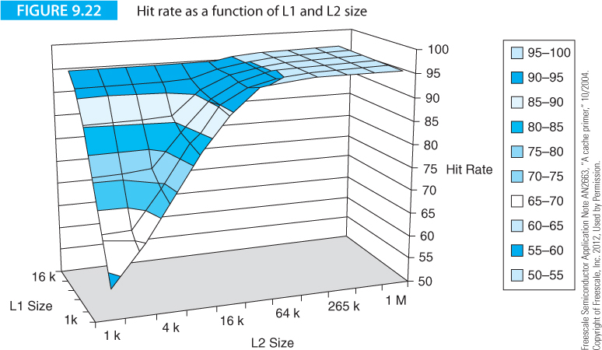
Computer Organization and Architecture: Themes and Variations, 1st Edition Clements
Figure 9.22 gives the hit ratio as a function of cache size on a three-dimensional graph for L1 and L2 cache sizes. The peak hit rate is 96%, which is a function of the code being executed (a GCC compiler). The application note concludes that a 16 KB L1 with a 1 KB L2 gives almost the same results as a 1 KB L1 with a 16 KB L2 (although no one would design a system with a larger L1 cache than an L2 cache).

Slide 91
Computer Organization and Architecture: Themes and Variations, 1st Edition Clements
Instruction and Data Caches
Data and instructions are at the heart of the von Neumann concept; that is, they occupy the same memory. Cache designers can choose to create a unified cache that holds both instructions and data, or to implement separate caches for data and instructions (the split cache).
It makes good sense to cache data and instructions separately, because they have different properties. An entry in an instruction cache is never modified, except when the line is initially swapped in.
Furthermore, you don’t have to worry about swapping out instructions that are overwritten in the instruction cache, because the program does not change during the course of its execution.
Since the contents of the instruction cache are not modified, it is much easier to implement an instruction cache than a data cache. Split instruction and data caches increase the CPU-memory bandwidth, because an instruction and its data can be read simultaneously.

Slide 92
Computer Organization and Architecture: Themes and Variations, 1st Edition Clements
We can summarize the advantages of both split and unified caches as:
I-cache can be optimized to feed the instruction stream
D-cache can be optimized for read and write operations
and D-caches can be optimized (tuned) separately
I-caches do not readily support self-modifying code
U-cache supports self-modifying code
D-caches increase bandwidth by operating concurrently
U-caches require faster memory
U-caches are more flexible (an I-cache may be full when the D-cache is half empty)

Slide 93
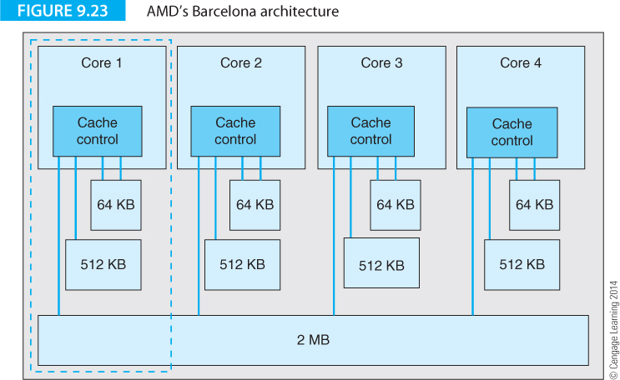
Computer Organization and Architecture: Themes and Variations, 1st Edition Clements
Barcelona architecture in Figure 9.23 demonstrates how cache memories have developed.
Barcelona is a multi-core system where each core has its own 64 KB L1 cache and a 512 KB L2 cache. All cores share a common 2 MB L3 cache.
The L1 cache is made up of two split 32 KB caches, one for data and one for instructions. Traditionally, multilevel caches are arranged so that the lowest level cache successively moves up the ladder following a cache miss (L1 interrogates L2, then L3, then main memory, until the missing data is located).

Slide 94
Computer Organization and Architecture: Themes and Variations, 1st Edition Clements
In the Barcelona architecture, the L1 cache is the target of all cache loads and all fetches are placed in L1. The L2 cache holds data evicted from the L1 cache. Because of the tight-coupling between L1 and L2 caches, the latency incurred in transferring data back from L2 to L1 is low.
L3 cache is shared between the cores. Data is loaded directly from the L3 cache to the L1 cache and does not go through L2. Data that is transferred may either remain in L3 if it is required by more than one processor or it may be deleted if it is not shared. Like L2, the L3 cache is not fed from memory but from data spilled from L2.

Slide 95
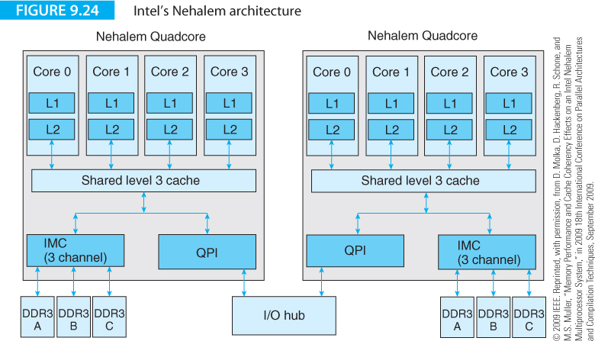
Computer Organization and Architecture: Themes and Variations, 1st Edition Clements
Figure 9.24 illustrates Intel’s Nehalem architecture, a contemporary of Barcelona.
The L1, L2, L3 cache sizes are 32K/256K/8M bytes, respectively.

Slide 96
Computer Organization and Architecture: Themes and Variations, 1st Edition Clements
Writing to Cache
Up to now, we’ve considered only read accesses to cache (the most frequent form of access).
Now we look at the rather more complex write access.
When the processor writes to the cache, both the line in the cache and the corresponding line in the memory must be updated, although is not necessary to perform these operations at the same time.
However, you must ensure that the copy of a cached data element in the memory is updated before it is next accessed; that is, the copies of a data element in cache and memory must be kept in step.

Slide 97
Computer Organization and Architecture: Themes and Variations, 1st Edition Clements
Writing to Cache
We have already stated that the average access time of a system with a cache that’s accessed in parallel with main store is t_{ave} = ht_{c} + (1 - h)t_{m}.
If data is not in the cache, it must be fetched from memory and loaded both in the cache and the destination register.
Assuming that t_{l} is the time taken to fetch a line from main store to reload the cache on a miss, the effective average access time of the memory system is given by the sum of the cache accesses plus the memory accesses plus the re-loads due to misses:
t_{ave} = ht_{c} + (1 - h)t_{m} + (1 - h)t_{l}.
The new term in the equation (1 - h)t_{l} is the additional time required to reload a line in the cache following each miss. This expression can be rewritten as
t_{ave} = ht_{c} + (1 - h)(t_{m} + t_{l}).

Slide 98
Computer Organization and Architecture: Themes and Variations, 1st Edition Clements
Writing to Cache
Accessing the element that caused the miss and filling the cache with a line from memory can take place concurrently.
The term (t_{l} + t_{m}) becomes max(t_{l}|t_{m}) and, because t_{l} > t_{m}, we can write
t_{ave} = ht_{c} + (1 - h)t_{l}.

Slide 99
Computer Organization and Architecture: Themes and Variations, 1st Edition Clements
Writing to Cache
Let's now consider the effect of write accesses on this equation.
When the processor executes a write, data must both be written to cache and to the main store.
Updating the main memory at the same time as the cache is loaded is called a write-through policy.
Such a strategy slows down the system, because the time taken to write to the main store is longer than the time taken to write to the cache.
If the next operation is a read from the cache, the main store can complete its update concurrently (i.e., a write-through-policy does not necessarily suffer an excessive penalty).

Slide 100
Computer Organization and Architecture: Themes and Variations, 1st Edition Clements
Writing to Cache
Relatively few memory accesses are write operations.
In practice, write accesses account for about 5 to 30% of memory accesses.
In what follows, we use the term w to indicate the fraction of write accesses (0 < w < 1).
If we take into account the action taken on a miss during a read access and on a miss during a write access, the average access time for a system with a write-though cache is given by
t_{ave} = ht_{c} + (1 - h)(1 - w)t_{l} + (1 - h)wt_{m},
where t_{l} is the time taken to reload the cache on a miss (this is assuming a no-write-allocate policy where a value is not caches on a write miss).

Slide 101
Computer Organization and Architecture: Themes and Variations, 1st Edition Clements
Writing to Cache
The (1 - h)(1 - w)t_{l} term represents the time taken to reload the cache on a read access and the (1 - h)wt_{m} represents the time taken to write to the memory on a write miss.
Since, the processor can continue onto another operation while main store is being updated, this (1 ‑ h)wt_{m} term can often be neglected because the main store has time to store write-through data between two successive write operations.
This equation does not include the time taken to load the cache on a write miss because it is assumed that the computer does not update the cache on a write miss.

Slide 102
Computer Organization and Architecture: Themes and Variations, 1st Edition Clements
Writing to Cache
An alternative strategy to updating the memory is called write-back.
In a cache system with a write-back policy a write operation to the main memory takes place only when a line in the cache is to be ejected.
That is, the main memory is not updated on each write to the cache. The line is written back to memory only when it is flushed out of the cache by a read miss.
We can now write:
t_{ave} = ht_{c} + (1 - h)(1 - w)t_{l} + (1 - h)(1 - w)t_{l}
= ht_{c} + 2(1 - h)(1 - w)t_{l}
Note the term (1 - h)(1 - w)t_{l} is repeated because a read miss results in writing back the old line to be swapped out to memory and loading the cache with a new line.

Slide 103
Computer Organization and Architecture: Themes and Variations, 1st Edition Clements
Writing to Cache
Each line in a cache memory includes flag bits that describe the current line.
For example, each line may have a dirty bit that indicates whether the line has been modified since it was loaded in the cache.
If a line has never been modified, it doesn’t need writing back to main store when it is flushed from the cache.
The average access time for a cache with such a write-back policy is given by
t_{ave} = ht_{c} + (1 - h)(1 - w)t_{l} + (1 - h)p_{w}wt_{l},
where p_{w} is the probability that a line will have to be written back to main memory.

Slide 104
Computer Organization and Architecture: Themes and Variations, 1st Edition Clements
Writing to Cache
Figure 9.25 provides a decision tree for a memory system with a cache that uses a write-back strategy.
This figure adds up all the outcomes for a system that updates the cache on a read miss and writes back a line if it has been modified.
On a write miss, the line in the cache is written back and the cache loaded with the new line.
These parameters give an average access time of
t_{ave} = ht_{c} + (1 - h)(1 - w)(1 – p_{w})t_{l} + (1 - h)(1 - w)p_{w}.2t_{l} + (1 - h)w.2t_{l},

Slide 105
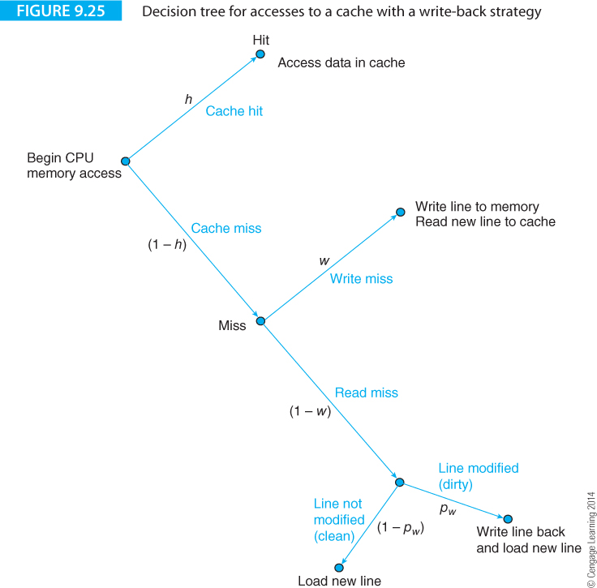
Computer Organization and Architecture: Themes and Variations, 1st Edition Clements

Slide 106
Computer Organization and Architecture: Themes and Variations, 1st Edition Clements
Virtual Memory and Memory Management
Memory management is the point at which the operating system and hardware meet and it is concerned with managing the main store and disk drives.
When computers first appeared, an address generated by the computer corresponded to the location of an operand in physical memory. Even today, 8-bit microprocessors do not use memory management.
Today, the logical address generated by high-performance computers in PCs and workstations is not the physical address of the operand accessed in memory.
Consider LDR r2,[r3] that copies the contents of the memory location pointed at by register r3 into register r2, and assume that register r2 contains 0x00011234.
The data might actually be copied from, say, memory location 0x00A43234 in DRAM-based main store. The act of translating 00011234 into 0A43234 is called memory management.

Slide 107
Computer Organization and Architecture: Themes and Variations, 1st Edition Clements
Virtual Memory and Memory Management
Virtual memory is a term borrowed from optics, where it describes an image that appears to be in a place where it is not (for example, a telescope may make an object appear as if it’s just in front of you when it’s a long distance away). Virtual memory space is synonymous with logical address space and describes the address space that can be accessed by a computer.
A computer with 64-bit address and pointer registers has a 2⁶⁴-byte virtual (logical) address space even though it may be in a system with only 2 GB (2³¹) of physical main store memory.
Memory management has its origins in the 1950s and 60s and describes any technique that takes a logical address generated by the CPU and translates it into the actual (i.e., physical) address in memory.
Memory management allows the physical address spaces of DRAM and hard disk to be seamlessly merged into the computer’s virtual memory space.

Slide 108
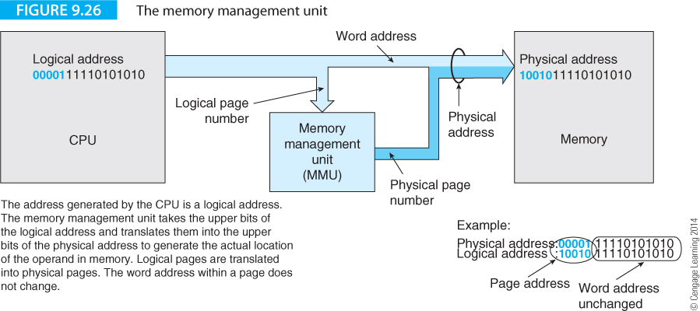
Computer Organization and Architecture: Themes and Variations, 1st Edition Clements
Memory Management
Computers using operating systems like Windows or UNIX make extensive use of memory management techniques.
Figure 9.26 describes the structure of a system with a memory management unit, MMU.
In principle, it's a very simple arrangement – the logical address from the CPU is fed to an MMU that translates it into the physical address of the operand in memory.

Slide 109
Computer Organization and Architecture: Themes and Variations, 1st Edition Clements
Translation involves a look-up table that converts logical addresses into physical addresses. Because a very large table indeed would be required to translate each logical address into a physical address, memory space is divided into pages and each address on a logical page is translated into the corresponding address on an a physical page.
A page is, typically, 4 KB. For example, if the page size is 4KB and the processor has a 32-bit address space, the logical address 0xFFFFAC24 might be 0x00002C24.

Slide 110
Computer Organization and Architecture: Themes and Variations, 1st Edition Clements
Memory Management
The size of a processor's logical address space is independent of the addressing mode used to specify an operand.
Nor does it depend on whether a program is written in a high-level language, assembly language, or machine code.
In a 32-bit system, the instruction LDR r4,[r6] lets you address a logical space of 4 GB.
No matter what technique is used, the processor cannot specify a logical address outside the 4 GB range 0 to 2³² ‑ 1, simply because the number of bits in its program counter is limited to 32.

Slide 111
Computer Organization and Architecture: Themes and Variations, 1st Edition Clements
Memory Management
Physical address space is the address space spanned by all the actual address locations in the processor’s memory system.
This is the memory that is in no sense abstract and costs real dollars and cents to implement. In other words, the system’s main memory makes up the physical address space.
The size of a computer’s logical address space is determined by the number of bits used to specify an address, whereas the quantity of physical address space is frequently limited only by its cost.
We can now see why a microprocessor’s logical and physical address spaces may have different sizes.
What is much more curious is why a microprocessor might, for example, employ memory management to translate the logical address $00001234 into the physical address $861234.

Slide 112
Computer Organization and Architecture: Themes and Variations, 1st Edition Clements
The fundamental objectives of memory management systems are:
To control systems in which the amount of physical address space exceeds that of the logical address space (e.g., an 8-bit microprocessor with a 16-bit address bus and a 64 Kbyte logical address space with 2 MB of physical RAM).
To control systems in which the logical address space exceeds the physical address space (e.g., a 32-bit microprocessor with a 4 GB logical address space and 64 MB of RAM).
Memory protection, which includes schemes that prevent one user from accessing the memory space allocated to another user.
Memory sharing, where one program can share the resources of another program (e.g., common data areas or common code).
Efficient memory usage in which best use can be made of the existing physical address space.
Freeing programmers from any considerations of where their programs and data are to be located in memory. That is, the programmer can use any address he or she wishes, but the memory management system will map the logical address onto an available physical address.

Slide 113
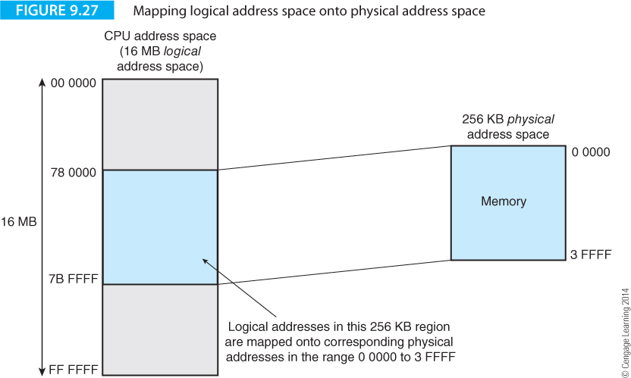
Computer Organization and Architecture: Themes and Variations, 1st Edition Clements
A section of the logical (or virtual) address space is mapped onto the available physical address space as shown by the example of Figure 9.27.
In this example, the 256 KB section of logical address space, in the range 78 0000 to 7B FFFF is mapped onto the physical memory in the range 0 0000 to 3 FFFF.

Slide 114
Computer Organization and Architecture: Themes and Variations, 1st Edition Clements
When the processor generates the logical address of an operand that cannot be mapped on to the available physical address space, we have a problem.
The solution adopted at Manchester University was delightfully simple. Whenever the processor generates a logical address for which there is no corresponding physical address, the operating system stops the current program and deals with the problem.
The operating system fetches a block of data containing the desired operand from disk store, places this block in physical and tells the memory management unit that a new relationship exists between logical and physical address space.
Data is held on disk and only those parts of the program currently needed are transferred to the physical RAM. The memory management unit keeps track of the relationship between the logical address generated by the processor and that of the data currently in physical memory.
This process is complex in its details and requires harmonization of the processor architecture, the memory management unit and the operating system.

Slide 115
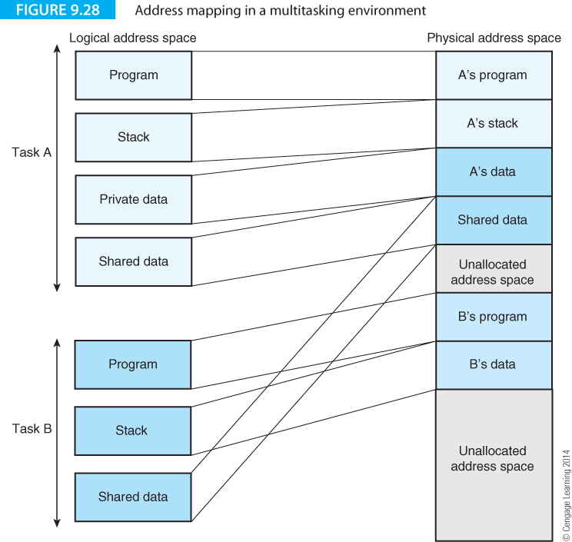
Computer Organization and Architecture: Themes and Variations, 1st Edition Clements
Memory Management and Multitasking
Multitasking systems execute two or more tasks or processes concurrently by periodically switching between tasks.

Slide 116
Computer Organization and Architecture: Themes and Variations, 1st Edition Clements
Figure 9.28 demonstrates how logical address space is mapped onto physical address space with two tasks A and. Each task has its own logical memory space and can access shared resources lying in physical memory space.
Task A and task B in Figure 9.28 can each access the same data structure in physical memory even though they use different logical addresses

Slide 117
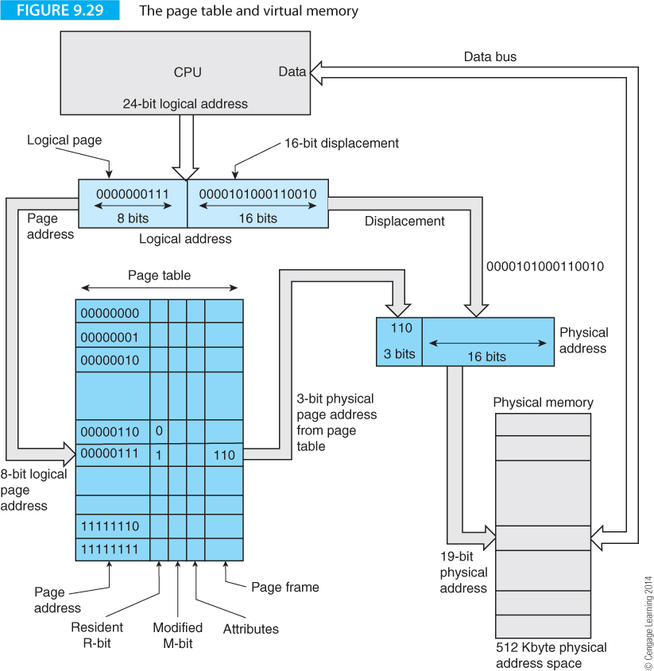
Computer Organization and Architecture: Themes and Variations, 1st Edition Clements
Address Translation
Memory management provides two distinct services. The first is to map logical addresses onto the available physical memory. The second function occurs when the physical address space runs out (i.e., the logical-to-physical address mapping cannot be performed because the data is not available in the random access memory).

Slide 118
Computer Organization and Architecture: Themes and Variations, 1st Edition Clements

Slide 119
Computer Organization and Architecture: Themes and Variations, 1st Edition Clements
Figure 9.29 shows how a page-memory system can be implemented. This example uses a microprocessor with a 24‑bit logical address bus and a 512 KB memory system. The 24-bit logical address from the processor is split into a 16‑bit displacement that is passed directly to the physical memory, plus an 8‑bit page address. The page address specifies the page (one of 2⁸ = 256 pages) currently accessed by the processor. The displacement field of the logical address accesses one of 2¹⁶ locations within a 64 KB page.

Slide 120
Computer Organization and Architecture: Themes and Variations, 1st Edition Clements
The page table contains 256 entries, one for each logical page; for example, in Figure 9.29 the CPU is accessing the 8‑bit logical page‑address 00000111₂. Each entry contains a 3‑bit page frame address that provides the three most‑significant bits of the physical address. In this example, the physical page frame is 110. The logical address has been condensed from 8 + 16 bits to 3 + 16 bits and logical address 00000111 0000101000110010 is mapped onto physical address 110 0000101000110010.

Slide 121
Computer Organization and Architecture: Themes and Variations, 1st Edition Clements
Although there are 256 possible entries in the page frame table (one for each logical page), the physical page frame address is only 3 bits, limiting the number of unique physical pages to eight. Consequently, a different physical page frame in random access memory cannot be associated with each of the possible logical page numbers. Each logical page‑address has a single‑bit R‑field labeled resident associated with it. If the R‑bit is set, that page‑frame is currently in physical memory. If the R‑bit is clear, the corresponding page frame is not in the physical memory and the contents of the page frame field are meaningless.

Slide 122
Computer Organization and Architecture: Themes and Variations, 1st Edition Clements
Whenever a logical address is generated and the R‑bit associated with the current logical page is clear, an event called a page fault occurs.
Once a memory access is started that attempts to access a logical address whose page is not in memory because the R‑bit was found to be clear, the current instruction must be suspended, because it cannot be completed.
A typical microprocessor has a bus error input pin that is asserted to indicate that a memory access cannot be completed.
Whenever this happens, the operating system intervenes to deal with the situation.
Although the information the CPU is attempting to access is not currently in the random access physical memory, it is located on-disk.
The operating system retrieves the page containing the desired memory location from disk, loads it in to the physical memory, and updates the page‑table accordingly. The suspended instruction can then be executed.

Slide 123
Computer Organization and Architecture: Themes and Variations, 1st Edition Clements
Two-level Tables
The arrangement of Figure 9.29 is impractical in modern high-performance processors.
Suppose a 32-bit computer uses an 8 KB page that is accessed by a 13-bit page offset (the offset is the location within a page).
This leaves 32 – 13 = 19 bits to select one of 2¹⁹ logical pages.
It would be impossible to construct such a large page table in fast RAM (notice that this is the same problem facing the designer of memory cache).

Slide 124
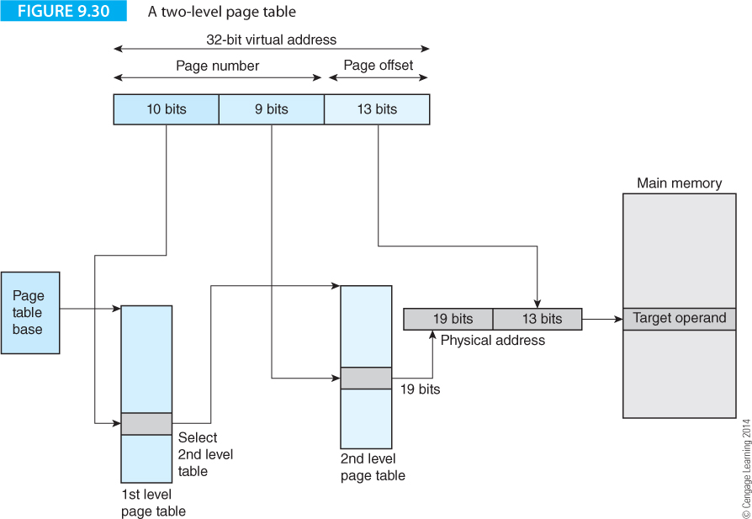
Computer Organization and Architecture: Themes and Variations, 1st Edition Clements
Figure 9.30 describes how it is possible to perform address translation without the need for massive page tables by using multi-level page tables. The logical (virtual) address from the computer is first divided into a 19 bit page number and a 13-bit page offset. The page number is then divided into a 10-bit and a 9-bit field corresponding to first-level and second-level page tables. These two tables would require 2¹⁰ = 1,024 and 2⁹ = 512 entries, respectively.

Slide 125
Computer Organization and Architecture: Themes and Variations, 1st Edition Clements
The diagram in Figure 9.30 is simplified and a real page table would contain a lot more information about the address translation process than just the pointers.
Figure 9.31 illustrates the PowerPC’s address translation tables.
The structure of a real page table includes more than pointers to other tables.
A page table entry contains a descriptor that points to the next level in the hierarchical address translation table.
The final descriptor in the chain points to the actual physical page and contains information the MMU requires about that page.
In practice, a typical memory management unit may contain table descriptors with the following information:

Slide 126
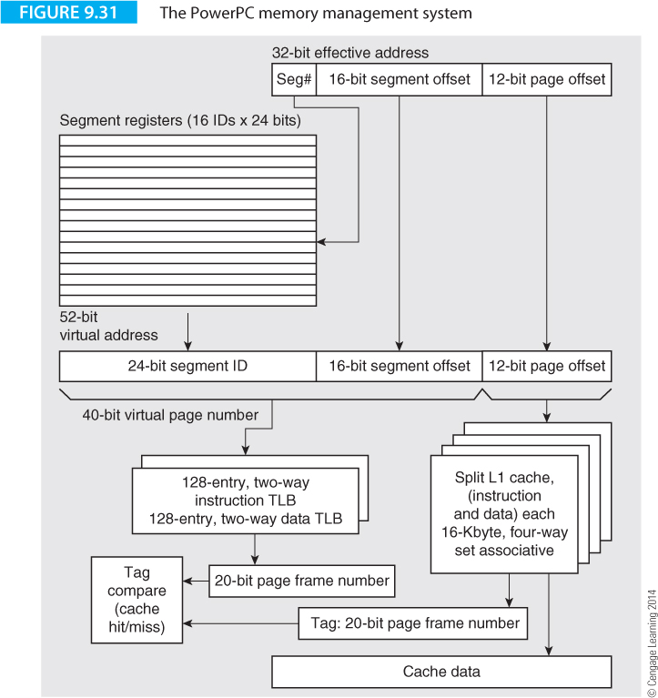
Computer Organization and Architecture: Themes and Variations, 1st Edition Clements

Slide 127
Computer Organization and Architecture: Themes and Variations, 1st Edition Clements
Descriptor type The descriptor type tells the MMU whether another level in the table exists.
Write Protect The write protect bit indicates that pages pointed at by this descriptor may not be written to. If W = 1, all subsequent levels in the trees and their associated page descriptors are write protected.
U The used bit is initially cleared to zero by the operating system when the descriptor table is set up. When the descriptor is accessed for the first time, the MMU automatically sets U to 1. The U bit is used in virtual memory systems when deciding whether to write back a physical page to disk when it is swapped out.

Slide 128
Computer Organization and Architecture: Themes and Variations, 1st Edition Clements
S When the supervisor bit is set pages pointed at by this descriptor can be accessed only from the supervisor mode (i.e., operating-system level privilege). The supervisor state is the state in which the operating system runs and it has a higher level of privilege than the user state; for example, I/O such as disk drives can be accessed only from the supervisor state.
Shared Globally When set to 1, the shared globally bit indicates that the page-descriptor may be shared. That is, if SG = 1 then all tasks within the system may access the physical page. SG tells the MMU that only a single descriptor for this page need be held in the page table cache, TLB (the TLB, translation lookaside buffer is just a term for a small associative cache that can rapidly perform an address table by searching all entries simultaneously).

Slide 129
Computer Organization and Architecture: Themes and Variations, 1st Edition Clements
Write Access Level The write access level indicates the minimum privilege level allowed for pages located via this descriptor.
Read access level The three read access level bits perform the corresponding read function to the WAL bits.
Limit The limit field provides a lower or upper bound on index values for the next level in the translation table; that is, the limit field restricts the size of the next table down. For example, one of the logical address fields may have 7 bits and therefore support a table with 128 entries. However, in a real system you might never have more than, for example, 20 page descriptors at this level. By setting the limit to 5, you can restrict the table to 32 entries rather than 12).

Slide 130
Computer Organization and Architecture: Themes and Variations, 1st Edition Clements
Lower/upper The lower/upper bit determines whether the limit field refers to a lower bound or to an upper bound. If L/U = 0, the limit field contains the unsigned upper limit of the index and all table indices for the next level must be less than or equal to the value contained in the limit field. If L/U = 1, the limit field contains the unsigned lower limit of the index and all table indices must be greater than or equal to the value in the limit field. In either case, if the actual index is outside the maximum/minimum, a limit violation will occur. The end result of a table walk is the page-descriptor that is going to be used to perform the actual logical-to-physical address translation. A page descriptor may have the following control bits not found in a table-descriptor.

Slide 131
Computer Organization and Architecture: Themes and Variations, 1st Edition Clements
Walking through a multi-level page table (e.g., as shown in Figure 9.30) produces the page descriptor that will be used in the actual logical-to-physical address translation. In addition to the above-listed table descriptor bits, a page descriptor may have the following control bits not found in a table descriptor:
Modified (M) bit indicates whether the corresponding physical page was written to. The M-bit is set to zero when the descriptor is first set up by the operating system, since the MMU may set the M-bit but not clear it. Note that the used bit is set if a table descriptor is accessed, while the M-bit is set if the page is accessed.
Lock (L) bit indicates that the corresponding page descriptor should be made exempt from the MMU's page replacement algorithm. When L = 1, the physical page cannot be replaced by the MMU. Thus, we can use the L-bit to keep page descriptors in the address translation cache.
Cache (CI) inhibit bit indicates whether or not the corresponding page is cacheable. If CI = 1, then this access should not be cached.

Slide 132

Computer Organization and Architecture: Themes and Variations, 1st Edition Clements

Slide 133
Computer Organization and Architecture: Themes and Variations, 1st Edition Clements

Slide 134
Computer Organization and Architecture: Themes and Variations, 1st Edition Clements

Slide 135
Computer Organization and Architecture: Themes and Variations, 1st Edition Clements

Slide 136
Computer Organization and Architecture: Themes and Variations, 1st Edition Clements

Slide 137
Computer Organization and Architecture: Themes and Variations, 1st Edition Clements

Slide 138
Computer Organization and Architecture: Themes and Variations, 1st Edition Clements

Slide 139
Computer Organization and Architecture: Themes and Variations, 1st Edition Clements

Slide 140
Computer Organization and Architecture: Themes and Variations, 1st Edition Clements

Slide 141
Computer Organization and Architecture: Themes and Variations, 1st Edition Clements

Slide 142
Computer Organization and Architecture: Themes and Variations, 1st Edition Clements

Slide 143
Computer Organization and Architecture: Themes and Variations, 1st Edition Clements

Slide 144
Computer Organization and Architecture: Themes and Variations, 1st Edition Clements

Slide 145
Computer Organization and Architecture: Themes and Variations, 1st Edition Clements

Slide 146
Computer Organization and Architecture: Themes and Variations, 1st Edition Clements

Slide 147
Computer Organization and Architecture: Themes and Variations, 1st Edition Clements

Slide 148
Computer Organization and Architecture: Themes and Variations, 1st Edition Clements

Slide 149
Computer Organization and Architecture: Themes and Variations, 1st Edition Clements

Slide 150
Computer Organization and Architecture: Themes and Variations, 1st Edition Clements

Slide 151
Computer Organization and Architecture: Themes and Variations, 1st Edition Clements

Slide 152
Computer Organization and Architecture: Themes and Variations, 1st Edition Clements

Slide 153
Computer Organization and Architecture: Themes and Variations, 1st Edition Clements

Slide 154
Computer Organization and Architecture: Themes and Variations, 1st Edition Clements

Slide 155
Computer Organization and Architecture: Themes and Variations, 1st Edition Clements

Slide 156
Computer Organization and Architecture: Themes and Variations, 1st Edition Clements

Slide 157
Computer Organization and Architecture: Themes and Variations, 1st Edition Clements

Slide 158
Computer Organization and Architecture: Themes and Variations, 1st Edition Clements

Slide 159
Computer Organization and Architecture: Themes and Variations, 1st Edition Clements

Slide 160
Computer Organization and Architecture: Themes and Variations, 1st Edition Clements

Slide 161
Computer Organization and Architecture: Themes and Variations, 1st Edition Clements

Slide 162
Computer Organization and Architecture: Themes and Variations, 1st Edition Clements

Slide 163
Computer Organization and Architecture: Themes and Variations, 1st Edition Clements

Slide 164
Computer Organization and Architecture: Themes and Variations, 1st Edition Clements

Slide 165
Computer Organization and Architecture: Themes and Variations, 1st Edition Clements

Slide 166
Computer Organization and Architecture: Themes and Variations, 1st Edition Clements

Slide 167
Computer Organization and Architecture: Themes and Variations, 1st Edition Clements

Slide 168
Computer Organization and Architecture: Themes and Variations, 1st Edition Clements

Slide 169
Computer Organization and Architecture: Themes and Variations, 1st Edition Clements

Slide 170
Computer Organization and Architecture: Themes and Variations, 1st Edition Clements

Slide 171
Computer Organization and Architecture: Themes and Variations, 1st Edition Clements

Slide 172
Computer Organization and Architecture: Themes and Variations, 1st Edition Clements

